Slide 1


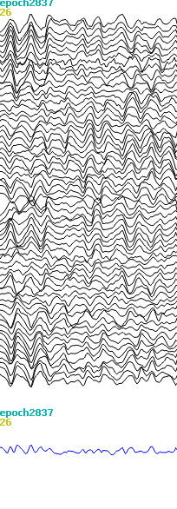
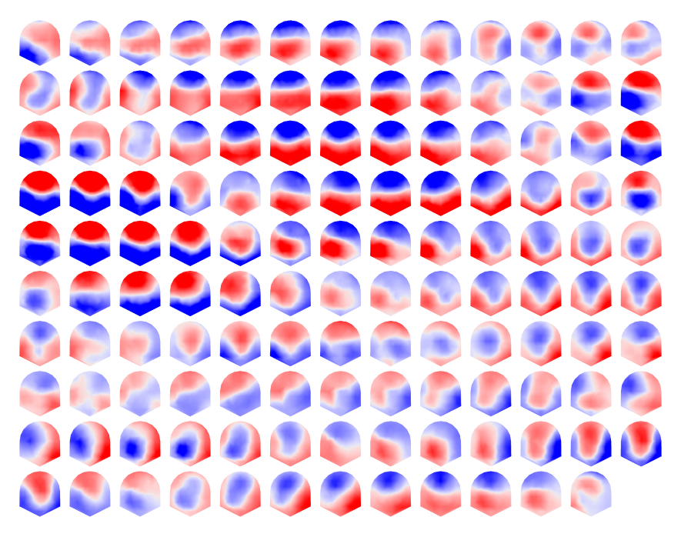
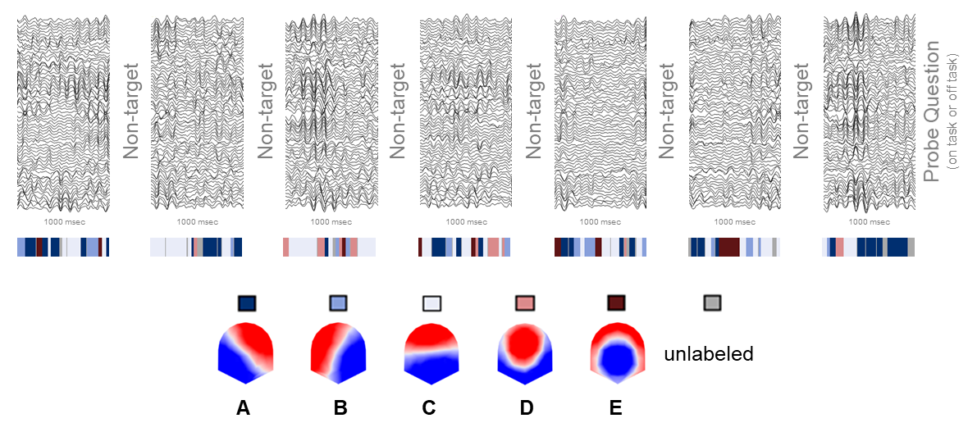
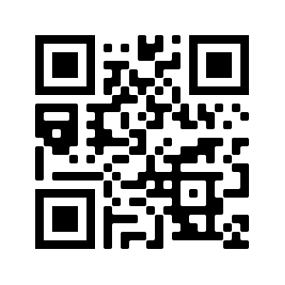

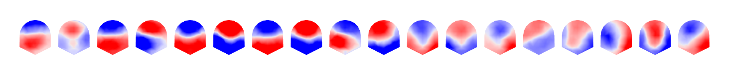
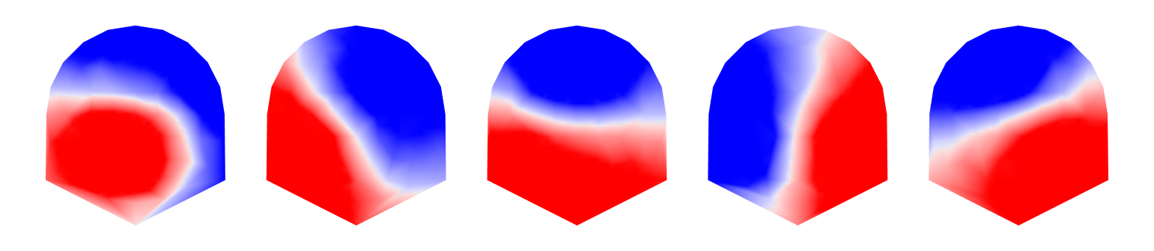
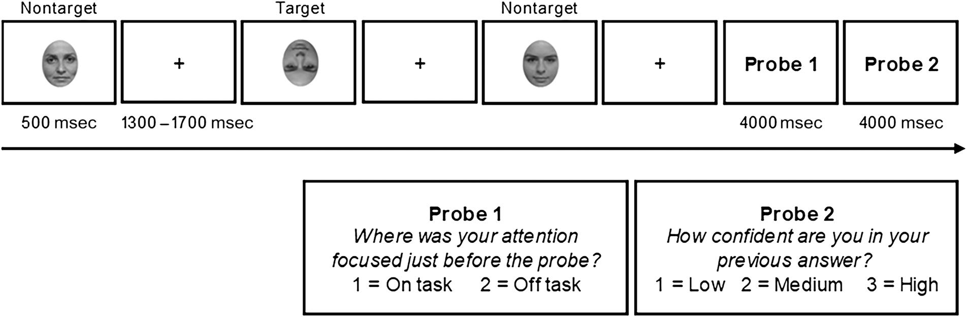
Correspondence: Anthony Zanesco, Email: apz13@Miami.edu
Self-reported Mind Wandering Differentiates Pre-stimulus EEG Microstate Dynamics during a Sustained Attention Task
Anthony P. Zanesco, Ekaterina Denkova, & Amishi P. Jha
University of Miami
Introduction
Current Trial (N) Demands
Topographic Segmentation and Microstate Analysis
It is a common experience for one’s attention to wander away from the task at hand and toward internal mental events such as task-unrelated thought. These episodes of mind wandering are pervasive and disrupt successful performance on tasks requiring sustained attention. The neurocognitive events corresponding with these “off-task” experiences are suggested to be multifaceted, dynamic, and reliant on a host of coordinated neural networks. Accounting for the spontaneous dynamics of neurocognitive networks is critical for understanding the neural correlates of mind wandering during task performance.
We investigated the association between EEG microstate temporal dynamics and self-reported mind wandering. Microstates refer to brief periods (~40 to 120 msec) of quasi-stability in the topographic voltage configuration of the scalp electric field that result from the synchronized activity of coordinated neuronal populations. Each microstate briefly predominates before transitioning rapidly to other configurations. We propose that the dynamics of microstates differentiate moments of task-related focus (i.e., self-reports of being on-task) from mind wandering (i.e., self-reports of being off-task).
To examine this proposal, the current study relied on EEG data collected in a recent study by Denkova and colleagues (2018). Thirty-six participants completed a sustained attention to response task in which they were asked to respond to upright faces (nontargets) and withhold responses to inverted faces (targets). Intermittently, experience sampling probes assessed whether they were focused on the task or whether they were mind wandering (i.e., off-task).
Broad-band EEG was segmented into a time series of EEG microstates based on data-driven clustering of topographic voltage patterns. Microstates were then fit to pre-stimulus epochs of trials preceding experience sampling probes to estimate the strength of electrocortical networks and their fine-grained temporal dynamics in the moments preceding self-reported mind wandering.
a. Clustering of voltage maps from pre-stimulus epochs
b. Clustering of subject-level centroids
c. Microstate labeling of pre-stimulus epochs
Scan to View
Cluster A
(41 topographies)
https://imgur.com/a/cW72R1o
Non-target
Cluster B
(40 topographies)
Cluster D
(24 topographies)
k-means clustering
A
1000 msec
B
Scan to View
Global Field Power (μV)
Cluster E
(19 topographies)
C
Voltage maps at local GFP maxima
Cluster C
(45 topographies)
D
https://imgur.com/a/zI4rzsR
k-means clustering
E
a). 64-channel voltage maps at local maxima of GFP are identified from the seven 1-second pre-stimulus epochs of trials preceding each probe. Maps are shown as 2-D isometric projections with nasion upwards. k-means clustering of voltage maps for each individual identifies the optimal number of subject-level topographic clusters of maps. Only the relative topographic distribution is considered and polarity is ignored in clustering.
b). The centroids of clusters for each individual undergo a second k-means clustering to identify the optimal k global clusters from among all individuals. Five global clusters from centroids of maps were identified. 169 cluster centroids derived from k-means clustering of 34 participant recordings are shown grouped by their global cluster membership. Each global microstate topography (A through E) is the centroid of clusters of maps.
c). Epochs are continuously labeled according to the global microstate topography that best correlates with the voltage map at EEG samples to re-express the EEG time series as a sequence of microstates. Maps remain unlabeled if the correlation is low (< 0.5). The five microstate topographies explain 62.11% of variance in the voltage topography of the EEG time series on average. Measures of strength and temporal dynamics (global explained variance, global field power, mean duration, occurrence rate, and percent time coverage) are subsequently derived from the categorized time series of epochs. Measures are averaged across the seven pre-stimulus epochs preceding each probe.
Probe-related Microstate Strength and Temporal Dynamics
Microstate C
Microstate E
Microstate C
Microstate E
Microstate E
Methods
Global Explained Variance (%)
Global Explained Variance (%)
Global Explained Variance (%)
Global Explained Variance (%)
Mean Global Explained Variance (%)
Participants: 36 undergraduate students (18 females, M age = 18.83 years, SD age = 1.28, age range = 18–25) participated in this study. Two participants were excluded from analyses: one for incomplete data, and one for poor performance.
Task: Participants completed an adapted sustained attention to response task (SART; Robertson et al., 1997). The Face SART (F-SART) consisted of a stream of successive face stimuli presented in the center of a white screen (see task schematic below). Participants were instructed to respond via button press to frequently occurring upright faces (non-targets; 833 trials) and withhold their response to infrequently occurring upside-down faces (targets; 45 trials). Occasionally, pairs of experience sampling probes were presented (45 pairs of probe questions in total). The first probe asked participants “Where was your attention focused just before the probe?”
Analysis: HLM was used to analyze the average microstate dynamics (see Topographic Segmentation and Microstate Analysis) of the six trials preceding the probes as a function of whether participants reported being on or off-task. We further examined the association between microstates and reaction time variability (ICV) of non-target responses for the trials preceding probes.
Off Task Trials
Microstate C explained more variance in the pre-stimulus EEG time series, had greater strength (GFP), occurred more frequently, and covered more percent time, during off-task trials than on-task trials.
Microstate E explained less variance, had less strength (GFP), occurred less frequently, and covered less percent time, during off-task trials than on-task trials.
Response Time Variability (ICV)
Response Time Variability (ICV)
Response Time Variability (ICV)
Response Time Variability (ICV)
b = 3.418%, p < .001
b = -0.084%, p = .920
Mean Off-Task Reports (%)
Individual Differences
Microstate E explained less variance, occurred less frequently, and covered less percent time for individuals who reported a greater total percentage of off-task reports.
Global Field Power (uV)
b = 1.957%, p < .001
Global Field Power (uV)
b = -0.995%, p = .003
Mean Duration (msec)
Mean Duration (msec)
r = -.399, p =.020
Response Time Variability (ICV)
Response Time Variability (ICV)
Mean Occurrence Rate (Hz)
Response Time Variability (ICV)
Response Time Variability (ICV)
b = 0.145 μV, p < .001
b = -0.106 μV, p = .009
b = 5.640 msec, p = .013
b = -4.861 msec, p = .032
Occurrence Rate (Hz)
Occurrence Rate (Hz)
Time Coverage (%)
Time Coverage (%)
Mean Off-Task Reports (%)
Time Coverage (%)
Time Coverage (%)
r = -.415, p =.015
Response Time Variability (ICV)
Response Time Variability (ICV)
Response Time Variability (ICV)
Response Time Variability (ICV)
Mean Time Coverage (%)
Time Coverage (%)
b = 0.133 Hz, p = .010
Time Coverage (%)
b = -0.232 Hz, p < .001
b = 3.342%, p < .001
b = -0.209%, p = .833
Reaction Time Variability
Microstate C explained more variance in the pre-stimulus EEG time series, had longer duration (msec), and covered more percent time, on sets of trials higher in reaction time variability.
Mean Off-Task Reports (%)
b = 1.705%, p < .001
b = -1.689%, p < .001
r = -.401, p =.019
On-task
Off-task
On-task
Off-task
Conclusions
The dynamics of pre-stimulus electrocortical activity are sensitive to the self-reported experience of mind wandering. Microstate characteristics preceding on- versus off-task moments were differentiated according to their prevalence, strength, and rate of occurrence. Microstate temporal dynamics were also associated with patterns of response time variability (ICV). The trial-by-trial fluctuations of microstates are therefore sensitive to both subjective and objective metrics of attentional lapses, and suggest that dynamic sequences of microstates encode behaviorally relevant information about one’s ongoing attentional state. The dynamics of brain electric microstates are therefore relevant for understanding ongoing cognition and the wandering mind.

