Slide 1
Fear of Negative Evaluation is
associated with Connectivity Strength
within Dorsomedial Default Mode Network
Seoul National University
JI SOO LEE D12
, HARIN KIM, SEYUL KWAK, JEANYUNG CHEY
Notes:
This is the poster for 2020 Cognitive Neuroscience.
Today I want to share

Slide 2
Social
Anxiety
Fear
Aging
Notes:
Today my presentation is all about Aging, Social Anxiety, and Fear of negative evaluation

Slide 3
-
Contents
01
03
Methods
Introduction
02
Results
Notes:
I will be following this contents order – introduction, methods, and results

Slide 4
NOW
Introduction
Notes:
So, first, Introduction

Slide 5
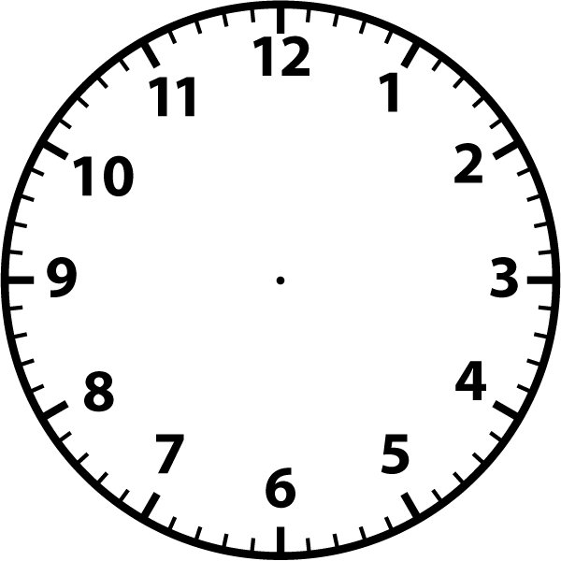
1
Introduction
Social Beings
Notes:
Humans are social beings.
People, we rely on group life for our health, well-being, comfort, and other positive outcomes.
Being accepted into a social group is therefore an almost indispensable goal of human striving.

Slide 6
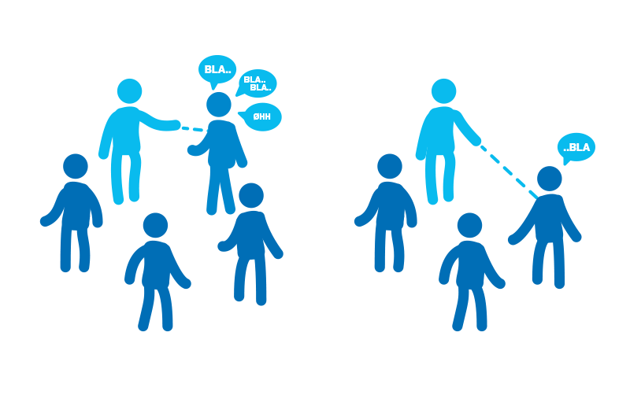
1
Introduction
Social Beings
Obtaining such acceptance is a long and difficult task that may entail years of learning how to behave in socially acceptable ways, acquiring marketable skills, cultivating good relationships, and building a favorable reputation
To succeed at those endeavors, people must have an effective capacity for altering their behavior so as to conform to externally and socially defined standard
Human beings long for the acceptance, because we are social animals
Afraid of getting negative feedbacks and social exclusion
(Baumeister et al., 2005)
Notes:
Obtaining such acceptance is however, a long and difficult task that may entail years of learning how to behave in socially acceptable ways, acquiring marketable skills, cultivating good relationships, and building a favorable reputation.
To succeed at those endeavors, people must have an effective capacity for altering their behavior so as to conform to externally and socially defined standard.
Despite such complicate and troublesome process, humans beings long for the acceptance.
Because human beings are social animals.
Therefore, we are afraid of getting negative feedbacks and get socially excluded.

Slide 7
1
Introduction
Previous Studies
Increase in fear of getting negative evaluation is frequently observed in social anxiety disorder (Kajimura, Kochiyama, Nakai, Abe & Nomura, 2015)
A chronic psychiatric condition characterized by fear and avoidance of social situations (Goldin et al., 2009; American Psychiatric Association, 2013)
Social anxiety appears to be represented on a spectrum ranging from subconical behavior (e.g., shyness) to clinical manifestation (Stein et al., 2007; Schmidt, 2012; Gentili et al., 2015)
According to the Ministry of Health and Welfare, people in 70s, living in rural area, having low education are more vulnerable to SAD in South Korea (MoHW, 2016)
Notes:
We all know the feeling of being nervous or uncomfortable in a social situation. Maybe everyone in here has clammed up when meeting someone new or gotten sweaty palms before making a big presentation.
Public speaking or walking into a roomful of strangers is not exactly thrilling for everybody, but most people can get through it.
However, if someone has social anxiety disorder, the stress of these situations is too much to handle.
People with social anxiety disorder might avoid all social contacts because things that other people consider “normal” -- like making small talk and eye contact -- make them so uncomfortable.
All aspects of their life, not just the social, could start to fall apart.
Social anxiety disorder (also known as social phobia) is one of the most common mental disorders.
It is an intense, persistent fear of being watched and judged by others. This fear can affect work, school, and your other day-to-day activities. It can even make it hard to make and keep friends.
A person with social anxiety disorder feels symptoms of anxiety or fear in certain or all social situations, such as meeting new people, dating, being on a job interview, answering a question in class, or having to talk to a cashier in a store. Doing everyday things in front of people—such as eating or drinking in front of others or using a public restroom—also causes anxiety or fear. The person is afraid that he or she will be humiliated, judged, and rejected. In other words, Increase in fear of getting negative evaluation is frequently observed in social anxiety disorder (SAD)
The fear that people with social anxiety disorder have in social situations is so strong that they feel it is beyond their ability to control. As a result, it gets in the way of going to work, attending school, or doing everyday things. People with social anxiety disorder may worry about these and other things for weeks before they happen. Sometimes, they end up staying away from places or events where they think they might have to do something that will embarrass them.
**The Current DSM-5 Definition:
A. A persistent fear of one or more social or performance situations in which the person is exposed to unfamiliar people or to possible scrutiny by others. The individual fears that he or she will act in a way (or show anxiety symptoms) that will be embarrassing and humiliating.
B. Exposure to the feared situation almost invariably provokes anxiety, which may take the form of a situationally bound or situationally pre-disposed Panic Attack.
C. The person recognizes that this fear is unreasonable or excessive.
D. The feared situations are avoided or else are endured with intense anxiety and distress.
E. The avoidance, anxious anticipation, or distress in the feared social or performance situation(s) interferes significantly with the person's normal routine, occupational (academic) functioning, or social activities or relationships, or there is marked distress about having the phobia.
F. The fear, anxiety, or avoidance is persistent, typically lasting 6 or more months.
G. The fear or avoidance is not due to direct physiological effects of a substance (e.g., drugs, medications) or a general medical condition not better accounted for by another mental disorder...

Slide 8
1
Introduction
Previous Studies
Fear of negative evaluation scale scores and fc of paraphippocampal gyrus and orbitofrontal cortex and the betweenness centrality of the right parietal cortex were negatively correlated (Kajimura, Kochiyama, Nakai, Abe & Nomura, 2015)
Resting alterations, particularly in the Default Mode Network, visual sensorimotor, and affective networks, have been shown to distinguish between clinical and nonclinical Social Anxiety Disorder population (Liu et al., 2015)
Inagaki & Meyer, 2019
Greater DMPFC subsystem connectivity at rest was associated with greater support at the time of the scan and one month later, after adjusting extraversion
DMPFC subsystem integrity at rest is also associated with the dampened withdrawal response proposed to facilitate care for others in need

Slide 9
1
Introduction
Research Question
Step1
Step3
“What is association between the fear of negative evaluation and default mode network (DMN) in older adults in South Korea?”
Physical Growth
& Differentiation
Maturity
“Senescing”
Notes:
Despite such increase in number of people who are suffering from social anxiety disorder, so far, not many studies have been conducted in South Korea.
Also, increase in fear of getting negative evaluation is frequently observed in social anxiety disorder (SAD) and it is accompanied by an altered brain functional connectivity pattern. Considering that the symptoms of SAD can develop on a spectrum ranging from mild non-clinical behavior to severe clinical manifestation, investigating the underlying neural mechanism of fear of negative evaluation in non-clinical sample is important.

Slide 10
NOW
Methods

Slide 11
2
Methods
Participants
Korean Social life, Health, Aging Project(KSHAP)m N= 126
Living rural area, Township K
Inclusion criteria
Complete 2 sessions of resting state fMRI
Cognitively Healthy Older Adults (CDR = 0)
No neurologic conditions
Head motion
N = 90
M_{age} = 71.74, SD_{age} = 6.67
Male = 31, Female = 59
34%
66%
MALE
FEMALE
Notes:
First, in the Korean Social life, Health, Aging Project (KSHAP), there were 126 participants, living in rural area, township K.
Among them, Ninety healthy older adults who complete two sessions of resting state fMRI, who are cognitively healthy based on CDR score, who do not possess neurologic conditions, and who do not show excessive head motion. Head motion part would be dealt in the fMRI methods part in the later.
Therefore, the number of the final inclusion participants was 90.
Their mean age was 71.74 with standard deviation 6.67
Among 90 participants, 31 were male, and 59 were female.

Slide 12
2
Methods
Demographics – age & education
 | All Participants (N = 90)
Education
No schooling | 4 (4.4%)
Elementary school | 49 (54.5%)
Middle school | 16 (17.8%)
High school | 13 (14.4%)
University + | 8 (8.9%)
Self-rated health
Poor | 2 (2.2%)
Fair | 19 (21.1%)
Good | 48 (53.3%)
Very good | 19 (21.1%)
Excellent | 2 (2.2%)
 | All Participants (N = 90)
Age
60 – 69 | 38 (42.2%)
70 – 79 | 42 (46.7%)
80 + | 10 (11.1%)
Sex
Female | 59 (66%)
Male | 31 (34%)
Living rural
Yes | 90 (100%)
No | 0 (0%)
According to the Ministry of Health and Welfare, people in 70s, living in rural area, having low education are more vulnerable to SAD in South Korea
Notes:
I thought this population was perfect for my research question.
Because as you can see in the demographics, particularly for age and education of this population, their mean age was in 70s and their mean education year was about 5 years.
When we look at the data of the Ministry of Health and Welfare, the 1year prevalence of social anxiety disorder in 2016 shows that people who are having low or high education level, and living in rural area had the higher prevalence of social anxiety.
Even though participants in this study were healthy population, they can be said as the good representation of whole population of social anxiety disorder.

Slide 13
2
Methods
fMRI
Resting State
TR = 2s, TE = 30ms, voxel = 3*3*3 (gap = 1mm)
10 minutes (300 volumes)
“please be awake, do not fall asleep”
Preprocessing
people with excessive head motion were excluded (max < 4.5, mean < 0.6, n = 90)
MNI registration
Realignment, Slice timing correction, Smoothing (8mm)
Artifact Detection Tools, global mean intensity (Z > 5), movement > 0.9mm
Brain connectivity Strength
Conn toolbox (18.a; Whitfield-Gabrieli & Nieto-Castanon, 2012)
ROI-to-ROI connectivity strength was calculated as mean connectivity value within ROIs
Step1
Step2
Step3
Physical Growth
& Differentiation
Maturity
“Senescing”
Notes:
fMRI procedure is followed below.
We asked participants to be awake during resting state fMRI scanning for 10 minutes
People with excessive head motion, having max motion over 4.5 and mean motion over 0.6 were excluded
For brain connectivity strength, we used Conn toolbox.
Lastly, connectivity strength was calculated as mean connectivity value within ROIs

Slide 14
2
Methods
ROI Selection
Medial Prefrontal Cortex
Step1
Step2
Physical Growth
& Differentiation
Maturity
Posterior Cingulate Cortex
Retrosplenial Cortex
Medial Temporal Lobe
https://findlab.stanford.edu/functional_ROIs.html
(Shirer, Ryali, Rykhlevskaia, Menon & Greicius, 2011)
Notes:
dDMN (dmn parcellation, Sandford 두가지로 나눔)
Shirer et al., 2011 paper parcellation based, dDMN and vDMN rois were selected.
It would be better than the arbitrary parcellation

Slide 15
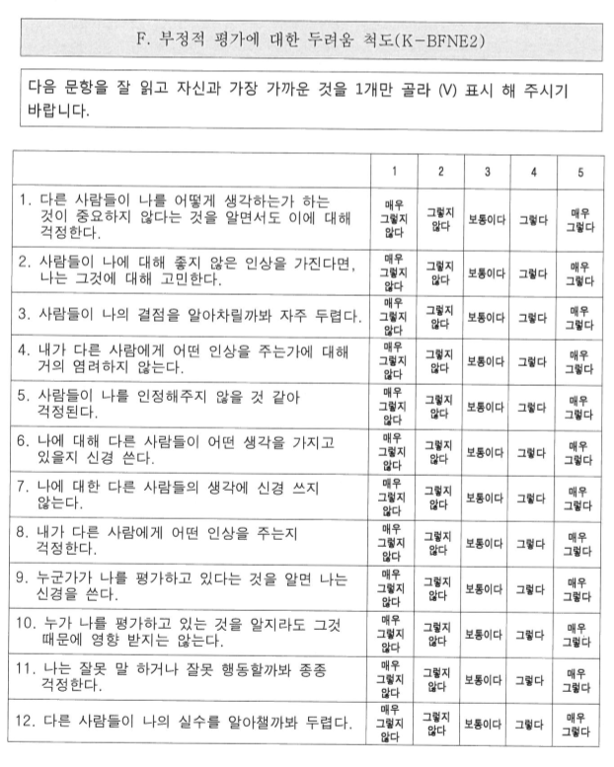
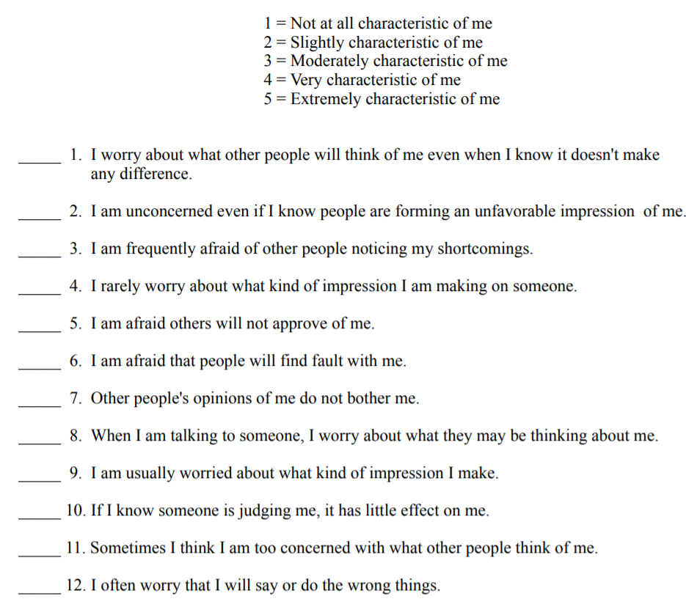
2
Methods
K-BFNE II
Step1
Step2
Step3
Physical Growth
& Differentiation
Maturity
“Senescing”
Notes:
They completed 12-item Brief Fear of Negative Evaluation scale (K-BFNE I)
The BFNE [Leary, 1983] is a short version of the FNE [Watson and Friend, 1969]. It comprises 12 items, 8 straightforwardly worded and 4 reverseworded. Each item is rated on a 5-point Likert scale, ranging from 0 (Not at all characteristic of me) to 4 (Extremely characteristic of me). Leary [1983] indicated that the psychometric properties of the BFNE were almost identical to those of the FNE,
사회적 불안의 한 측면인 다른 사람들로부터 부정적인 평가를 받는 것에 대한 두려움을 측정하기 위한 척도이다. 사회적 인정의 상실에 대한 두려움을 측정하고 있다.
2. 척도개발과정
Watson과 Friend(1969)가 30문항으로 제작한, 원래 척도에서 FNE 전체 점수와 .50 이상의 상관이 있는 문항들을 뽑아서 Leary(1983)가 제작한 검사이다. 이것을 최정훈과 이정윤(1994)이 우리말로 번안하였다.
3. 척도내용 및 채점방법
12문항의 진위형 FNE와는 달리, BFNE는 리커트 5점 척도이다. 점수분포는 12점에서 60점까지이며, 점수가 높을수록 부정적 평가에 대한 두려움이 많음을 나타낸다.
4. 신뢰도
* 내적 일치도 계수 Cronbach ⍺= .90
* 4주 간격의 검사-재검사 신뢰도= .75
5. 본 척도의 출처
최정훈. 이정윤(1994). 사회적 불안에서의 비합리적 신념과 상황 요인, 한국심리학회: 상담과 심리치료, 6(1), 21-47
6. 원판의 출처
Leary, M. R (1983). A brief version of the Fear of Negative Evaluation Scale. Personality and Social Psychology Bulletin, 9, 371-375

Slide 16
NOW
Results

Slide 17
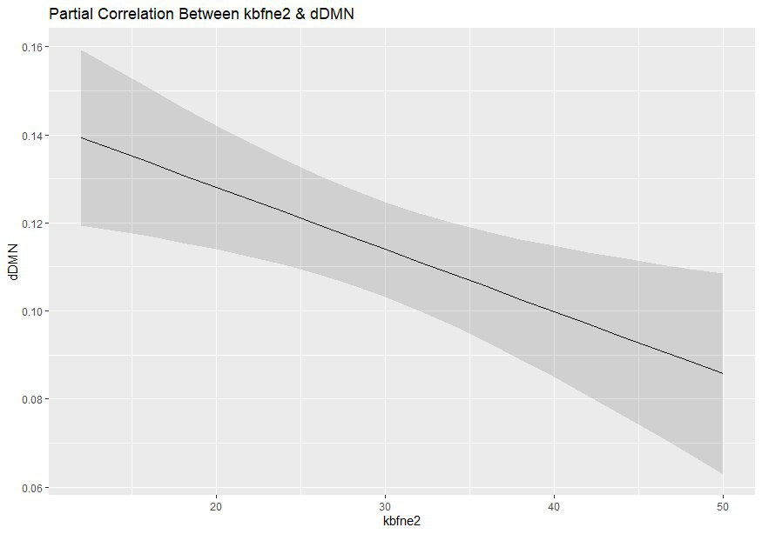
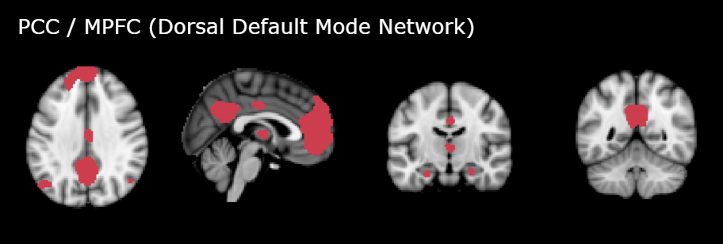
3
Results
fMRI results
PCC / MPFC (Dorsomedial Default Mode Network)
Maturity
“Senescing”
r = -.294 , p = .006
After controlling age, sex, education, the correlation between fear of negative evaluation and within dDMN mean connectivity strength was significant
Notes:
The partial correlation result which controlled for sex, age, and education, shows that fear of negative evaluation total score is associated with dorsomedial DMN rather than ventral DMN.
Dorsomedial DMN was significant at p value of point 006. It had negative relationship with kbfne2 total score.
It means that when dDMN connectivity strength gets stronger, people tend to have less fear of getting negative evaluation.
To be more specific, in this study,
dDMN connectivity strength was calculated as mean connectivity value within dDMN ROIs, such as medial prefrontal cortex (MPFC) and posterior cingulate cortex (PCC). Then we examined the association between dDMN connectivity strength and the fear of negative evaluation, using a linear regression analysis.
As shown in the previous slide, K-BFNE II score was negatively associated with dDMN connectivity strength in rsfMRI after controlling for the effect of age, sex, and education (r = -0.294, p = 0.006).

Slide 18
4
Results
Implications
Implication #1
Implication #2
Since the dorsomedial DMN is known for its association with the ability to understand the others, it this study suggests that
the weakened dDMN connectivity may be an underlying neural mechanism of fear of negative evaluation or the response to significant negative evaluation from the past, which possibly influence on one’s ability to understand others.
The result supported the perspective that social anxiety occurs on a spectrum and indicated that the K-BFNE II is a useful means of detecting neural alterations that may relate to the social anxiety spectrum.

Slide 19
Thank
You.
Seoul National University
JI SOO LEE, HARIN KIM, SEYUL KWAK, JEANYUNG CHEY
Acknowledgement

