Slide 1


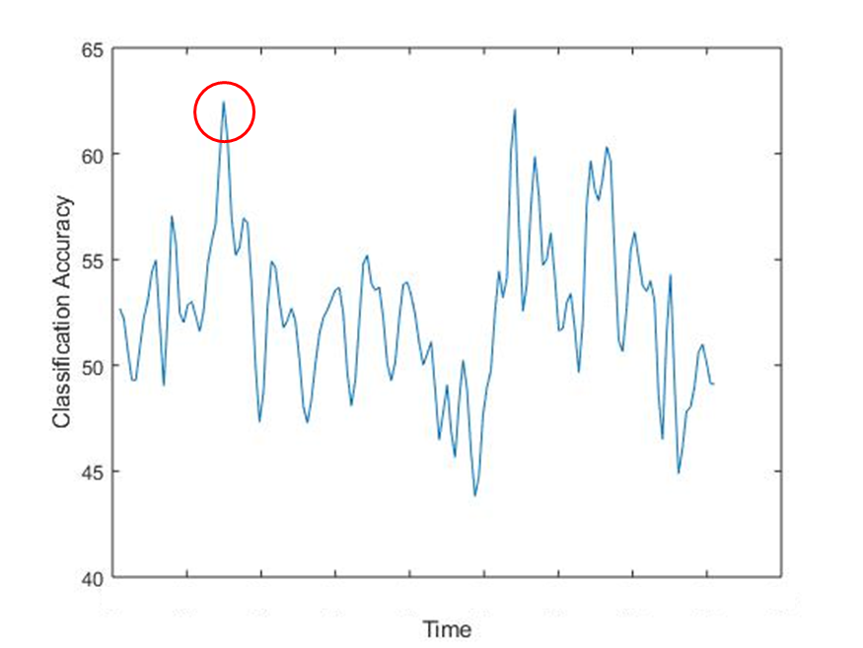
The reversion of information processing between episodic learning and retrieval across the adult lifespan
Soroush Mirjalili and Audrey Duarte, PhD
Georgia Institute of Technology
INTRODUCTION
Events we experience in our daily lives are composed of both simple, low-level perceptual features as well as more abstract, high-level ones.
Low level features like color are discriminated earlier in time and by earlier visual cortical regions than more abstract ones (Carlson et al., 2013).
Capitalizing on the temporal resolution of EEG, Linde-Domingo and colleagues found that perceptual details of the objects, i.e. whether they were photographs or line drawings, were discriminable earlier than conceptual ones, i.e. whether they were animate or inanimate.
Interestingly, these temporal dynamics were reversed during memory retrieval such that conceptual episodic features were recovered prior to the perceptual ones (Linde-Domingo et al.).
It is unknown whether attention/aging affects the temporal dynamics at encoding and retrieval.
It is well known that normal aging is associated with slowing of visual processing and memory retrieval, with EEG and MEG studies showing processing delays on the order of hundred milliseconds (Onofrj, et al., 2001, Clarke et al., 2015) sometimes even in the absence of memory impairments or reduced neural activity.
It is an open question whether this visual processing hierarchy during encoding and reversal during retrieval is influenced by whether these low or high complexity features are the focus of one’s attention.
Current study
We used EEG to assess the hierarchical nature of episodic encoding and retrieval for low- and high-level features while modulating attention demands across the adult lifespan.
There are three different potential models associated with processing perceptual features of different levels of complexity.
In the first model, low-level features, processed by earlier visual cortical areas, are encoded prior to and retrieved following high-level ones, regardless of whether they were attended to at encoding.
In the second model, the attended context feature will be encoded and retrieved earlier than the ignored one (and the dynamics are independent of the context features complexity).
In the hybrid model, both attention and features’ complexity determine the temporal dynamics.
METHOD
Participants: 58 subjects from 18-72.
EEG (32-channel) was recorded during encoding and retrieval.
Time-resolved classification analyses were performed to distinguish context hits/misses at encoding and retrieval.
For each classification analysis, we selected power values of a specific 300ms sliding time interval in the time-frequency representation.
Features were extracted based on common- spatial patterns (CSP) at each frequency bands.
CSPs are spatial filters that maximize the difference between the variance of the two classes.
Used naïve Bayesian classifier to discriminate context hits/misses.
Used 5-fold cross validation average accuracy to evaluate the classifier’s performance.
The peak moment for decoding/retrieving contexts was associated with the global peak of the classifier’s performance in the first 1200ms.
RESULTS
Behavioral results
Evidence for the hybrid model: attention at encoding (whether the object had to be associated with the color or the scene) modulates the temporal dynamics of context feature encoding, across age.
Evidence for the hybrid model: there is a reversion on the temporal dynamics of context feature retrieval and attention at encoding modulates it, across age.
Evidence for the hybrid model: there is a reversion on the temporal dynamics of context feature retrieval and attention at retrieval (whether the participant had to initially make context memory judgement for the color or the scene) modulates it, across age.
CONCLUSIONS
Our results confirmed that low-level features (i.e. color) are encoded earlier and retrieved later than high-level features (i.e. scene).
However, while the complexity of the visual feature is the dominant factor in determining the temporal dynamics, attention modulates these dynamics as well.
Encoding and retrieval dynamics and the attention modulation is preserved by age.
REFERENCES
Carlson, T., Tovar, D., Alink, A. & Kriegeskorte, N. Representational dynamics of object vision: the first 1000 ms. J. Vis. 13, 1–19 (2013).
Clarke, A., Devereux, B.J., Randall, B., Tyler, L.K., Predicting the Time Course of Individual Objects with MEG Cereb Cortex. 2015
Linde-Domingo, J., Treder, M.S., Kerrén, C., Wimber, M. Evidence that neural information flow is reversed between object perception and object reconstruction from memory. Nature communications 10 (1), 1-13
Onofrj, M.1., Thomas, A., Iacono, D., D'Andreamatteo, G., Paci, C., (2001). Age-related changes of evoked potentials. Neurophysiol Clin. 31(2), 83-103
ACKNOWLEDGEMENTS
I'd like to appreciate the support of my advisor, Prof. Audrey Duarte, who has helped me a lot during this study. I should also thank the members of the Memory and Aging Lab who collected the data, our participants, and the NSF Grant #1125683 for funding and making this study possible.

