Slide 1
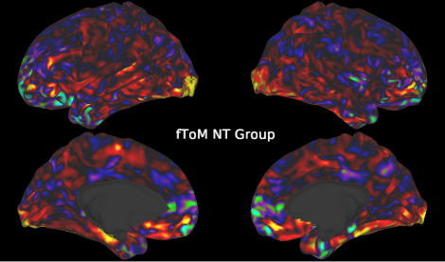
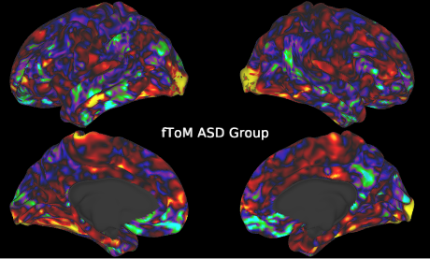
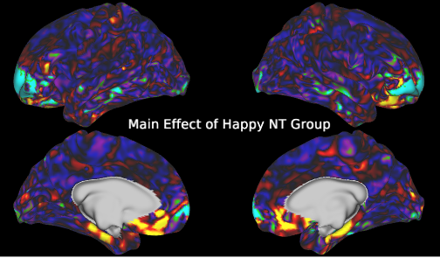
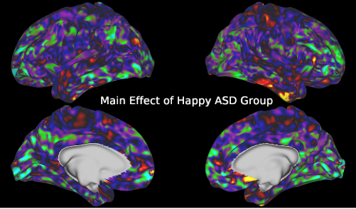
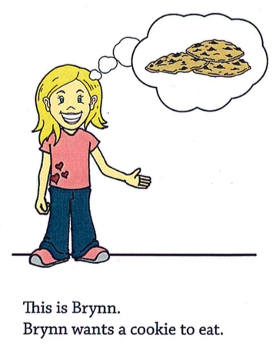
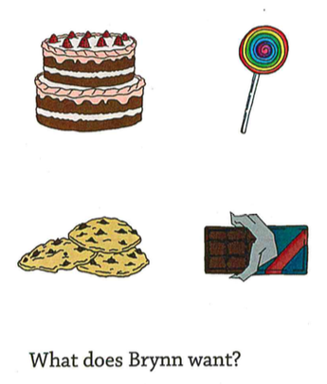
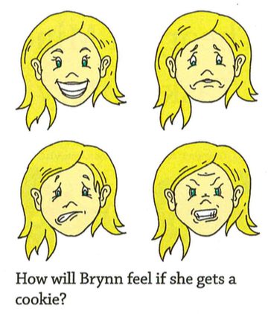
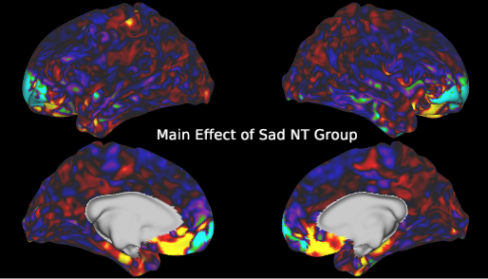
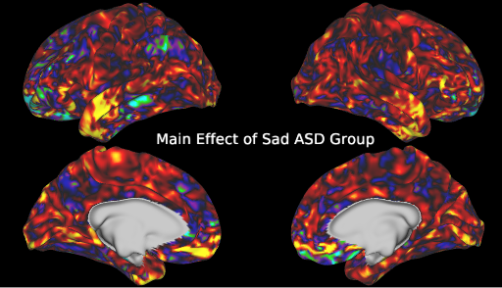
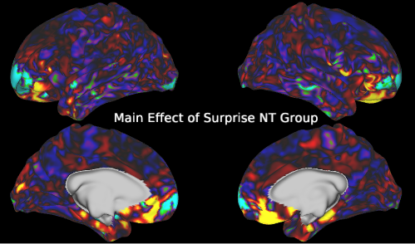
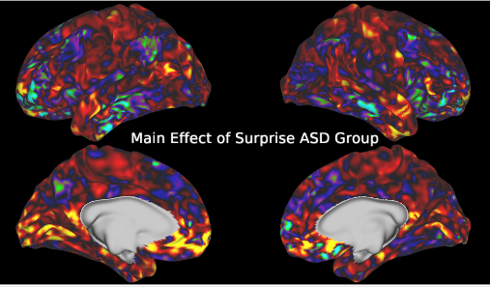
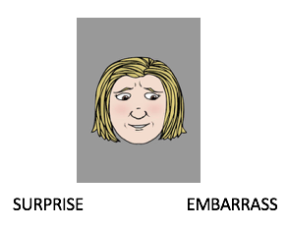
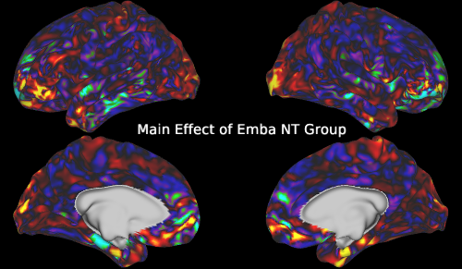
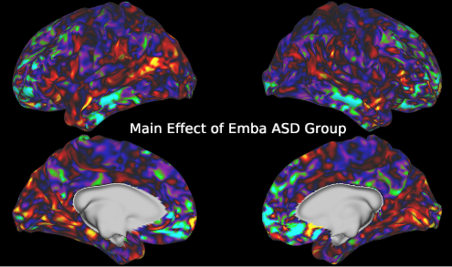
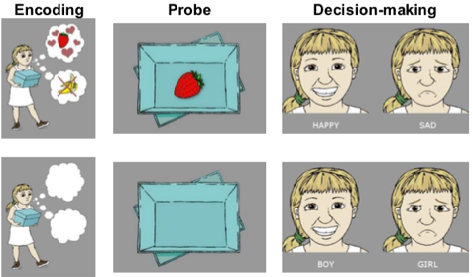
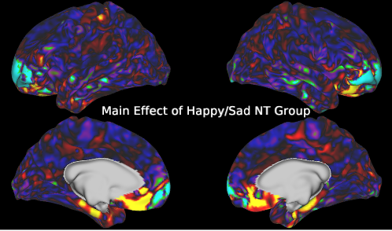
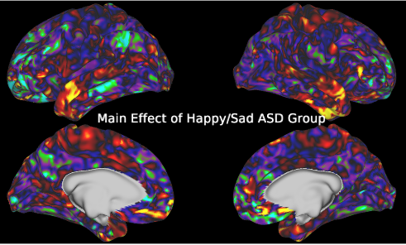
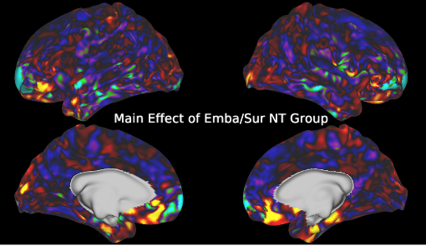
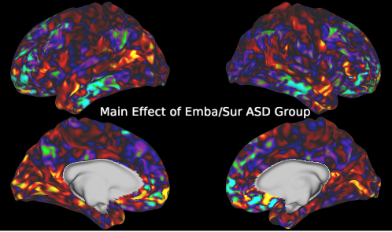
Examining the Neural Mechanisms underlying Emotion
Recognition and Theory of Mind in ASD
Yu Han^{1,2,3}, Emily L. Coderre^{1,2}, Ph.D.,. Patricia A. Prelock^{1,2,4}, Ph.D., CCC-SLP
Department of Communication Sciences and Disorders, University of Vermont
Neuroscience Graduate Program, Larner College of Medicine, University of Vermont
Vermont Complex Systems Center, University of Vermont
4. Provost and Senior Vice President Office, University of Vermont
Autism Spectrum Disorder (ASD) is a complex neurodevelopmental disorder that affects nearly 1 in 59 children. Children with ASD struggle with social interactions and connecting with others due to deficits in theory of mind (ToM). In this study, we will collect behavioral and neuroimaging data for children with and without ASD, particularly in the areas of emotion recognition and understanding which are key skills required for meaningful social interaction. The research will use these measures to determine which brain systems contribute to behavioral functions associated with ToM. Insights derived from clarifying the neural systems involved in ToM surrounding desire-based emotion, a less well studied basic emotion (i.e., surprise), and a more complex emotion (i.e., embarrassed) are expected to facilitate improvement in the diagnosis and design of intervention methods for this population. The study will include 40 children (7 to 14 years of age), 20 children with ASD and 20 neurotypycal children (NT). We will use two novel functional magnetic resonance imaging (fMRI) paradigms. The first is an fMRI Emotion Recognition task to assess recognition of surprise and embarrassment requiring ToM using a series of visually presented faces. The second is an fMRI ToM task developed to assess desired-based emotions, in which participants are required to infer the reaction. Findings of this study are expected to increase our knowledge of the relationships between brain activity and behavioral responses to theory of mind tasks in children with and without ASD.
PARTICIPANT
16 Neurotypical
6 ASD (The Autism Diagnostic Observation Schedule (ADOS-2);The Social Communication Questionnaires (SCQ) )
7~14 years old
BEHAVIORAL ASSESSMENT
The Nonverbal Intelligence Test (UNIT-2)
The Comprehensive Assessment of Spoken Language (CASL)
Theory of Mind Inventory-2 (ToMI-2)
Theory of Mind Task Battery (ToMTB)
BRAIN SCAN: T1, T2, fMRI, DTI, Resting State
EMOTION RECOGNITION TASK
Happy, Sad, Surprise and Embarrassment
8 characters, 2 versions of each expression, 16 unique stimuli for each expression
Mixed design across two runs
THEORY OF MIND TASK
10 characters, 30 items
Event-related design over 2 runs
ANALYSES
Structural analysis: HCP pipelines
fMRI first level analysis: General Linear Model
fMRI second level analysis: Permutation Analysis (i.e.,5000)
MAIN EFFECT OF TOM
MAIN EFFECT OF HAPPY
MAIN EFFECT OF SAD
MAIN EFFECT OF SURPRISE
MAIN EFFECT OF EMBARASSMENT
MAIN EFFECT OF HAPPY & SAD
MAIN EFFECT OF SURPRISE AND EMBARRASSMENT e
Conclusion
Abstract
Methodology
Results
BRAIN ACTIVITY OF THEORY OF MIND :
There are different brain activity patterns between NT and ASD groups.
There are significantly increased activities in occipital lobe both groups.
BRAIN ACTIVITY OF HAPPY:
There are increased activities in frontal pole, dorsal anterior cingulate area in NT group.
There are increased activities in inferior temporal sulcus and mostly decreased activities in different regions in ASD group.
BRAIN ACTIVITY OF SAD:
There are increased activities in frontal pole, dorsal anterior cingulate area in NT group.
There are massive brain activities in ASD group, especially in areas of temporal lobe and dorsal anterior cingulate cortex.
BRAIN ACTIVITY OF SURPRISE
There are increased activities in ventral frontal pole, orbitalfrontal area, dorsal anterior cingulate area in NT group.
There are increased activities in visual cortex and dorsal anterior cingulate area in ASD group.
BRAIN ACTIVITY OF EMBARRASSMENT
There are increased activities in ventral frontal pole and occipital lobe in NT group.
There are increased activities in visual cortex and dorsal anterior cingulate area in ASD group.
Overall, the preliminary results suggest that visual cortex is associated with ToM; there are different brain activation patterns when processing different emotions between ASD and NT subjects: ASD brain is more active when processing sad and surprise; and less active when processing happy and embarrassment.
Introduction
WHAT IS AUTISM
A “spectrum disorder” and a heterogeneous disorder without a specific known cause or cure
Main challenge: communicating and interacting with others
Language and intellectual impairments may or may not occur
Early diagnosis and intervention (e.g., speech and language therapy, social cognitive behavioral intervention, etc.) are critical
THEORY OF MIND: A CORE DEFICIT IN AUTISM
Ability to reason about the thoughts and feelings of self and others, including the ability to predict what others will do or how they will feel in a given situation on the basis of their inferred beliefs.
Shared world knowledge
Perception of various social cues
Interpretation of actions
INNOVATION AND GOALS
The current study is the first to examine the neural correlates of emotions requiring ToM and establish the connections between behavior and brain activities in children with ASD.
Surprise, Embarrassment, Desire-based emotion
Establish baseline behavioral patterns and identify differences between groups in the understanding of these less well-studied and complex emotions
Establish baseline patterns of brain activation, and potential differences in brain activation between groups, during recognition of these less well-studied and complex emotions
Acknowledgements

