Slide 1
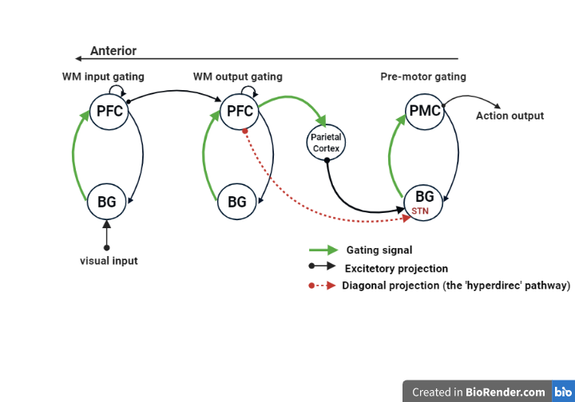
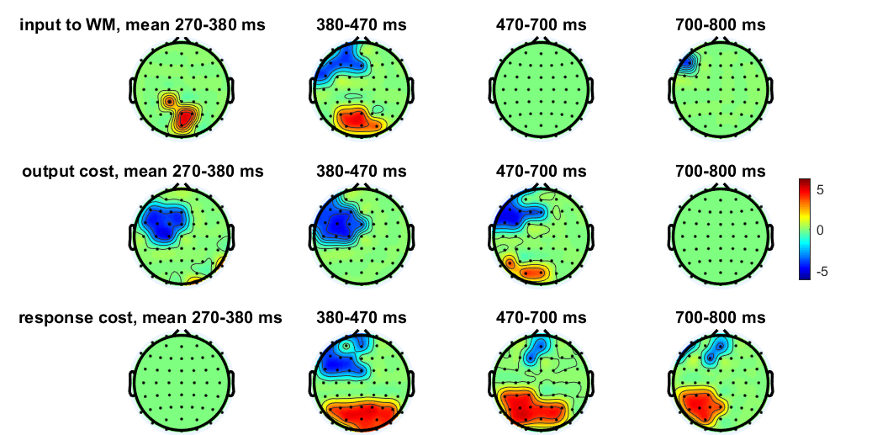
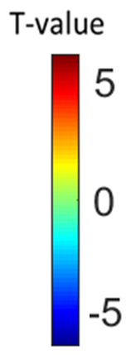
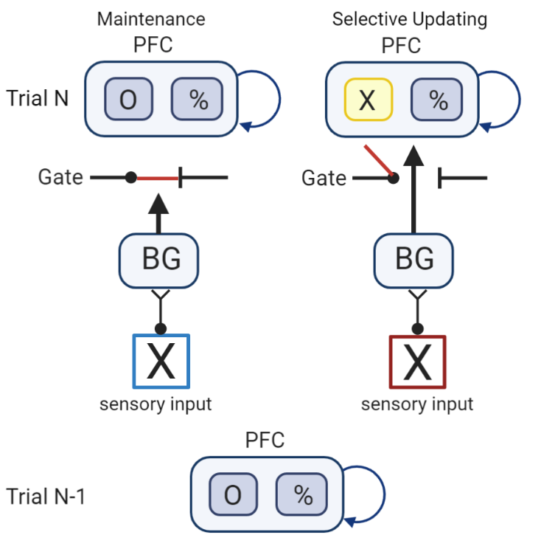
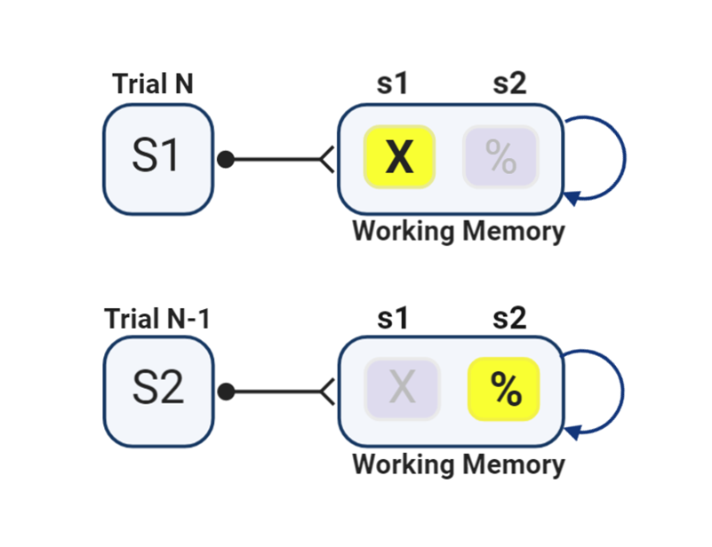
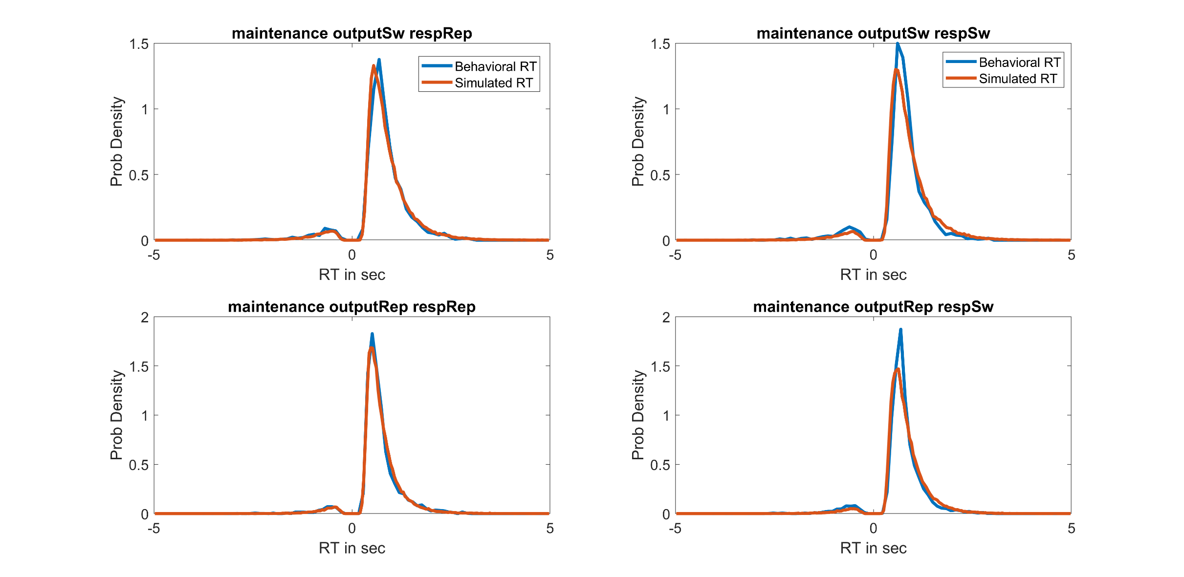
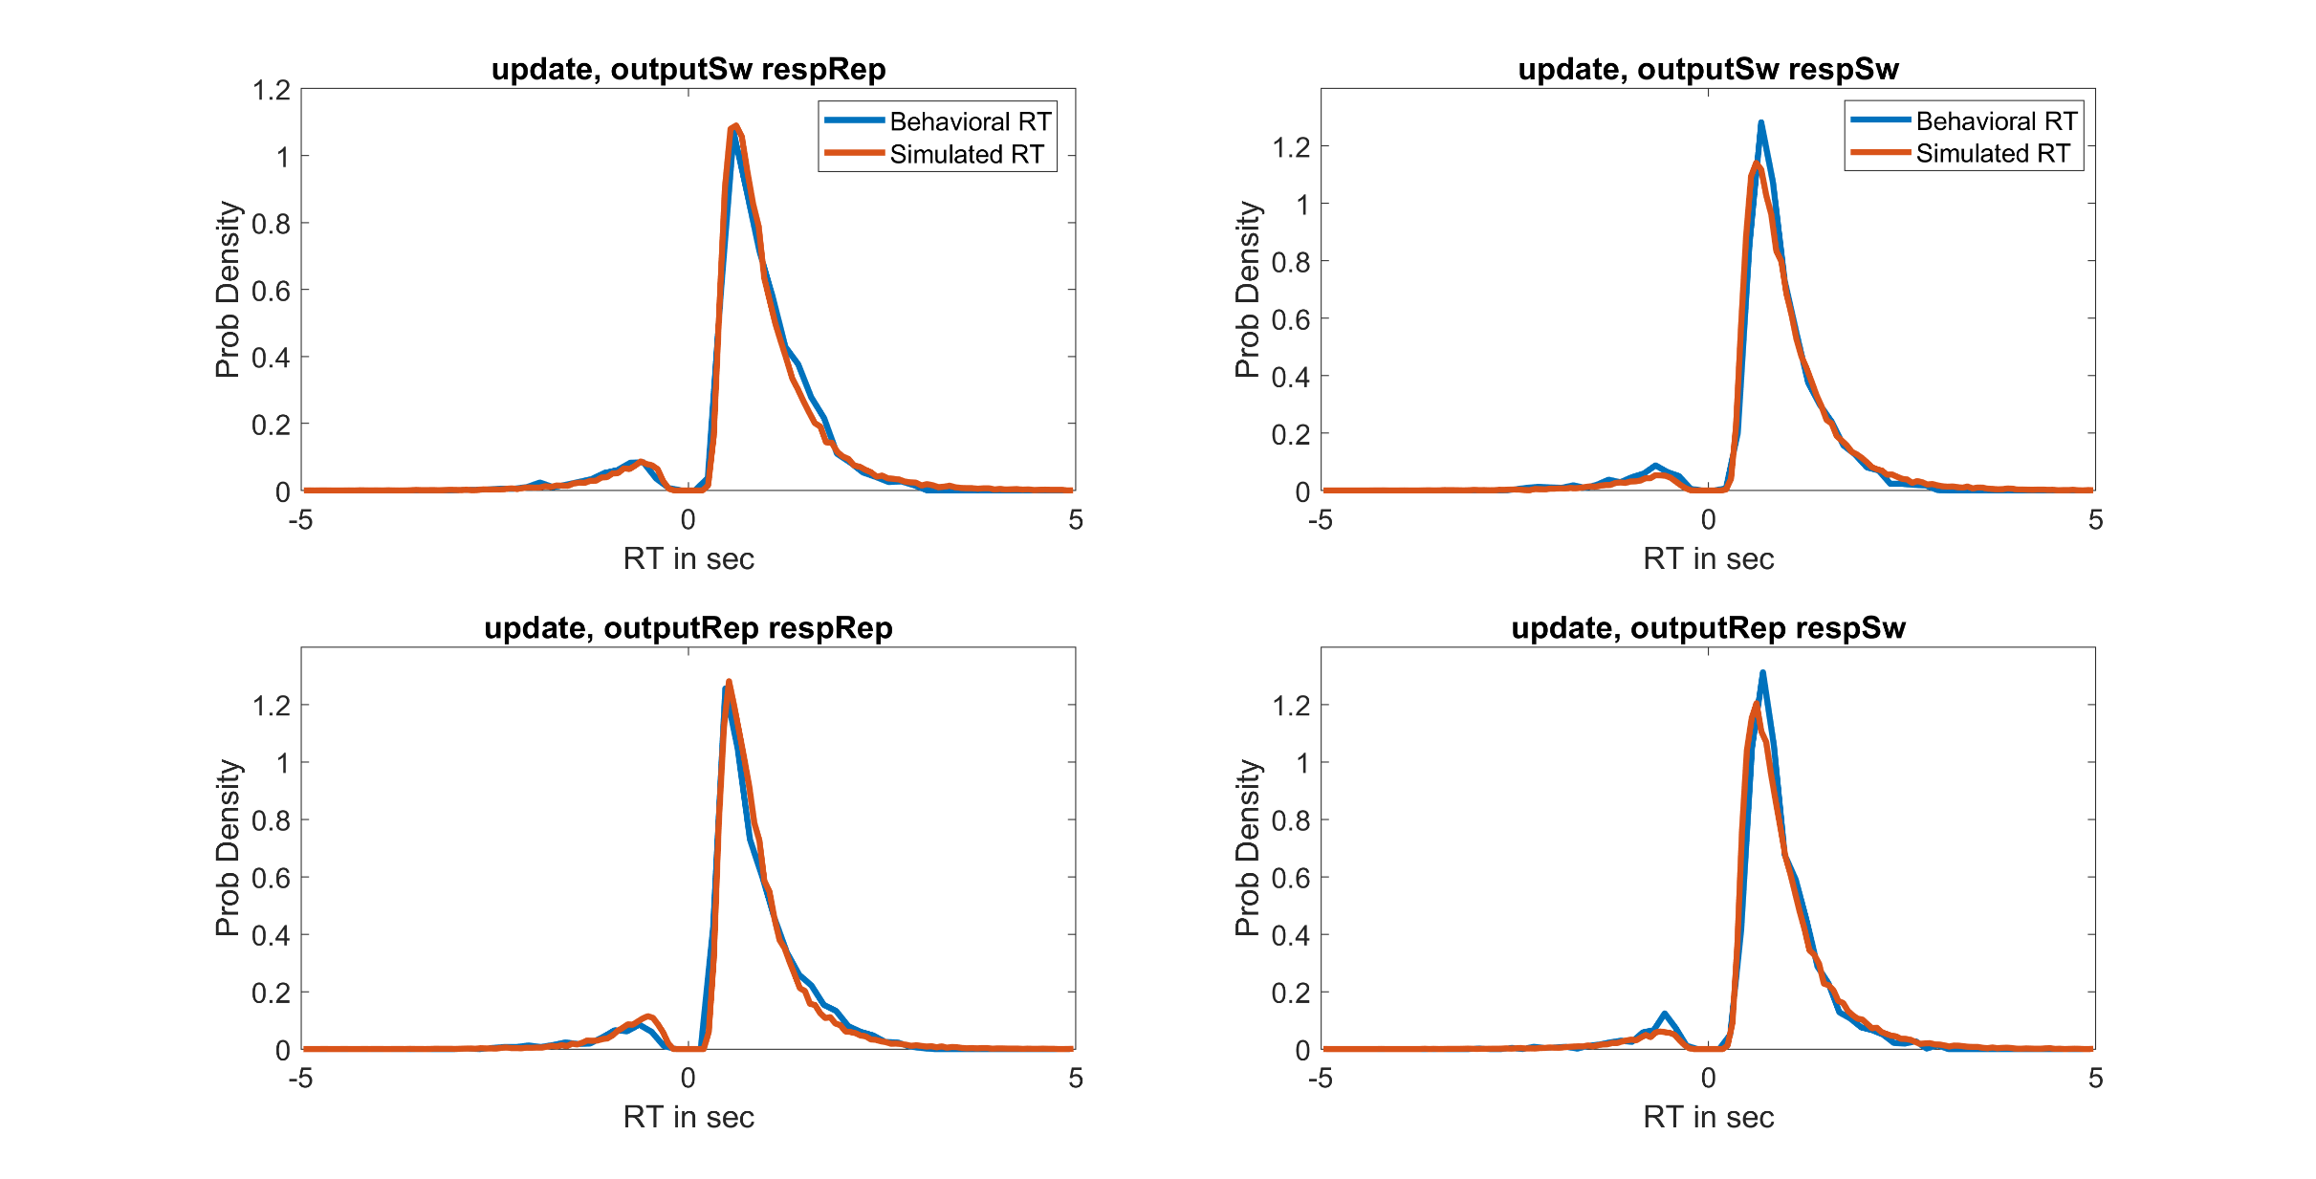
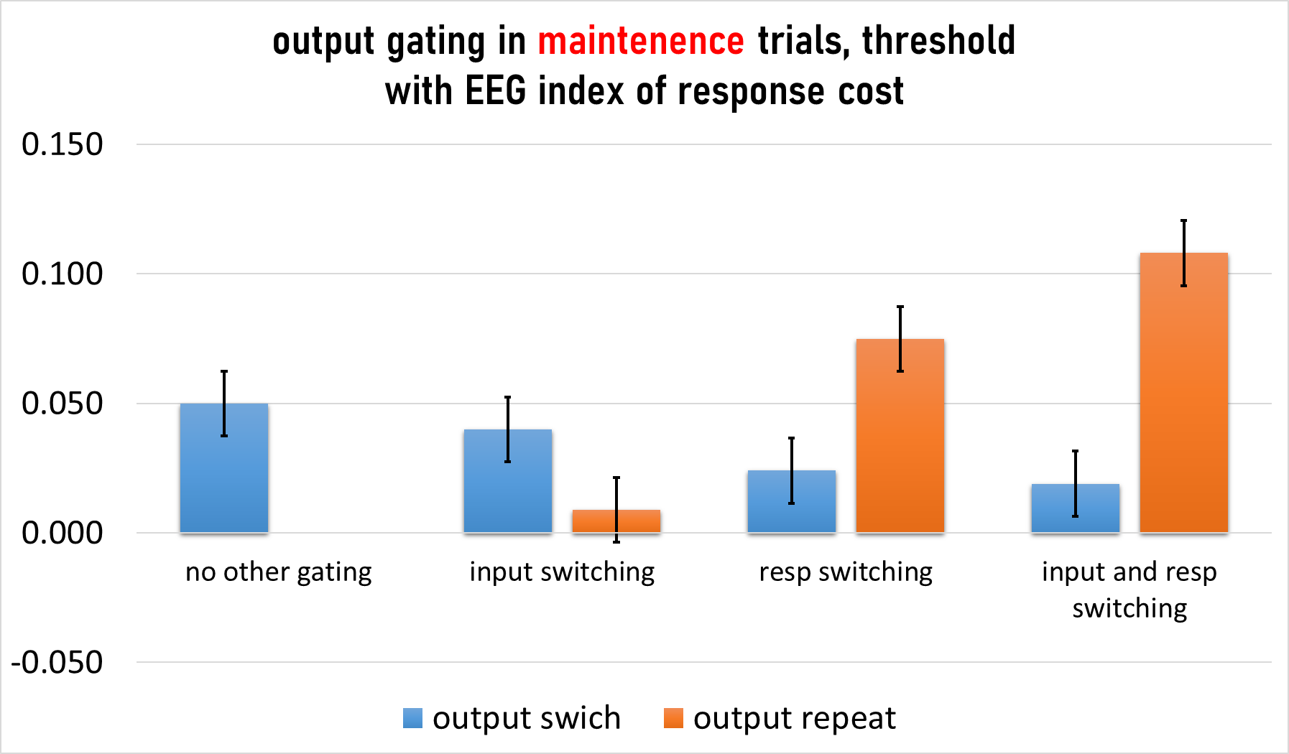
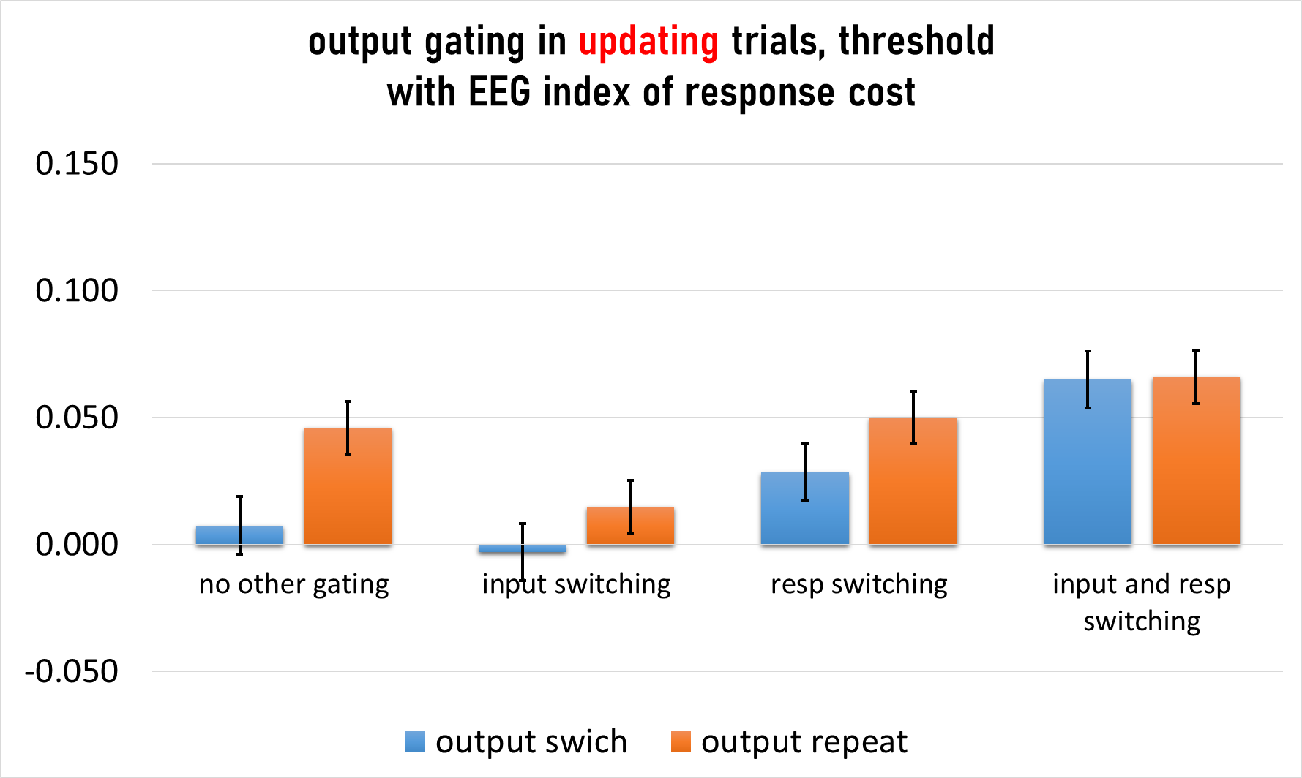
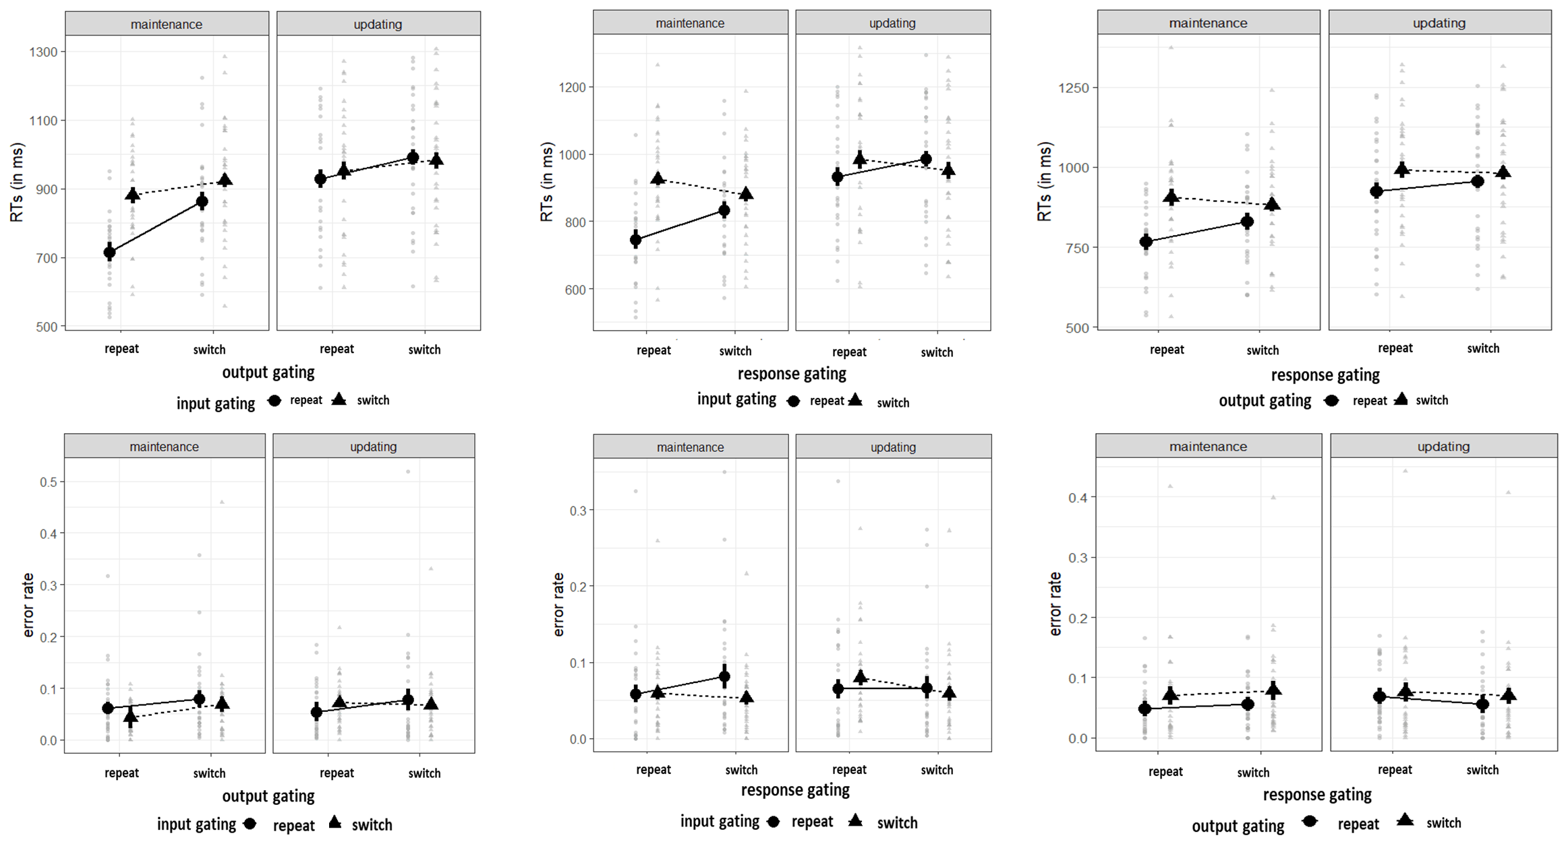
EEG correlates of dynamic decision parameters of WM updating Rachel Rac-Lubashevsky¹, and Michael Frank¹ ¹Cognitive, Linguistic, & Psychological Sciences, Brown Institute for Brain Science, Brown University
The hierarchical fronto-striatal gating model
Dynamic regulation of motor action gating
Goal
Effective cognitive control is depends on a gating network which regulates information selection to WM and motor selections [1-4]. The gating network is composed of several parallel gating loops that are hierarchally arranged:
The higher level circuit learns to gate context relevant information (like the task set ) into the PFC stripe.
The parallel middle level circuit learns, to output gate relevant information from the PFC to guide subsequent process (e.g., response selection), given the perceptual stimulus and the context.
A parallel lower level circuit learns to gate the motor response that is appropriate given the output gated information.
Each gating decision is accomplished by separate mechanism operating mostly in parallel toward a response.
Motor action gating in the lower loop is constrained by the parallel-higher cognitive loops via the ‘hyperdirect pathway’ (from mPFC to the STN, in the motor loop) that raise the “evidence threshold” [8-9] on response when there is a cognitive conflict.
The aim of this study was to characterize the cognitive architectures that supports cognitive-control
Specify the decision parameters involved in the cognitive-control of WM
Identify the times sensitive neural correlates of these decision parameters
EEG GLM analysis
Summary & Conclusion
Methods: Selective gating paradigm (the reference-back task)
A regression approach was used to simultaneously extract the effect of the multiple conditions and RT, on the EEG signal.
We identified significant masks (clusters of electrodes and time points) that showed significant sensitivity to each gating decision.
These GLM masks demonstrate mostly parallel processing across the gating network
We tested how the decision parameters (threshold and drift rate) are modulated on a trial-to-trial basis by the level of gating conflict.
Behavior and EEG results demonstrated that input gating, output gating and response gating are mostly operating in parallel thus providing further evidence for the idea of separate gating mechanisms [1,2,4,5].
The ERP results mirrored the threshold adjustment in the HDDM [7]. Both demonstrated that the gating architecture follows a hierarchical top-down influence wherein the highest level of conflict sets the threshold level.
The regression model with the EEG results and the HDDM further demonstrated that conflict arising from inconsistency across the hierarchy leads to increase of the decision threshold over the higher level gate.
The results in the drift-rate are not shown but they only exhibited response facilitation for across level consistent gating decisions.
Results
Hierarchical DDM with EEG decoding
The reference-back tsk is a variant of the n-back task [5].
In each trial participants had to indicate whether the stimulus was the same as or different than the most recent red stimulus from the same category.
While all trials required a same/different decision only red trials additionally required WM updating while blue trials required maintenance in WM.
We tested the evidence accumulation processes for selecting correct and incorrect responses during the reference-back task [6-7].
A similarity index (dot-product) was calculated between the activity patterns in individual trials and the mask yielding a trial-by-trial index of the contrast related activity at the trial level (e.g., how much is the brain is in an “output gating” state.
Input gating
(switch in WM state)
Output gating
(switch in category)
In a regression model we tested if trial-to-trial adjustment of decision parameters (threshold and drift-rate) could be predicted by the trial-to-trial variations in the EEG similarity index
EEG activity Individual trial
Similarity Index
GLM mask “response cost”
Posterior predictive check
Response gating
(switch in response)
Trial level gating conditions
References
[1] Badre, D. (2012). Opening the gate to working memory. Proceedings of the National Academy of Sciences USA, 109, 19878-19879.
[2] Ranti, C., Chatham, C. H., & Badre, D. (2015). Parallel temporal dynamics in hierarchical cognitive control. Cognition, 142, 205-229.
[3] Hazy, T. E., Frank, M. J., & O’Reilly, R. C. (2006). Banishing the homunculus: making working memory work. Neuroscience, 139, 105-118.
[4] Collins, A. G., & Frank, M. J. (2013). Cognitive control over learning: Creating, clustering, and generalizing task-set structure. Psychological review, 120, 190-229.
[5] Rac-Lubashevsky, R., & Kessler, Y. (2018). Oscillatory correlates of control over working memory gating and updating: An EEG study using the reference-back paradigm. Journal of cognitive neuroscience, 30, 1870-1882.
[6] Collins, A. G., & Frank, M. J. (2018). Within-and across-trial dynamics of human EEG reveal cooperative interplay between reinforcement learning and working memory. Proceedings of the National Academy of Sciences, 15, ‏2502-2507.
[7] Cavanagh, J. F., Wiecki, T. V., Cohen, M. X., Figueroa, C. M., Samanta, J., Sherman, S. J., & Frank, M. J. (2011). Subthalamic nucleus stimulation reverses mediofrontal influence over decision threshold. Nature neuroscience, 14, 1462-1469.
[8] Zavala et al., (2016). Human subthalamic nucleus–medial frontal cortex theta phase coherence is involved in conflict and error related cortical monitoring. NeuroImage, 137, 178-187.
[8] Ratcliff, R., & Frank, M. J. (2012). Reinforcement-based decision making in corticostriatal circuits: mutual constraints by neurocomputational and diffusion models. Neural computation, 24, 1186-1229.‏
Gate switching is defined as selecting the representation that was not selected in the previous trial.
Evidence for parallel processing across all the gating architecture
Input and output gating gating
Input and response gating
output and response gating
Acknowledgements
We are grateful to Romy Frömer and Matt Nassar for generously sharing code and advice.
This research was supported by THE ISAREL SCIENCE FOUNDATION (grant No. 96/19).
And by Fulbright United states - Israel Educational Foundation
Contact: Rachel_ratz-lubashevsky@brown.edu

