Slide 1
Gateway to South Baltimore

Slide 2
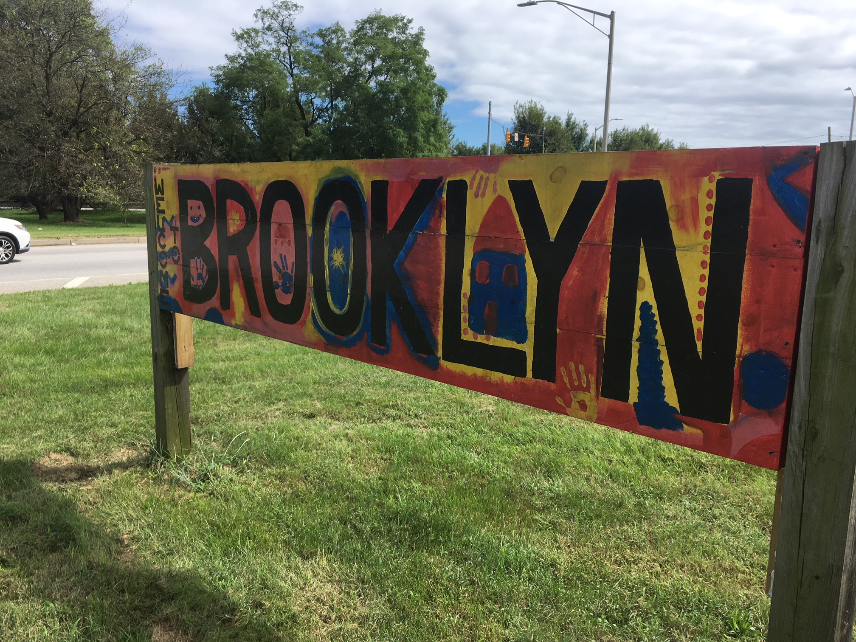

Slide 3
Port Covington
Development
Brooklyn

Slide 4
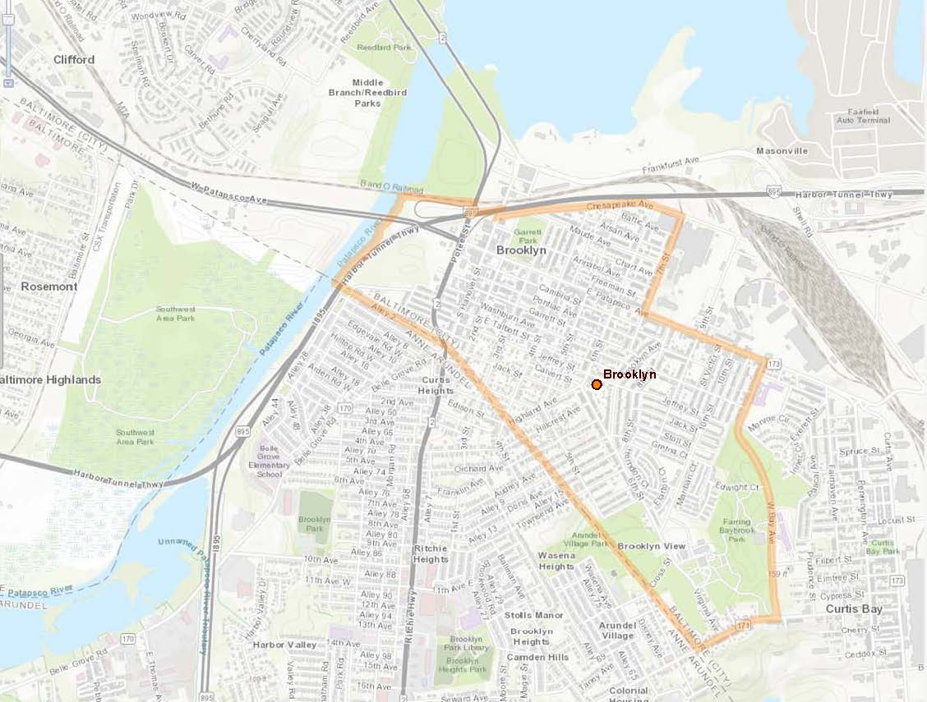
Where is Brooklyn?
½ mile to Port Covington
1 mile to Federal Hill
Between Curtis Bay
& Cherry Hill
Water
I-895
Masonville Cove
Water
Baltimore County
Brooklyn
Anne Arundel County
Water
Route 2
Target, Home Depot, Lowe’s, Giant, Best Buy, Starbucks, Shoppers, Aldi

Slide 5
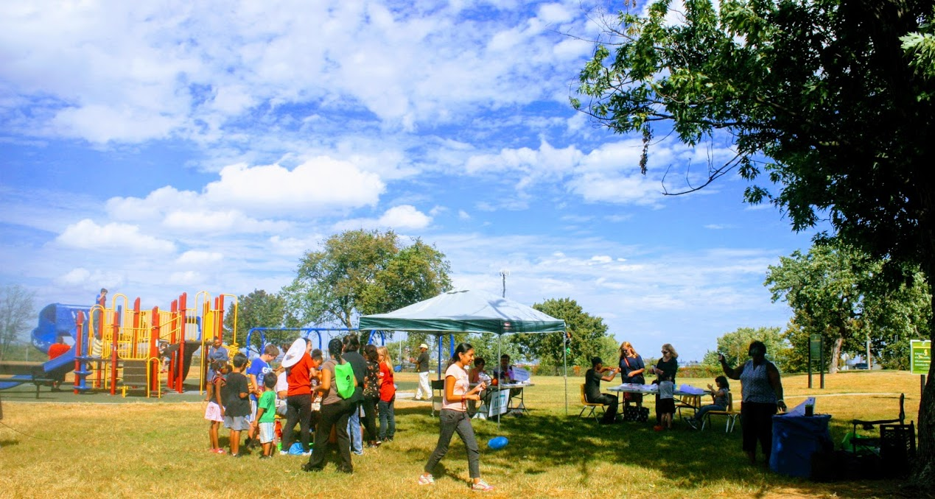
Brooklyn is Outdoors.

Slide 6
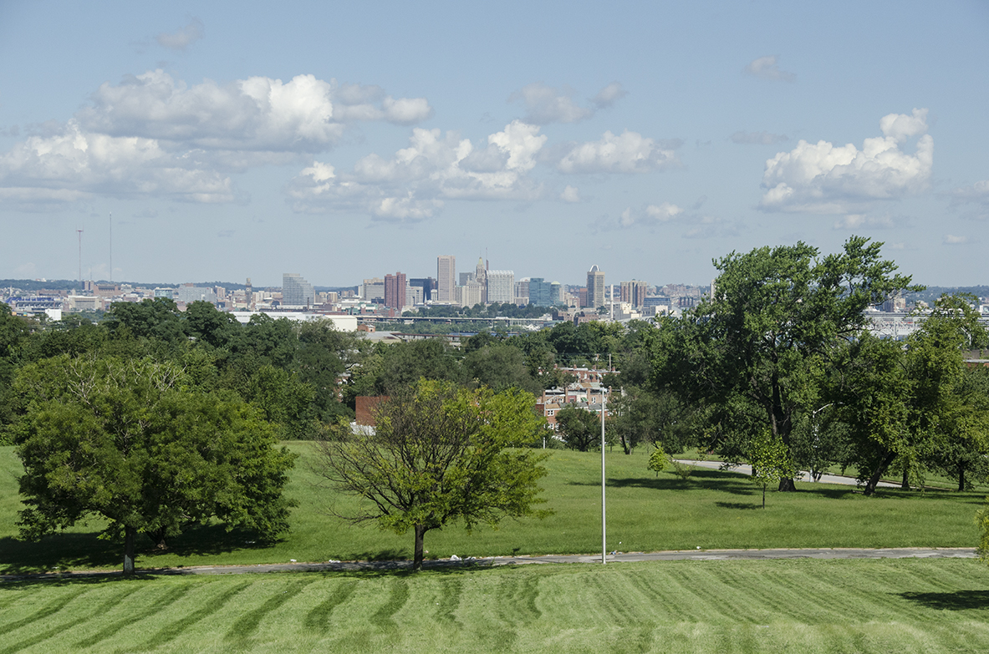
Farring Baybrook Park
Tons of activities, and a great spot to view the Baltimore city skyline and 4th of July fireworks.

Slide 7
Plus, a new multi-million dollar athletic field in Farring Baybrook Park was just completed
in July 2018.

Slide 8
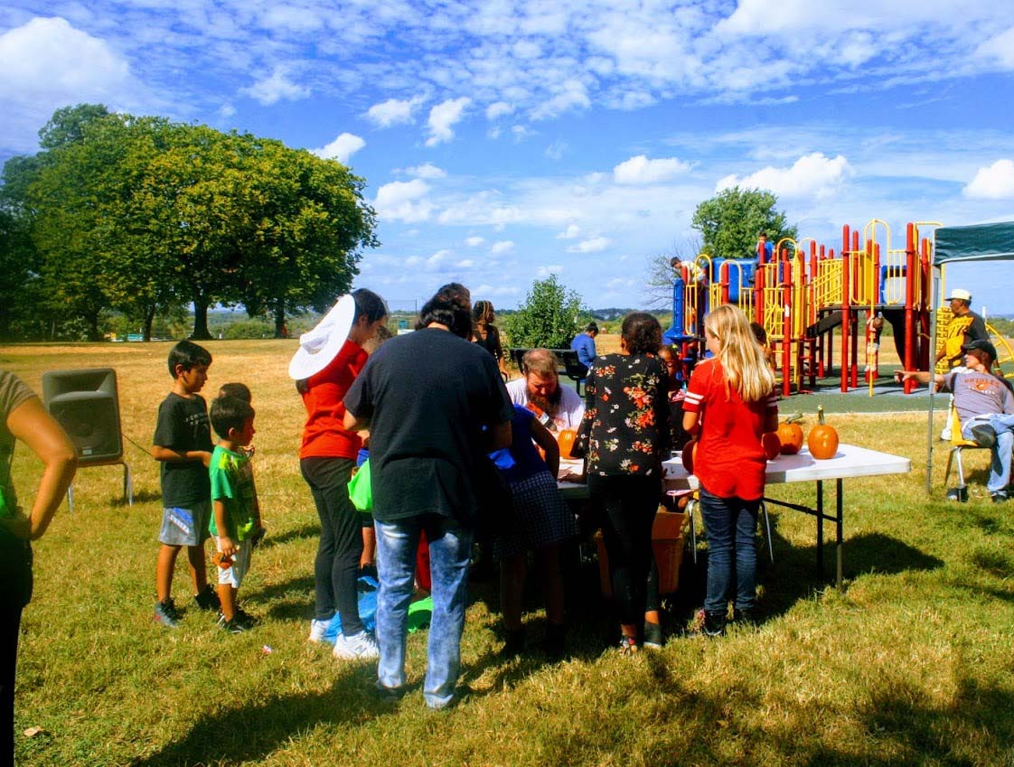
Garrett Park
Friends of Garrett Park recently received significant funding for park improvements & programming.
Monthly events are held in the park.

Slide 9
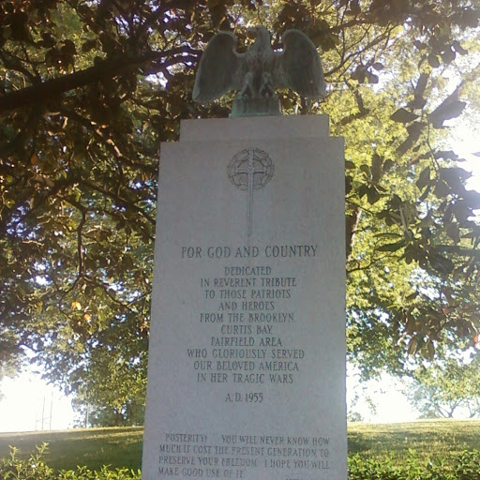
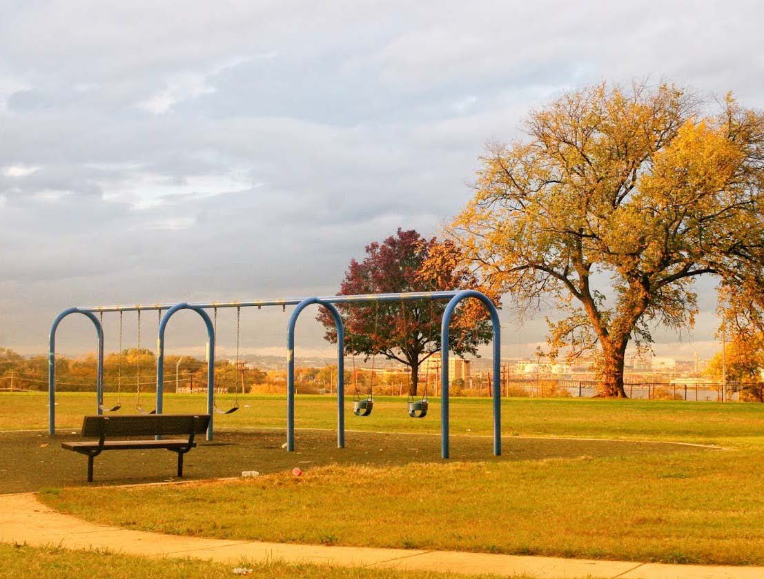
Join Friends of Garrett Park in fun projects with neighbors.
Garrett Park has a beautiful view of the Baltimore skyline and of the 4th of July fireworks.

Slide 10
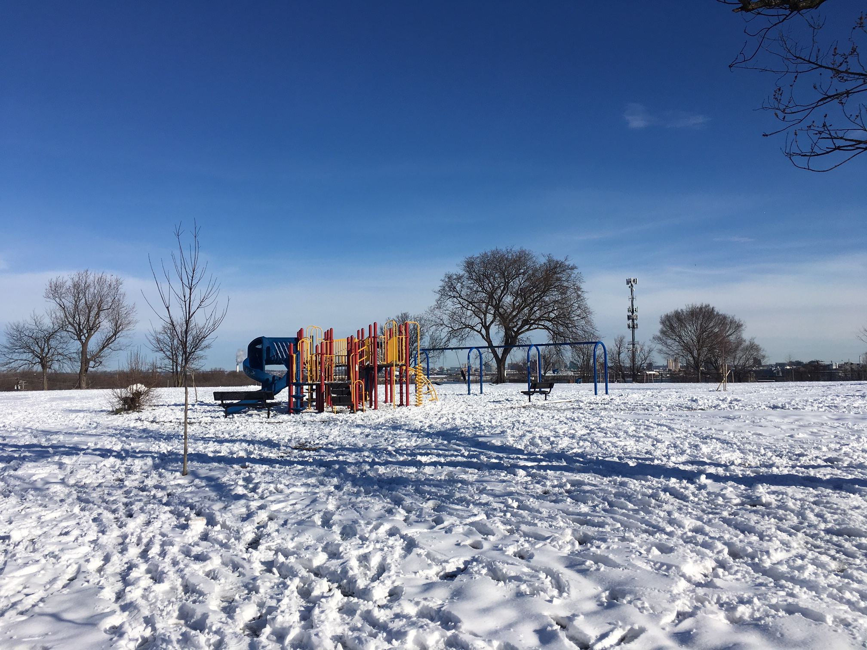

Slide 11
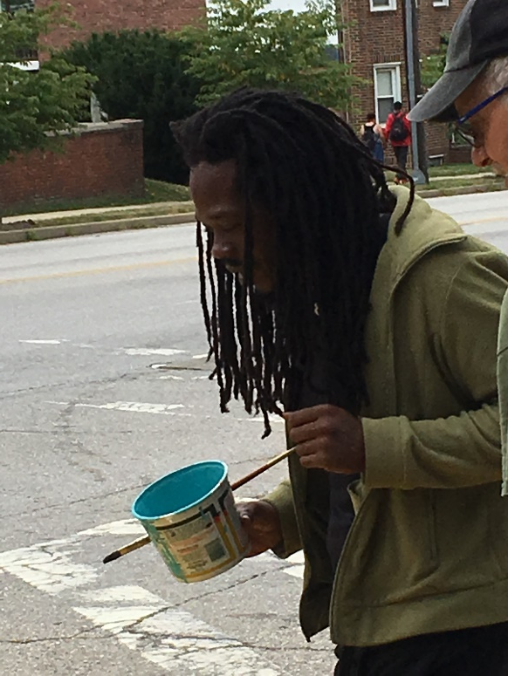
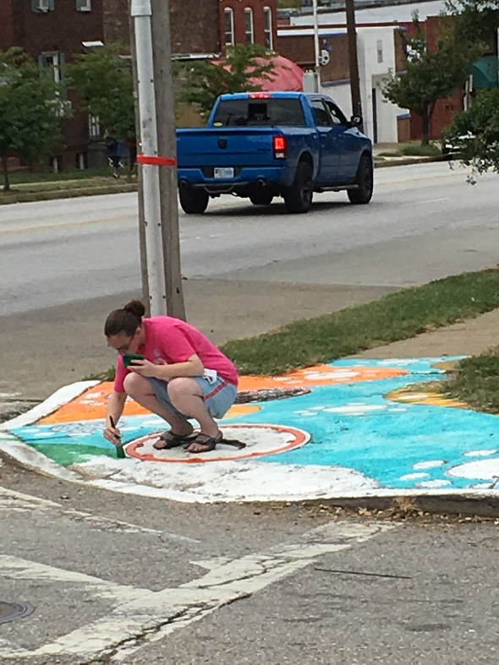
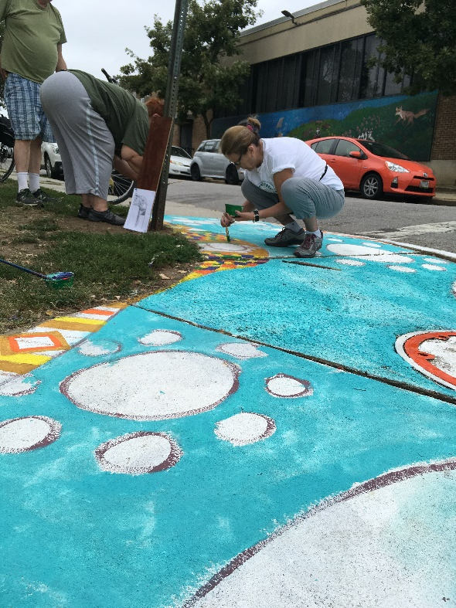
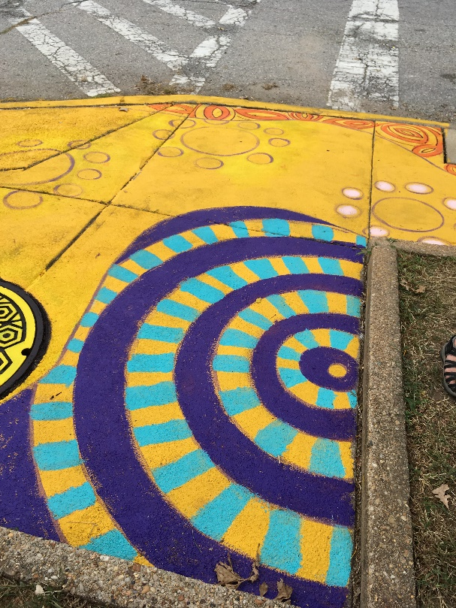
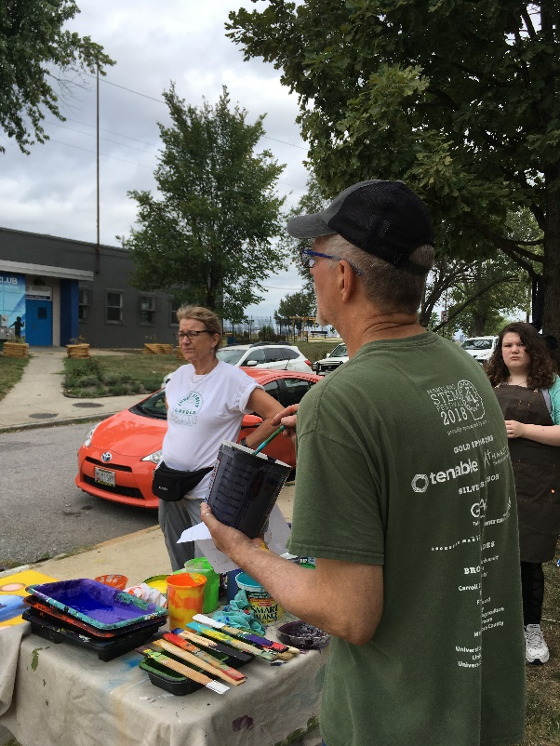
Sidewalk Murals
around
Garrett Park

Slide 12
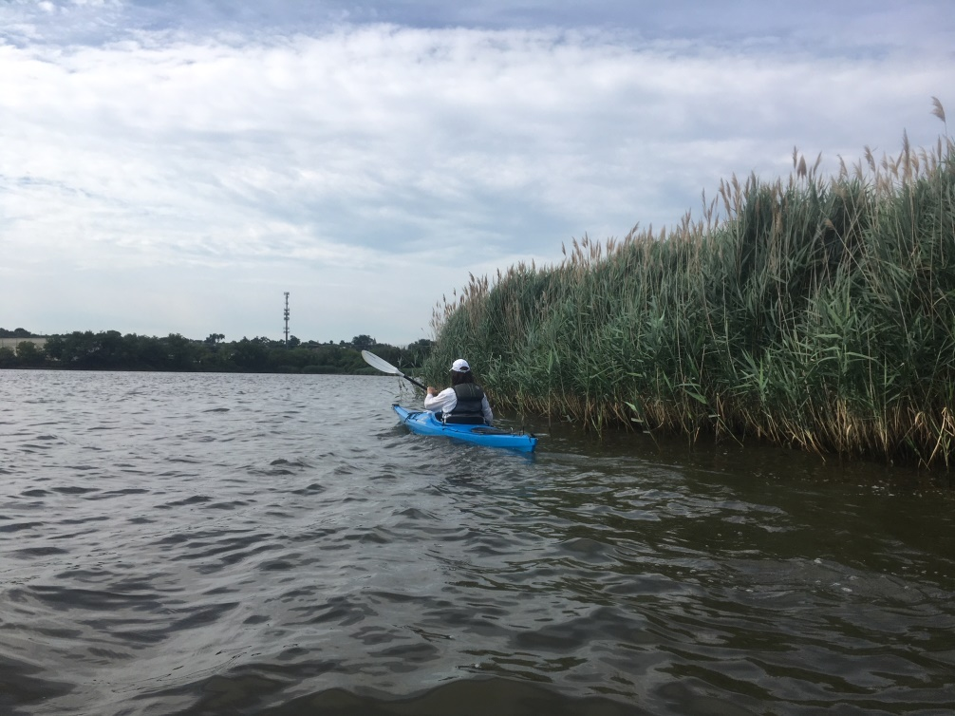
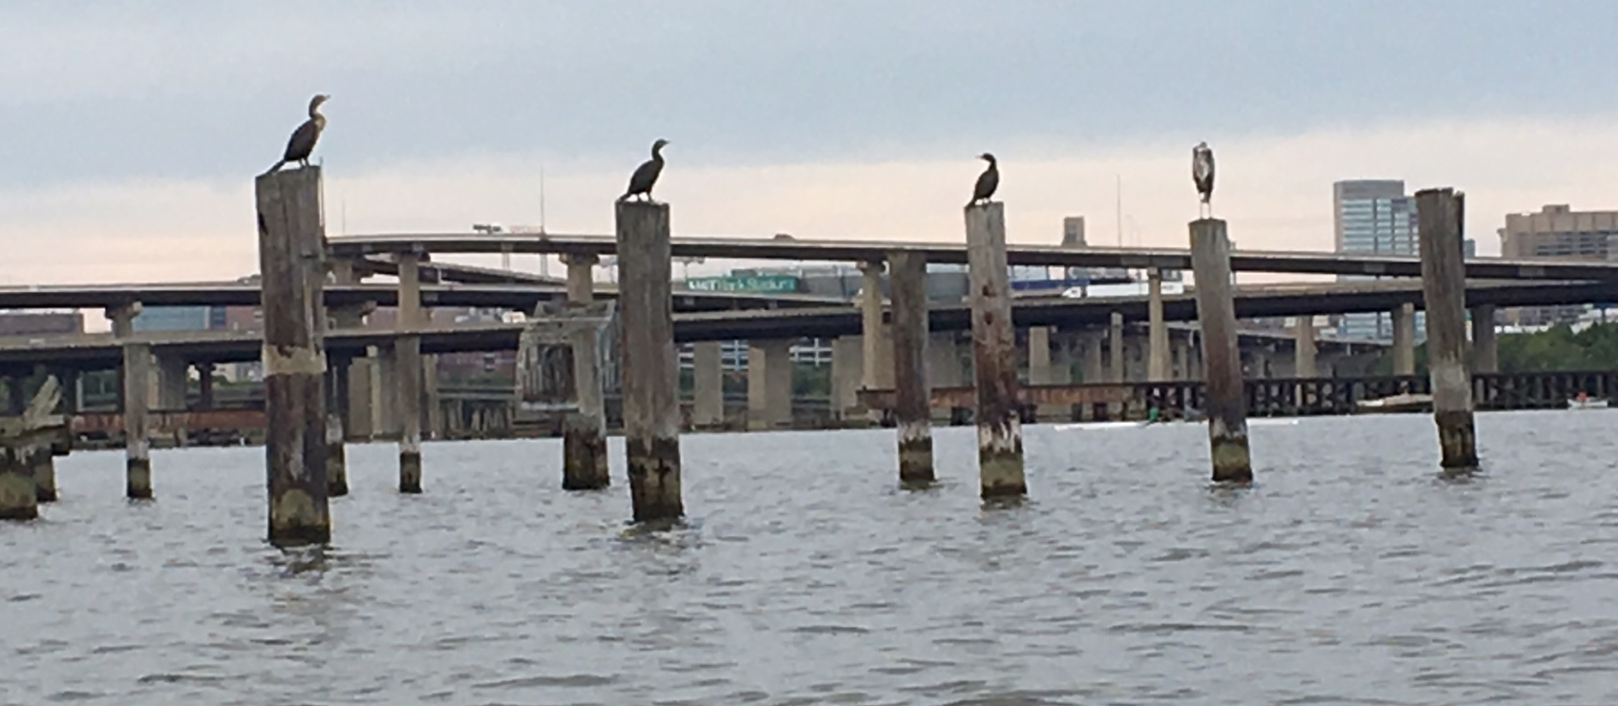
Brooklyn is a waterfront neighborhood
all around us…
…walking, fishing, kayaking, enjoying

Slide 13
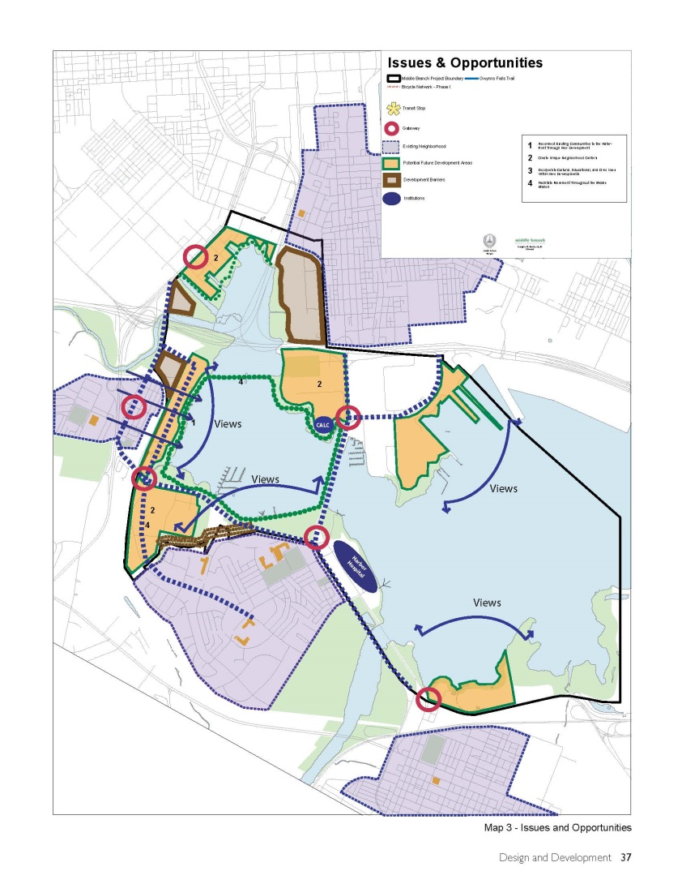
And we are part of the Middle Branch Waterfront Master Plan

Slide 14
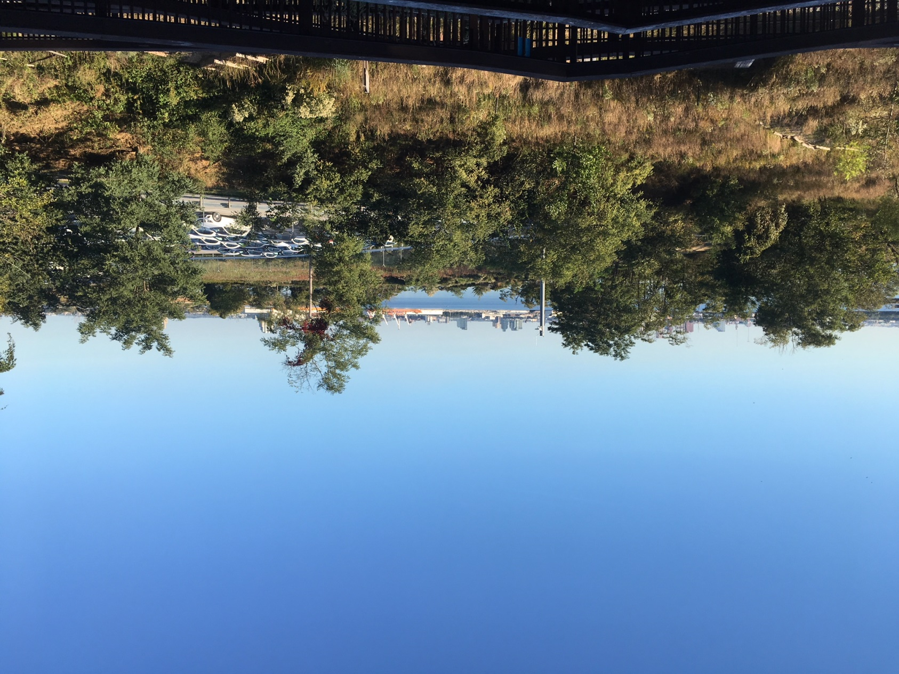
…including Masonville Cove
and the Masonville Cove Environmental Education Center

Slide 15
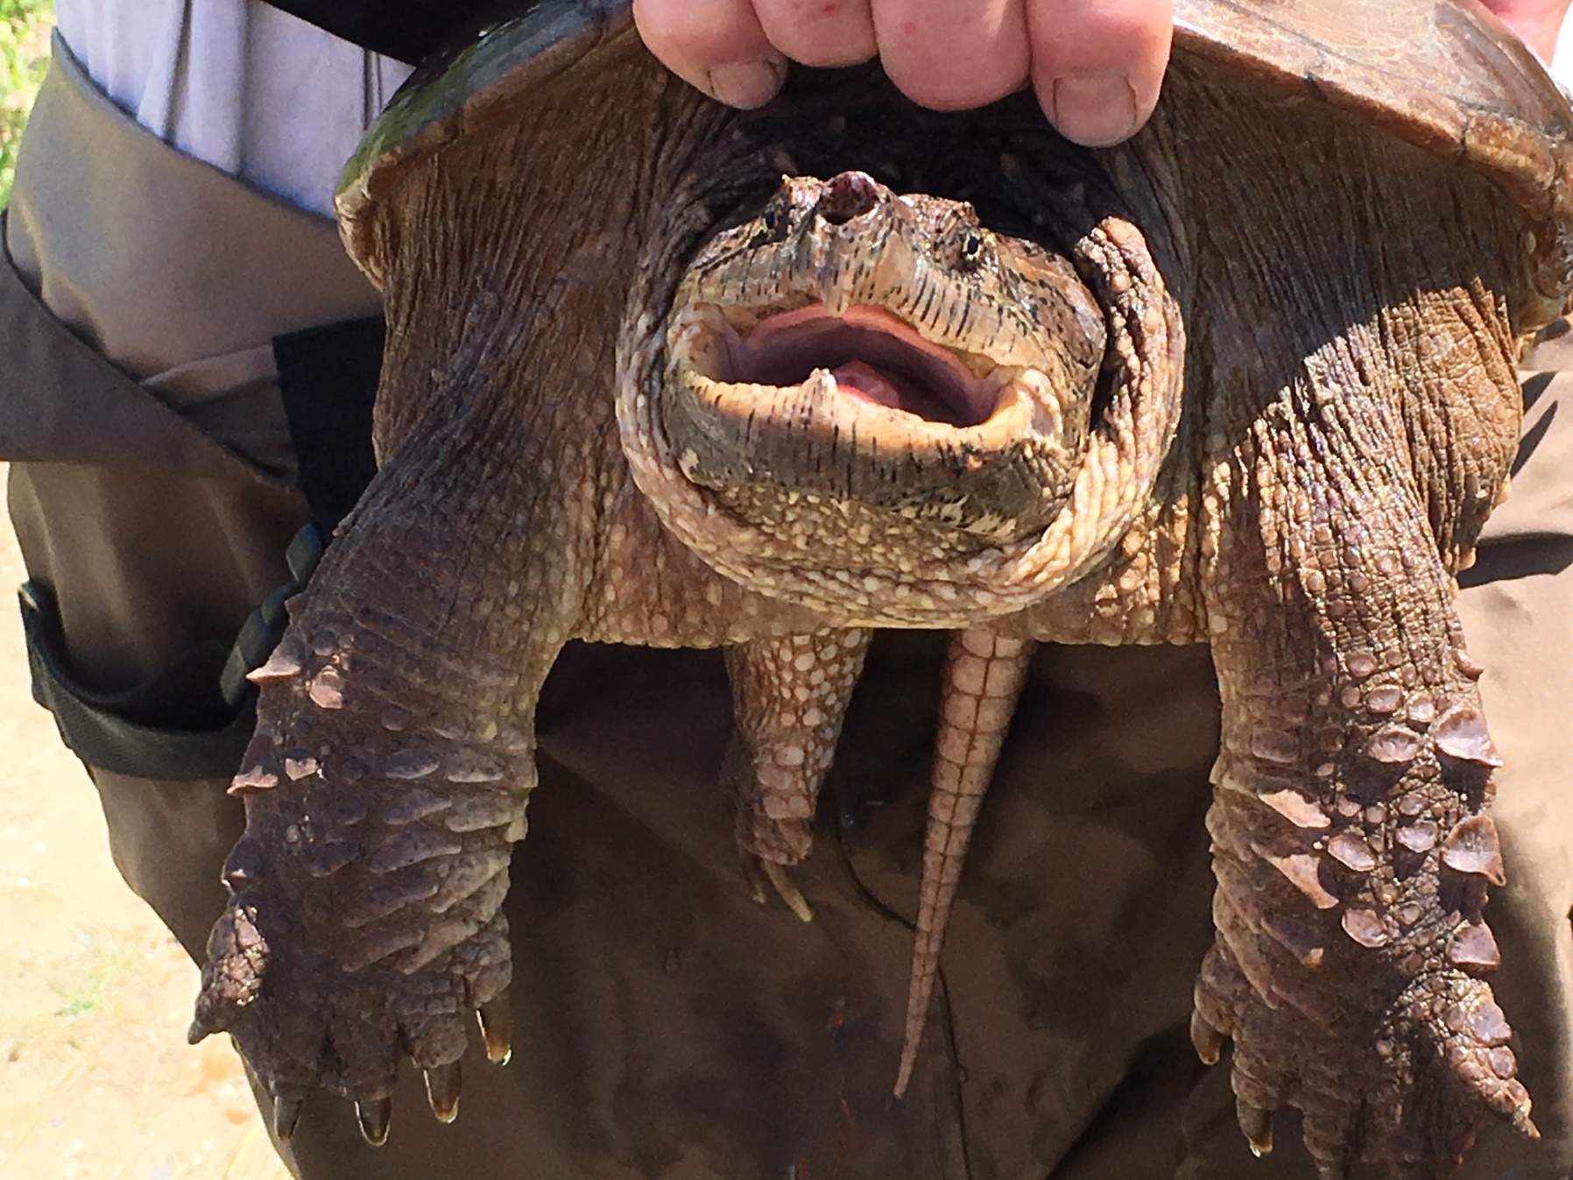
A recent visitor to Masonville Cove Environmental Education Center.

Slide 16
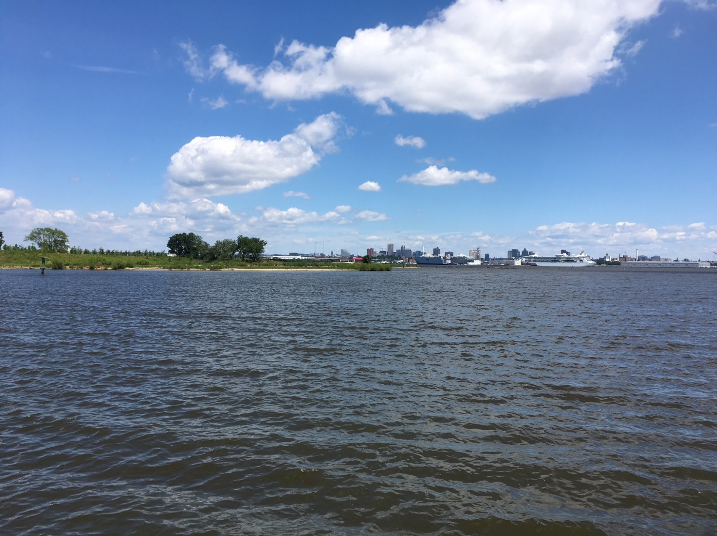
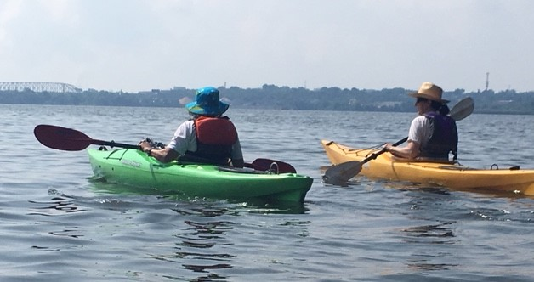
Masonville Cove - A great kayak paddle and full of opportunities to work with Blue Water Baltimore and the National Aquarium.

Slide 17
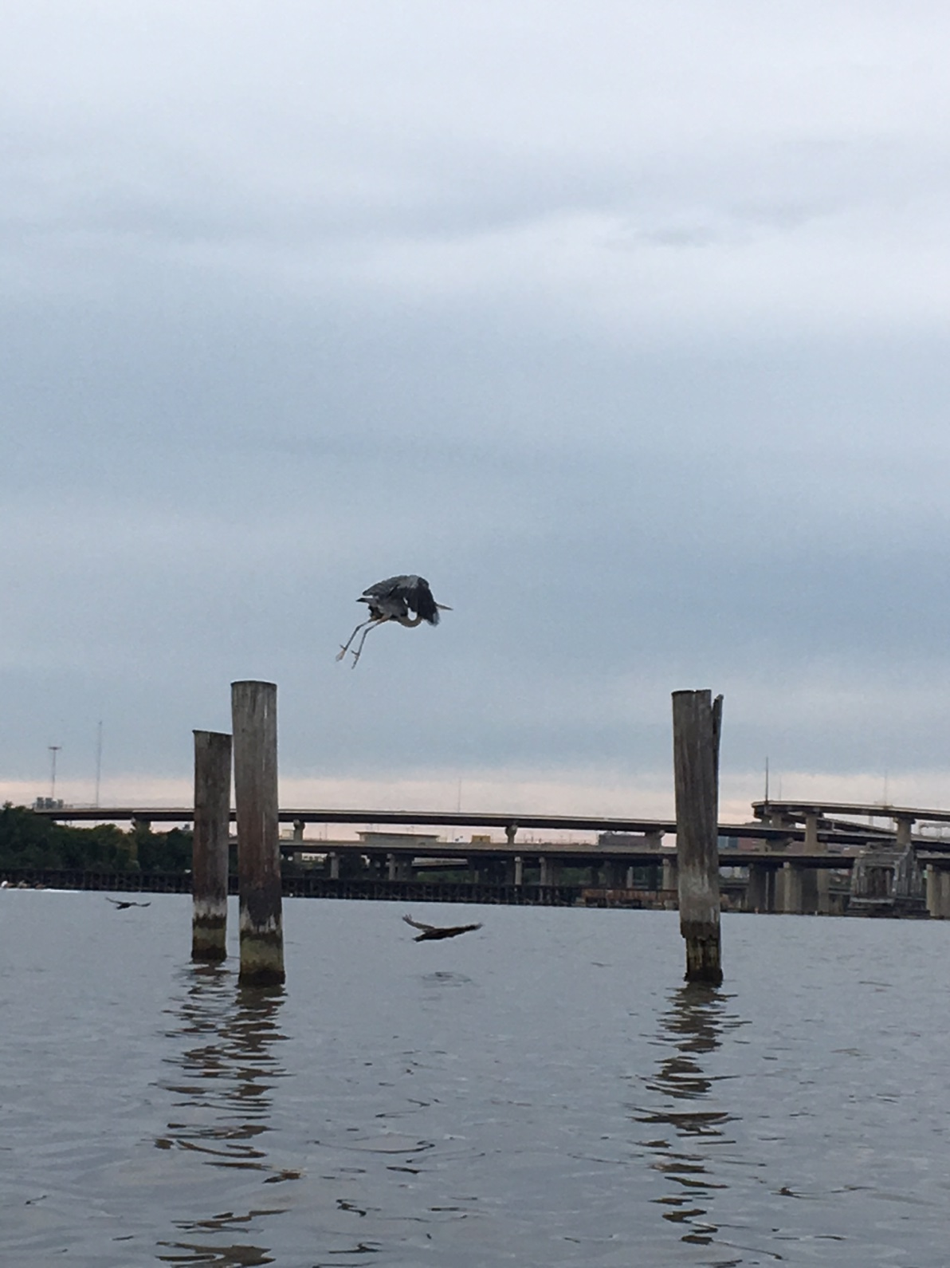
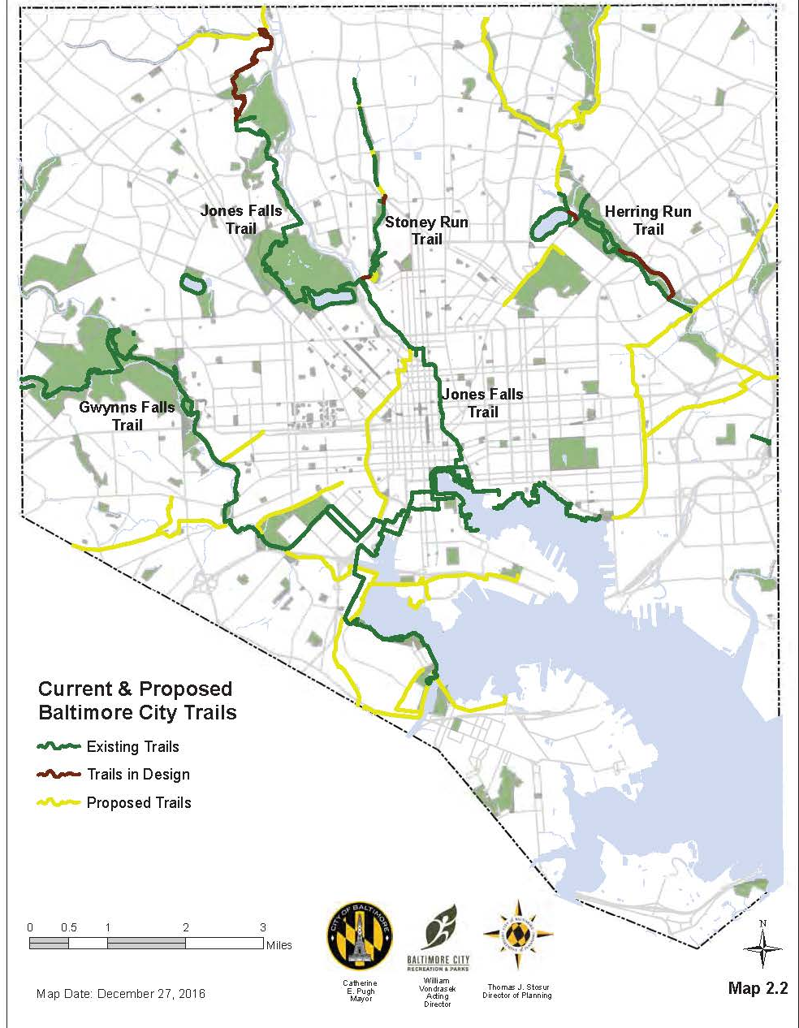
We’re connected to trails throughout the city.

Slide 18
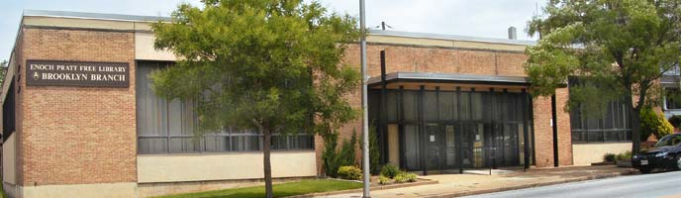
Brooklyn branch Public Library

Slide 19
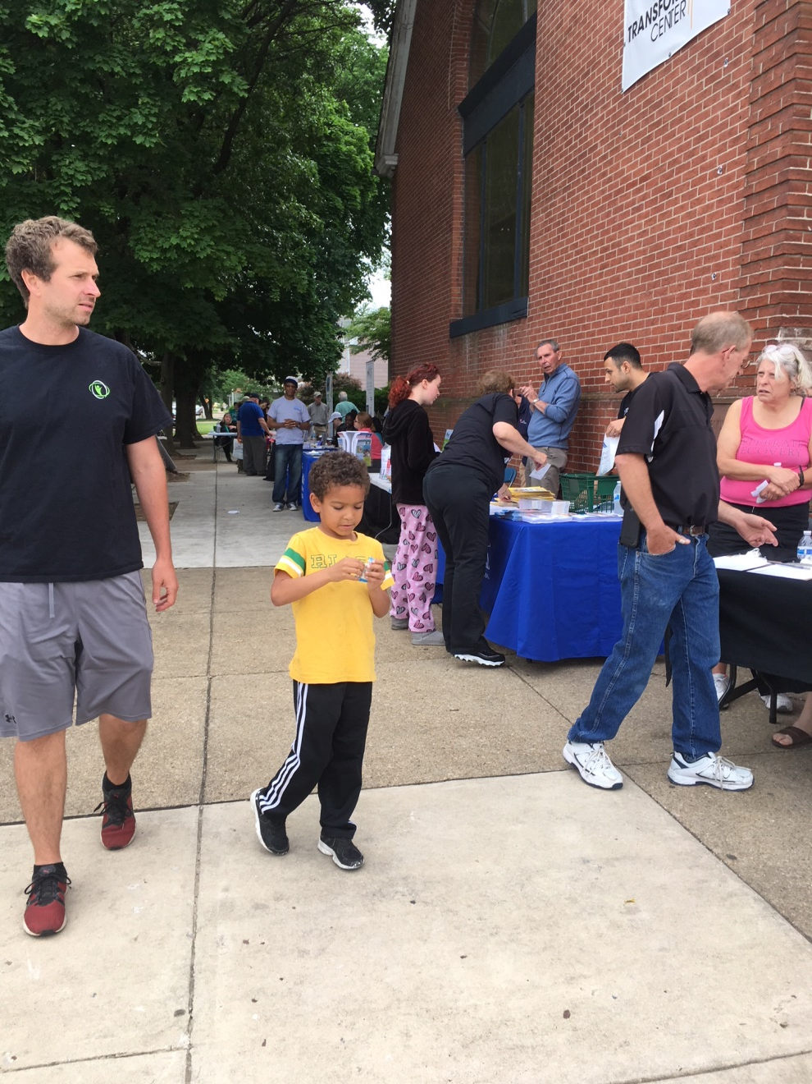
This is who we are…

Slide 20
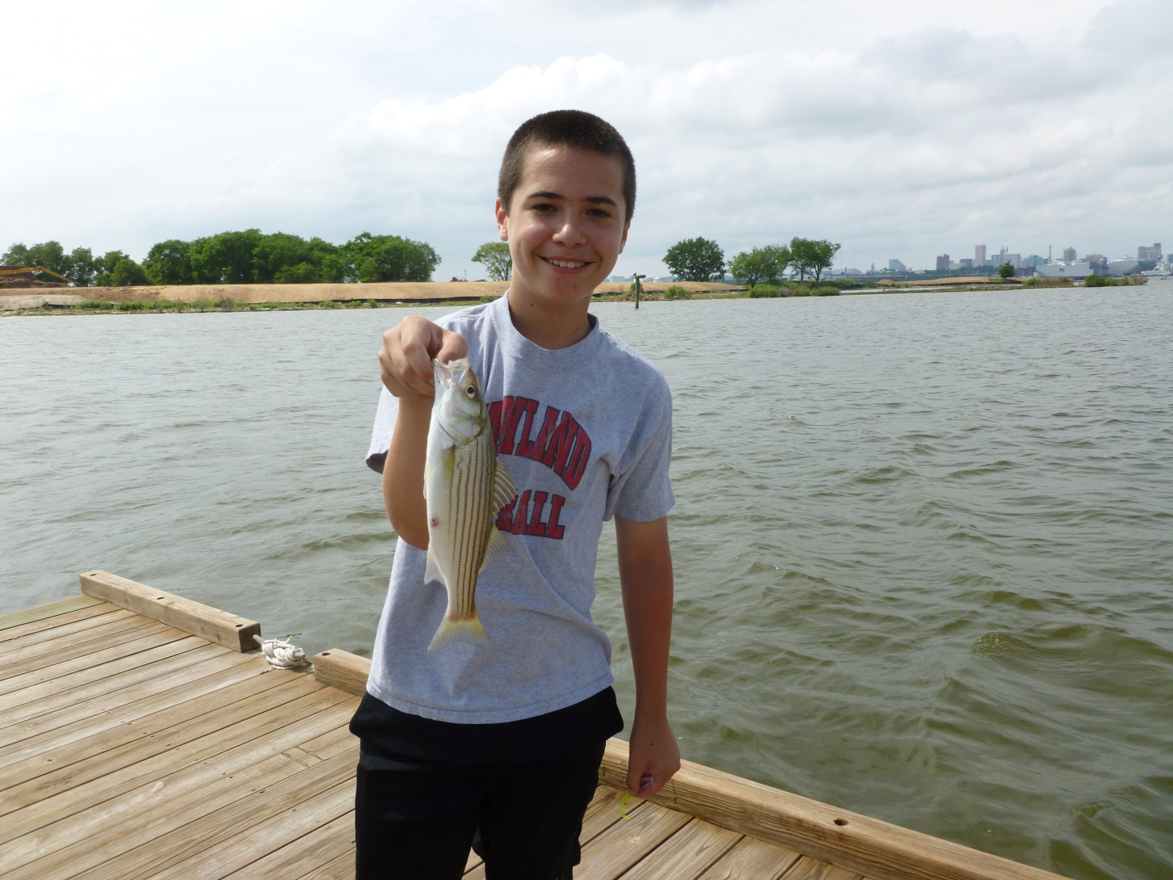
…people who catch fish.

Slide 21
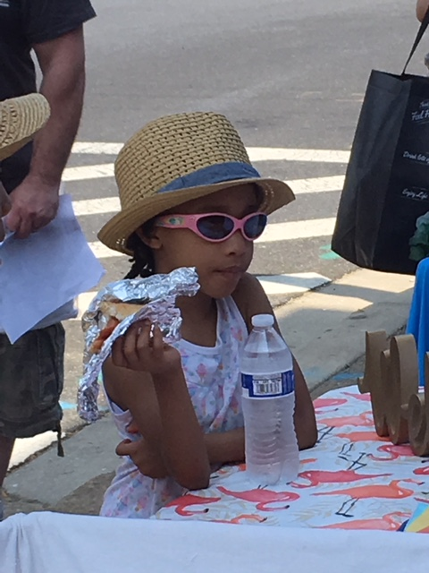
Stylish People

Slide 22
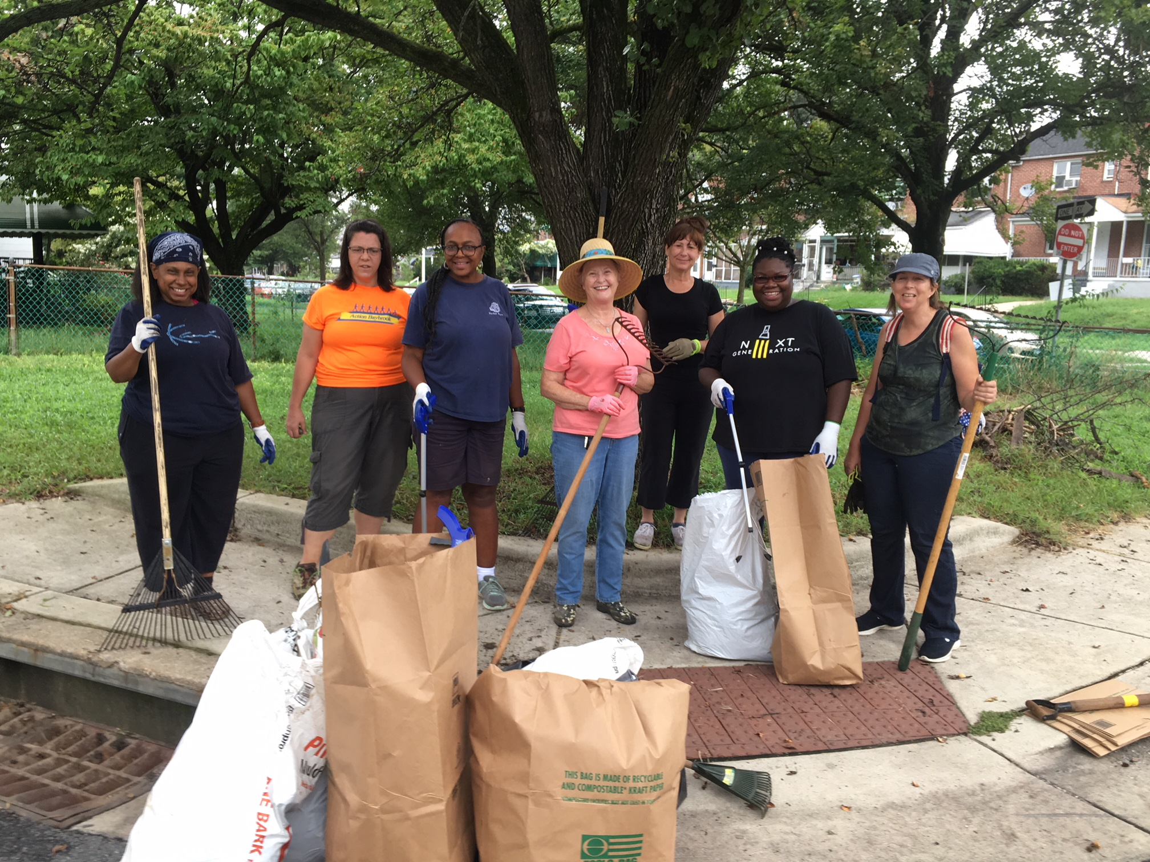
Neighbors working together

Slide 23

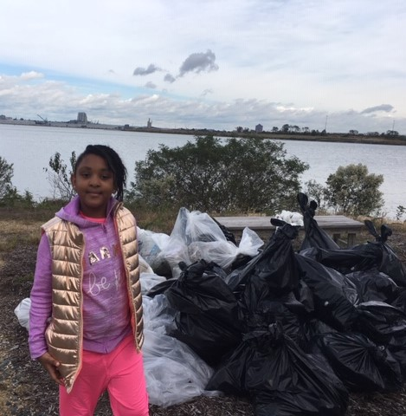

Slide 24
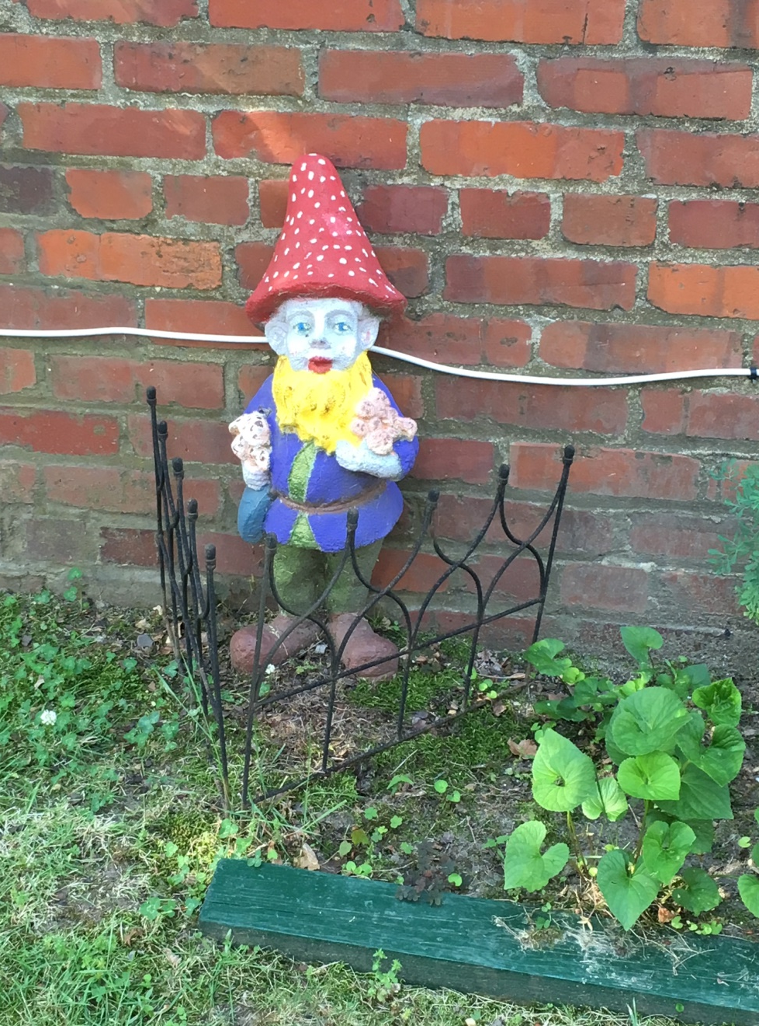
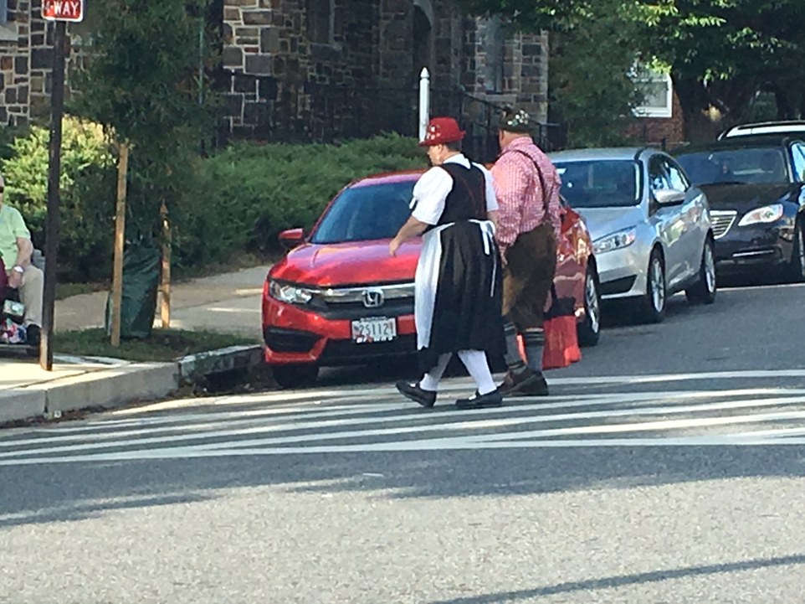
Brooklyn has local characters.

Slide 25
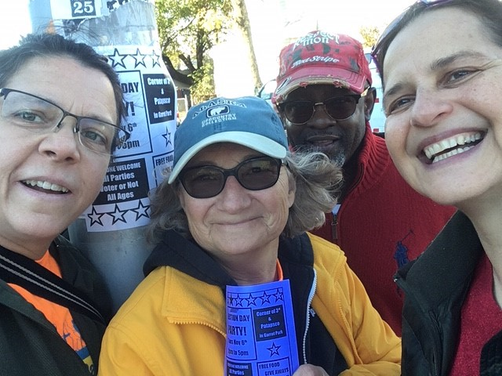
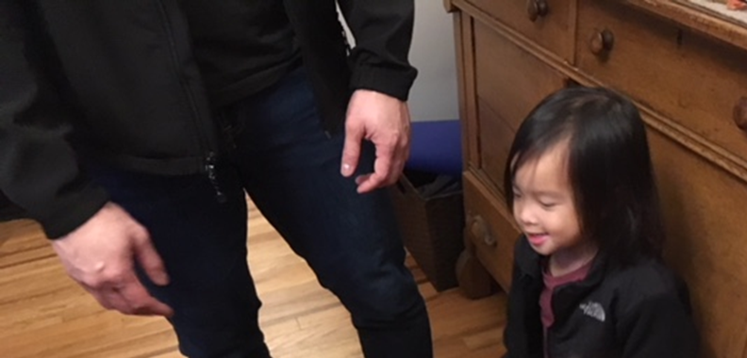
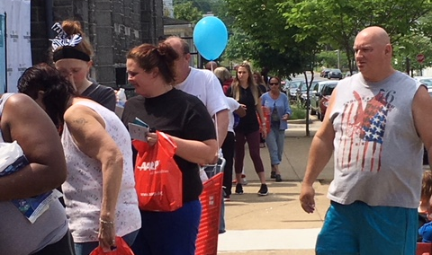
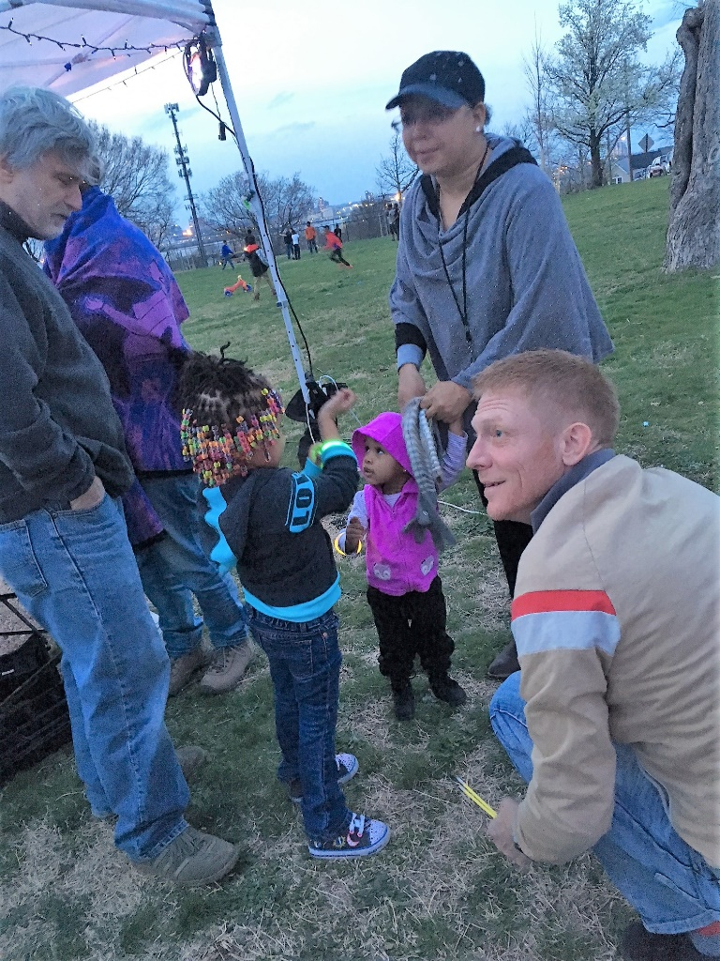
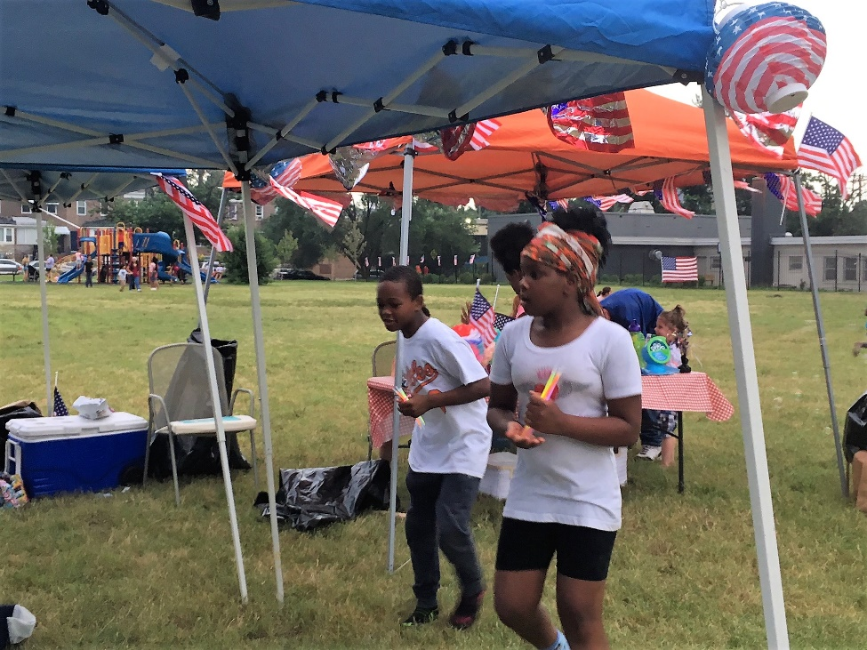
We are
Neighborhood
a
d
i
v
e
r
s
e

Slide 26
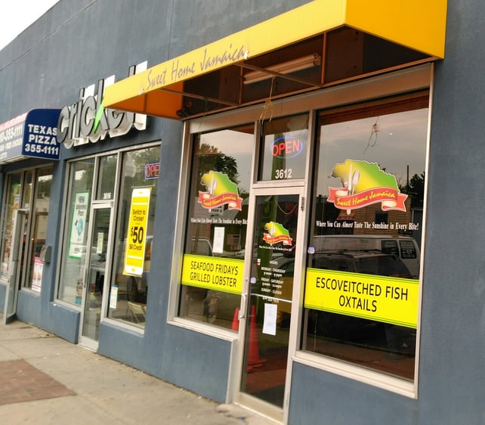
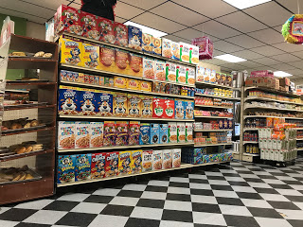
Brooklyn is about
1/3 African American
1/3 Hispanic, 1/3 White
Centro Latino Mercado
Sweet Home Jamaica Restaurant

Slide 27
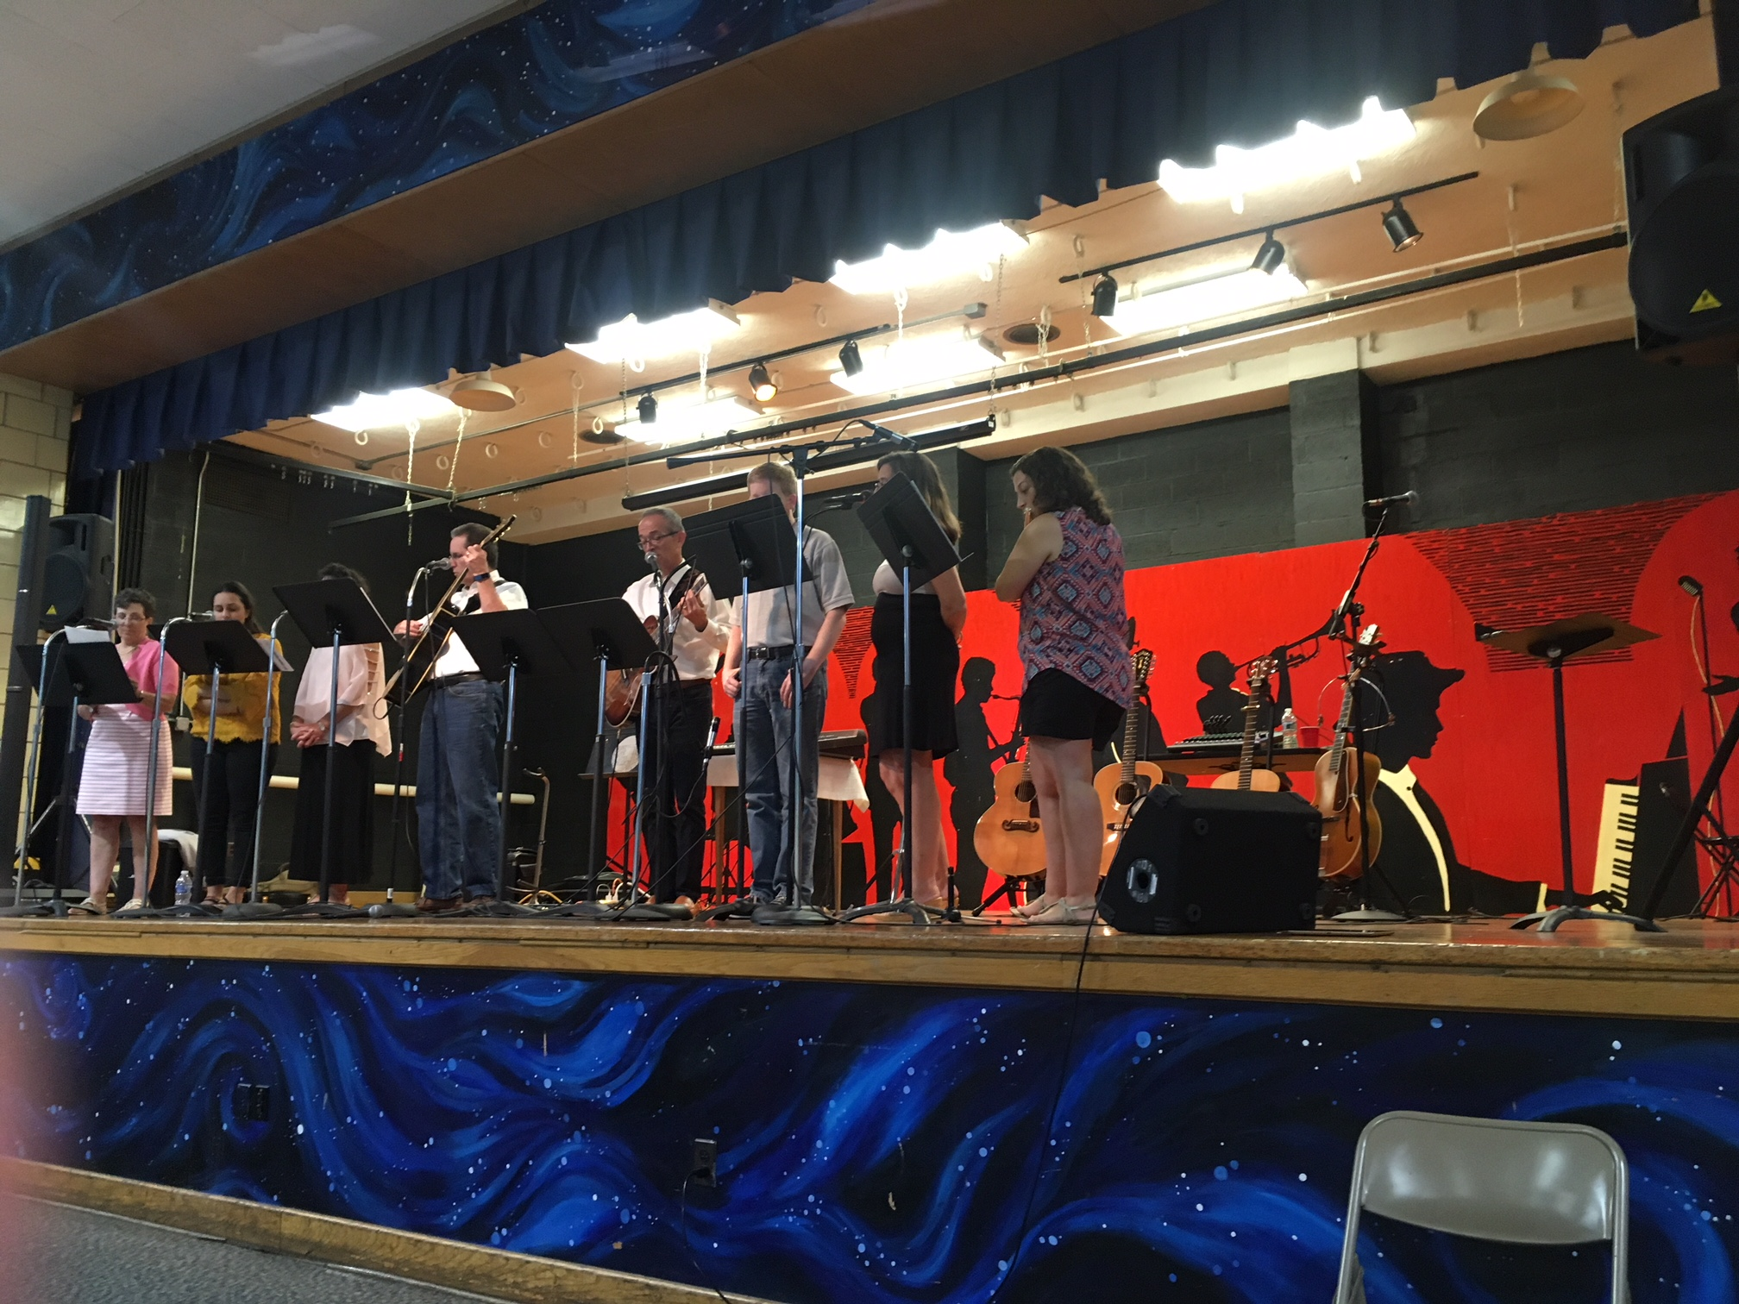
We play together.

Slide 28
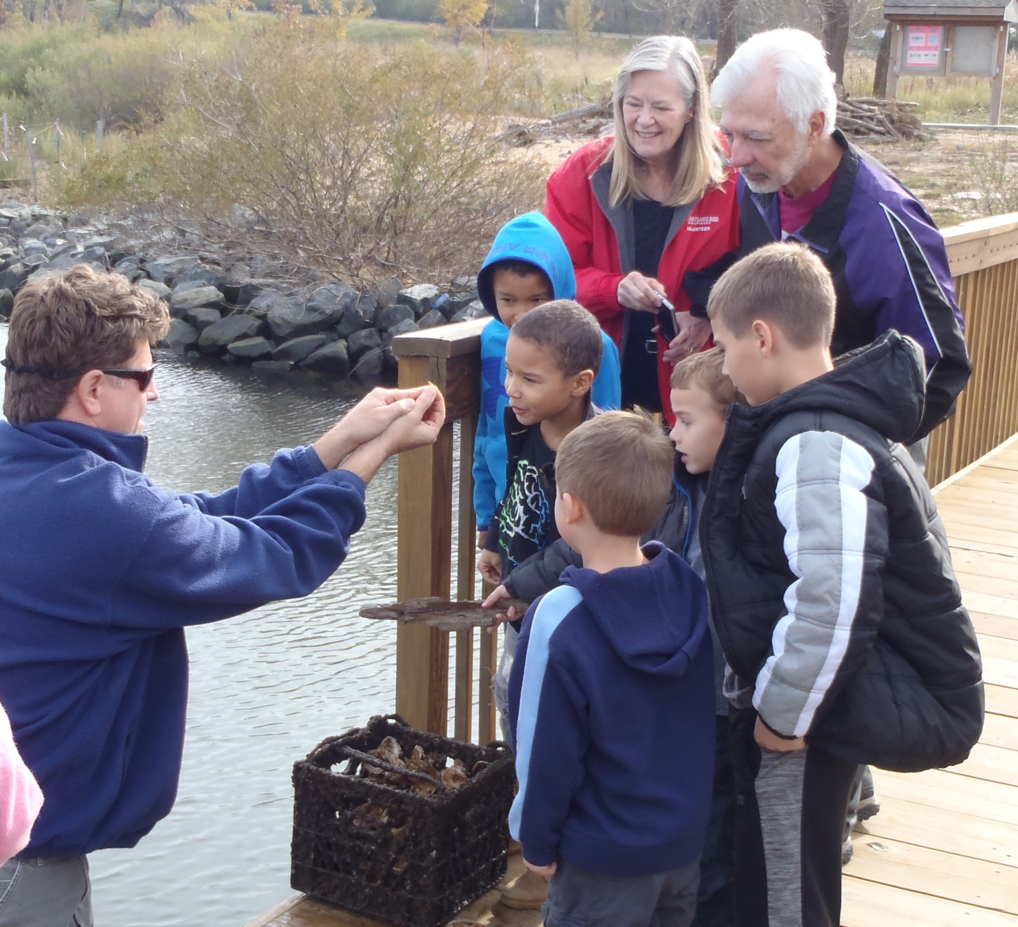
We are water and nature lovers.

Slide 29
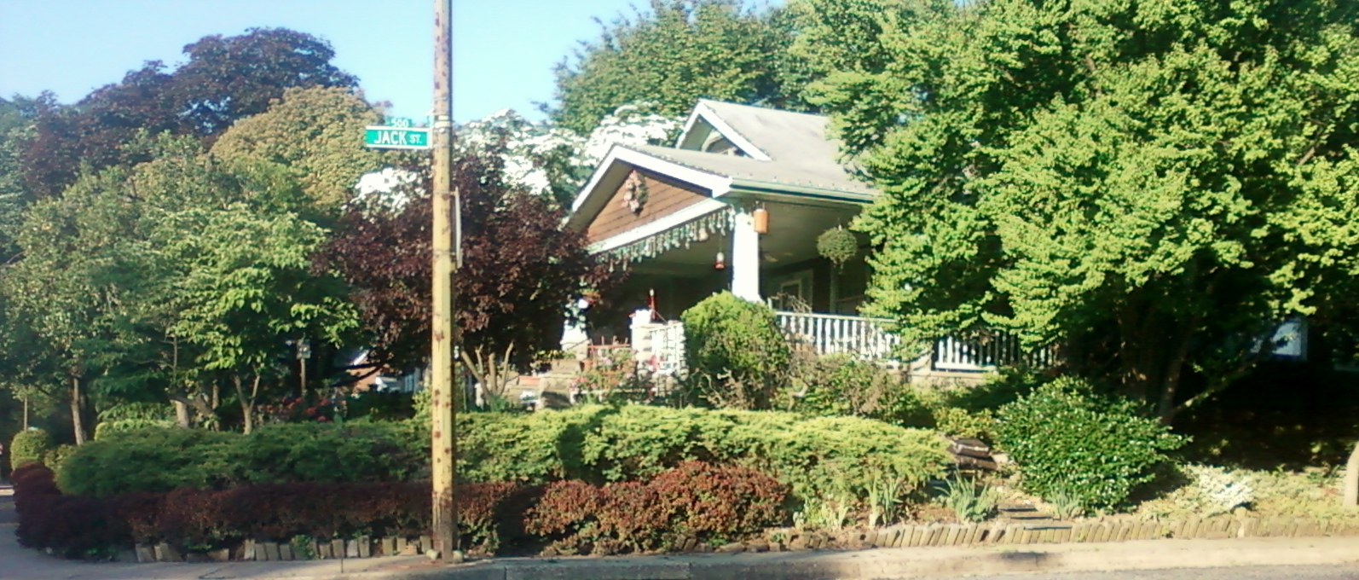
We have a variety of housing.
Single Family Homes...

Slide 30
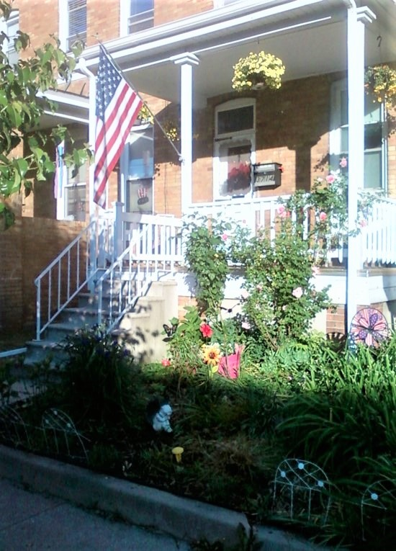
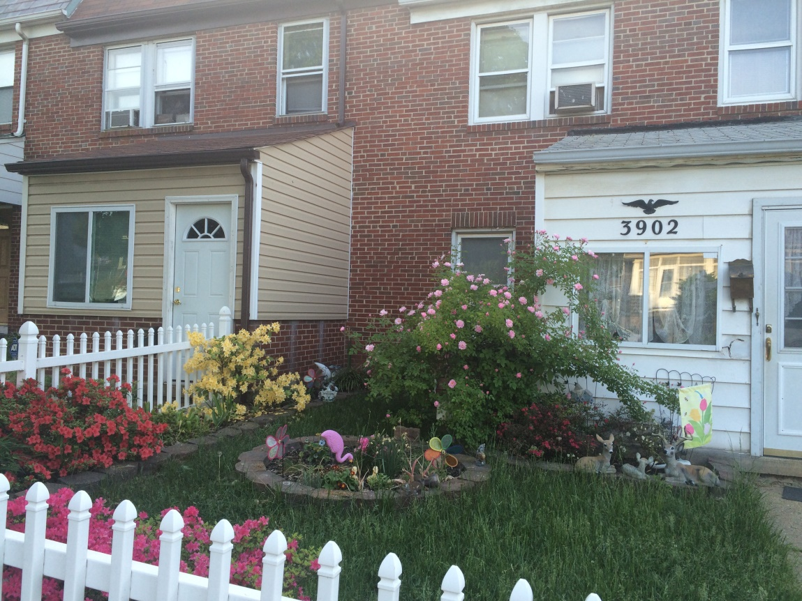
Brooklyn has beautiful rowhouses at affordable prices.

Slide 31
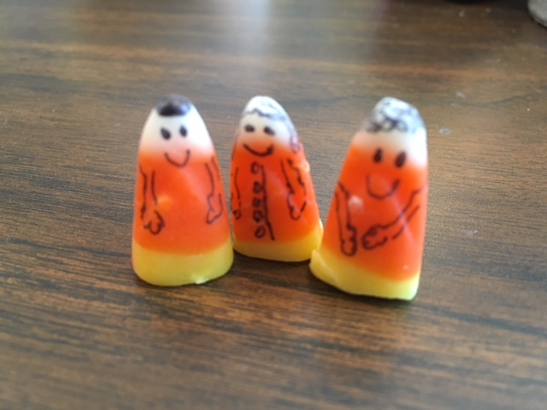
We like holidays in Brooklyn.
Like Halloween.

Slide 32
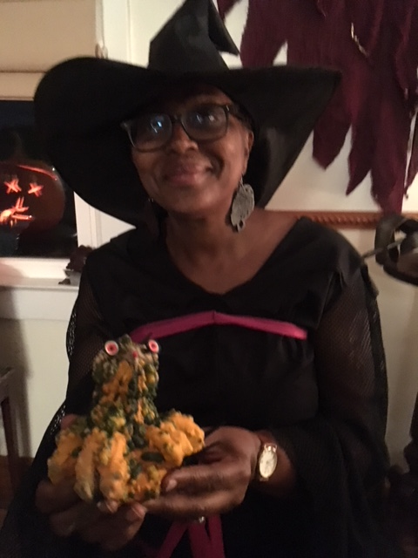
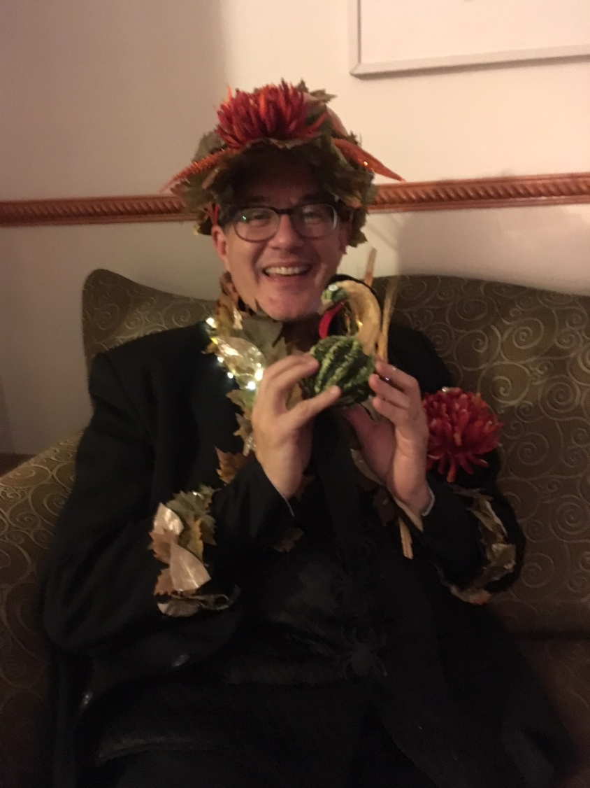

Slide 33
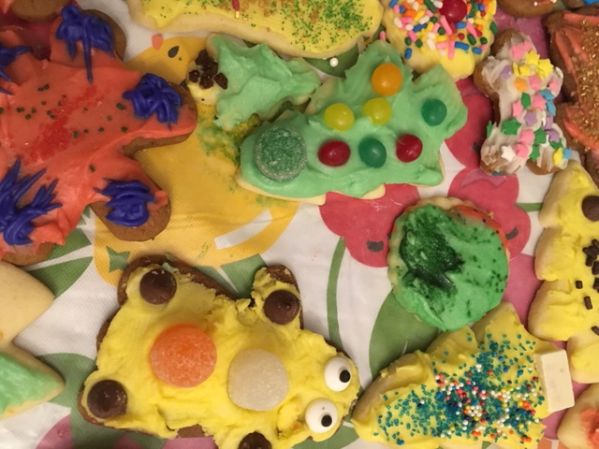
And Christmas.

Slide 34
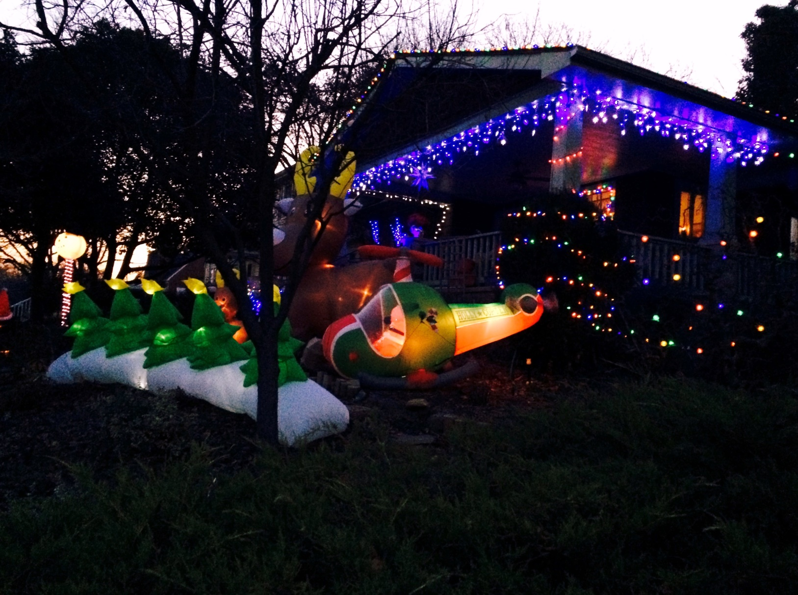

Slide 35
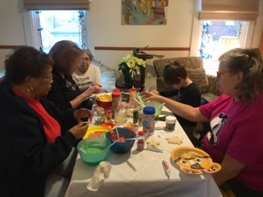
Decorating cookies to take to local senior citizens and nursing homes on Christmas Day.

Slide 36
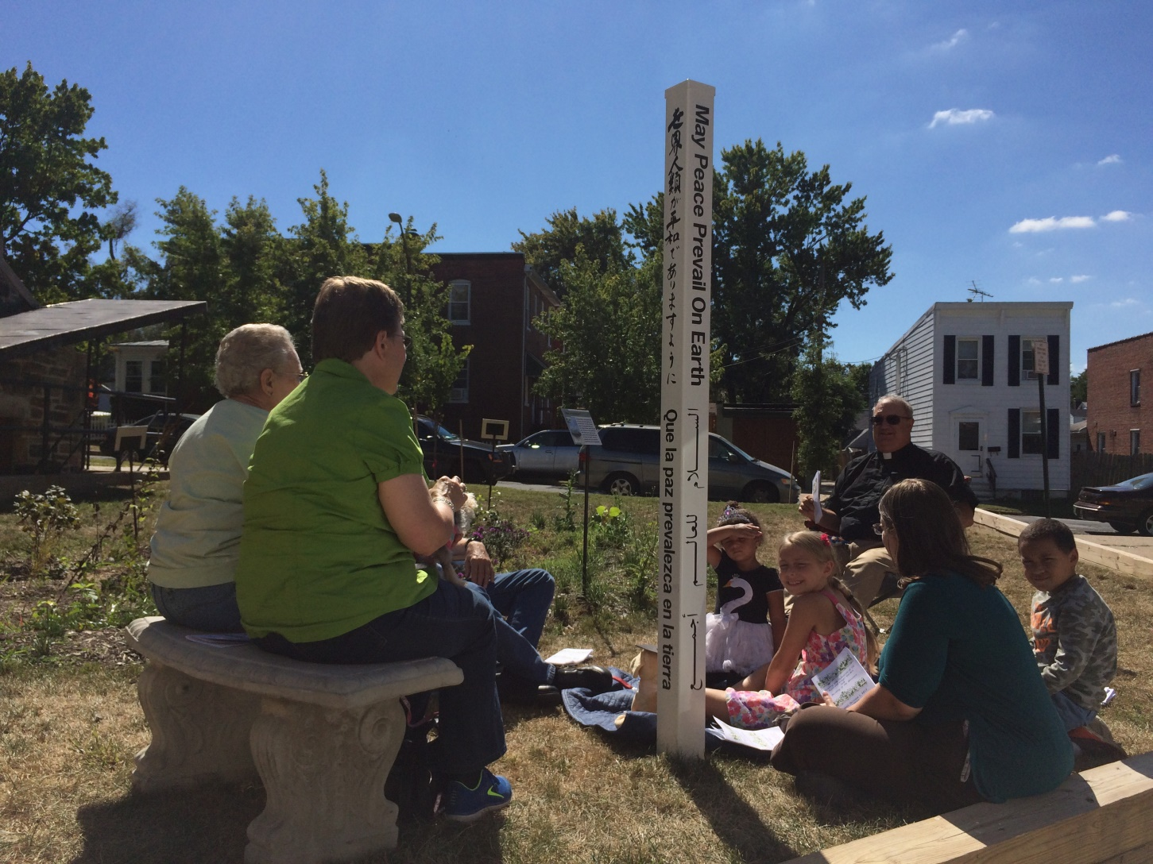
We have a lot going on!

Slide 37
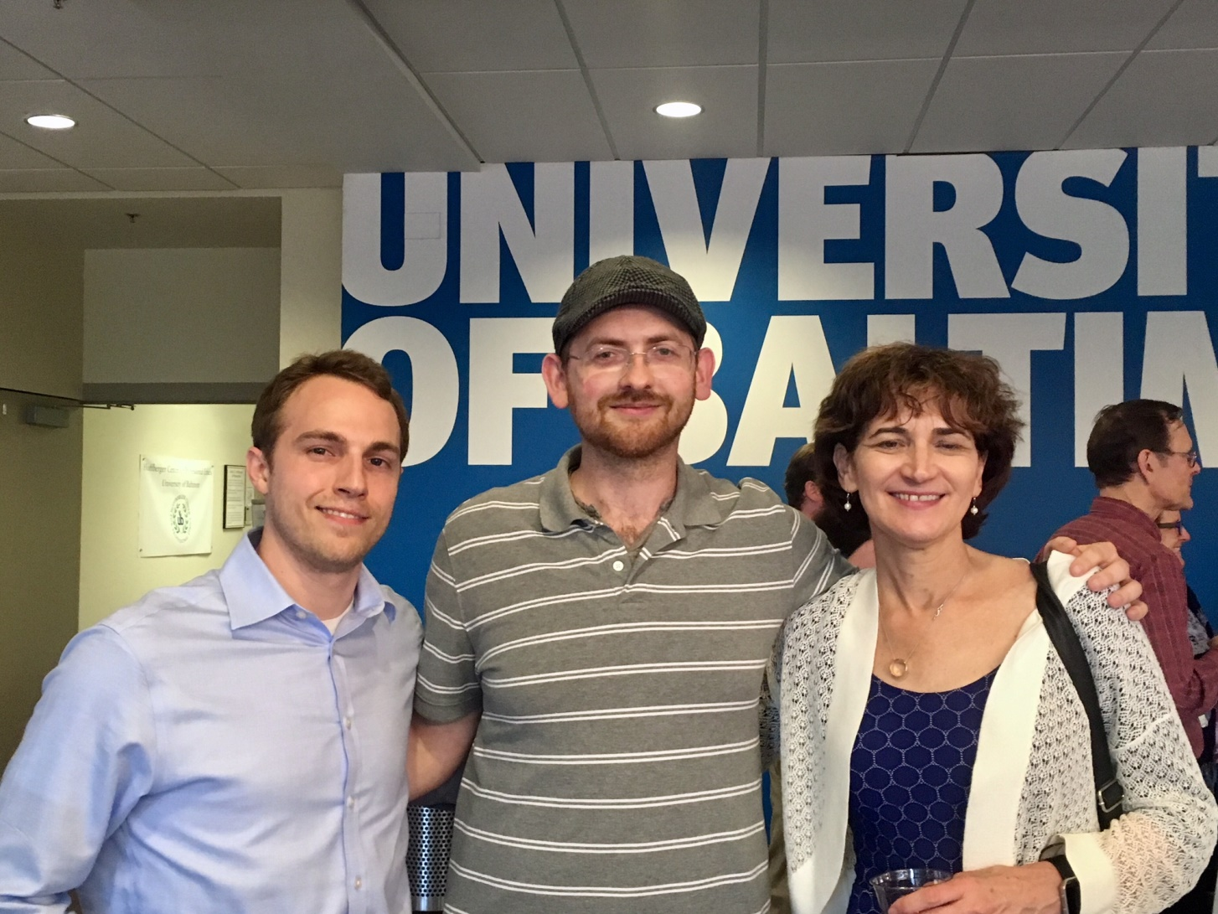
Award winning community planning

Slide 38

Improving the Hanover Street Bridge

Slide 39


Slide 40






Slide 41






Slide 42
Try
Us
Out!
Brooklyn

