Slide 1
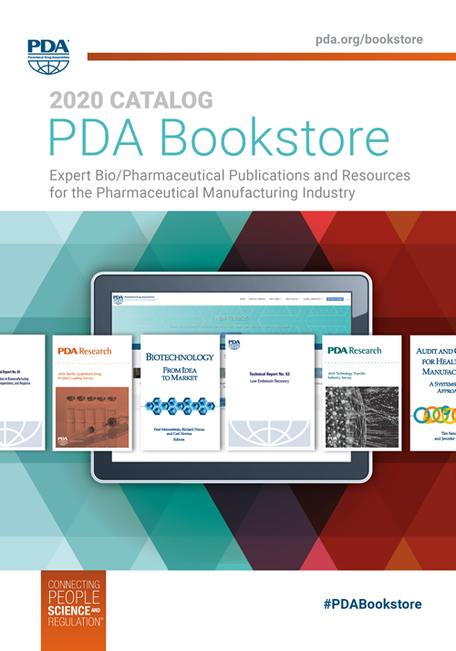
Now Available! 2020 PDA Bookstore Catalog
Explore PDA’s full library of publications, including the technical reports, books and much more!
For more information on all PDA’s expert bio/pharmaceutical publications and resources for the pharmaceutical manufacturing industry, please visit pda.org/bookstore.

