Slide 1
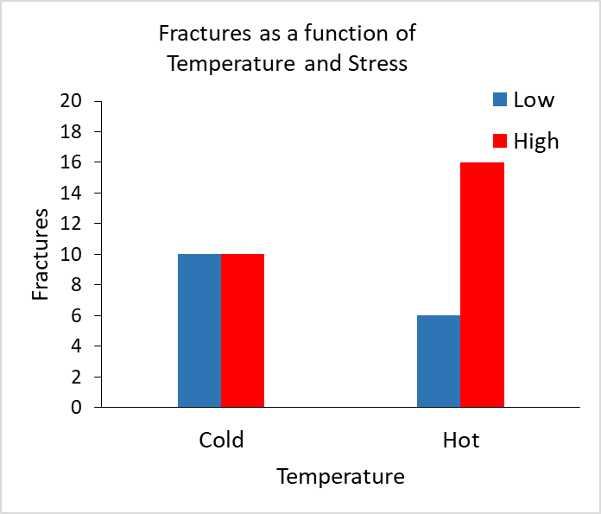
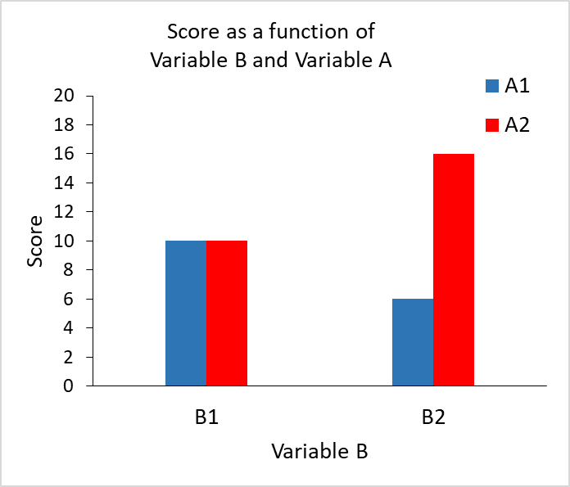
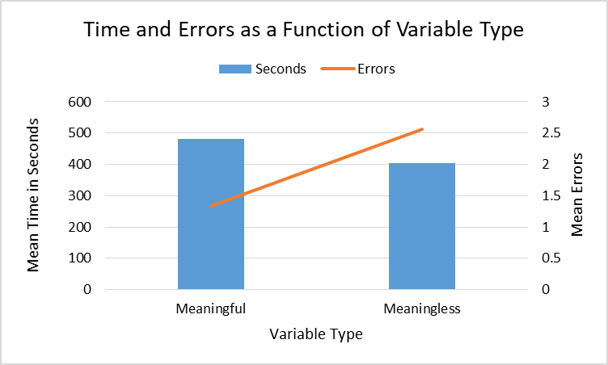
Meaningful Variable Names Facilitate Processing of 2x2 Interaction Graphs
Non-Cognitive Predictors of Student Success: A Predictive Validity Comparison Between Domestic and International Students
Larence Becker, J. Craig Clarke, Thomas J. Tomcho, Victoria Barreira*, Oluchi Dan-Egwu*, Meredith Hannahs*, Pauline Nsimba*, Abby Wiles*
(* = student)
Salisbury University
Sample graph: Meaningful Variable Names
Sample graph
INTRO
This study is an extension of a larger research program from Ali and Peebles’ (2012) on how student’s interpret graphs of two-way interactions. Instead of using their format of open-ended questions we used an original multiple-choice question format to investigate graphs with 2 x 2 interactions with either meaningful or neutral variables. Our goal was to find which graphs were the most efficient in understanding how advanced graphs are interpreted.
METHODS
Participants: N = 32
Used psychology students from the courses General Psychology and Cognitive Psychology
Materials and Procedure:
Students were randomly assigned to either the meaningful variables group or the neutral variables group. They were then asked to observe the respective graphs on a PowerPoint slideshow.
After observing graphs, students were then asked to answer a series of questions on a physical answer sheet. These series of questions were the same for both graphs and the only difference was the use of meaningful or neutral variables.
RESULTS
There was a significant difference between the time to complete the meaningful variable graphs (M = 482.92 sec.) and neutral graphs (M = 402.75 sec, t(28) = 2.56, p <.05). However, participants were more accurate answering the questions for the meaningful variable graphs (M = 1.5 errors out of 24 questions) than the neutral graphs (M = 3.19, t(20) = 2.21, p < .05).
DISCUSSION
The findings lead us to believe that meaningful variables help participants develop a narrative to more accurately understand data presented in a bar graph.
To extrapolate upon the results, we believe an effective application of these findings would be to implement more meaningful variables when teaching students how to comprehend graphs.
Sample graph: Neutral Variable Names
Sample graph
Response times suggest students use variable names to create a context for interpreting graphical information
Notes:
Example adding an image to a poster

