Slide 1
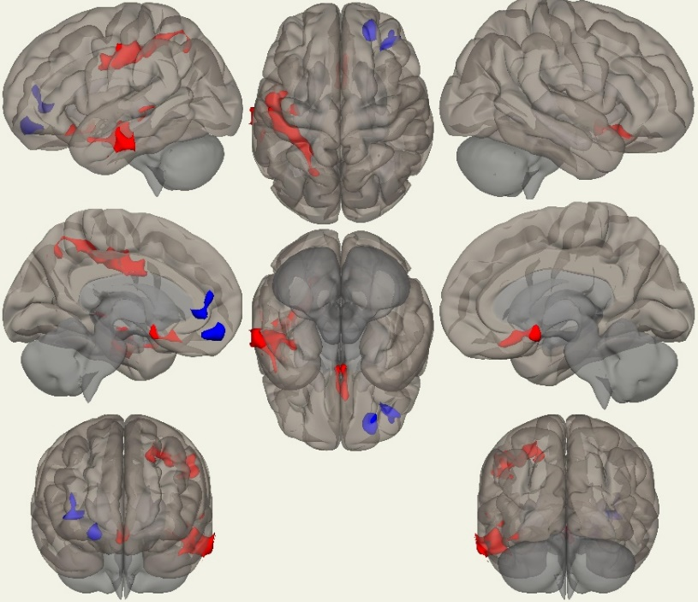
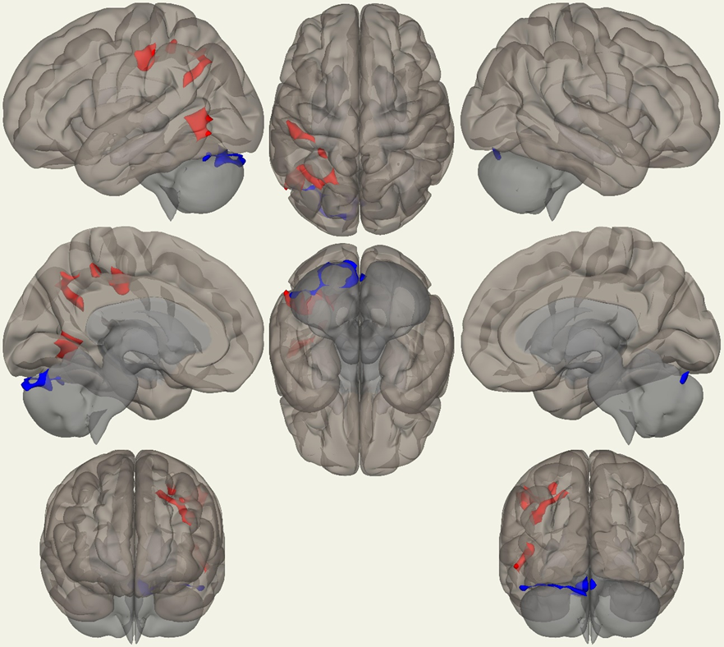
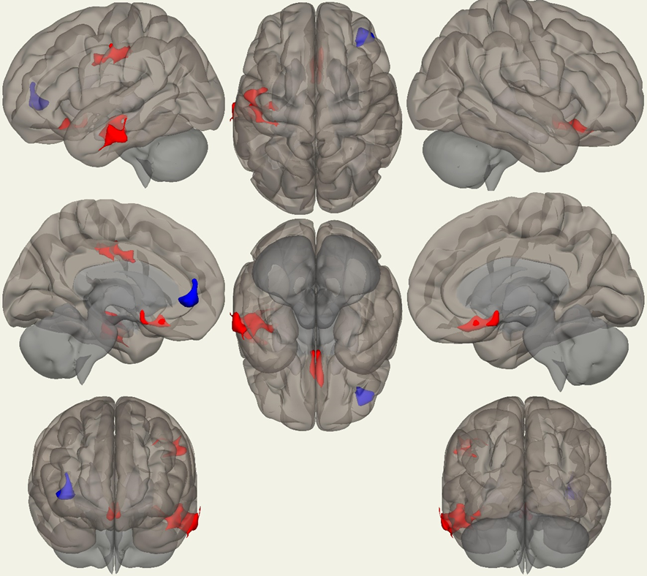
Resting State Functional MRI in Parkinson Disease:
Alterations in Connectivity Based on Cognitive Impairment
B. Hanna-Pladdy, L. Jiang, R. Gullapalli
Diagnostic Radiology & Nuclear Medicine, Center for Advanced Imaging Research, University of Maryland School of Medicine
OBJECTIVES
RESULTS
Disruptions in functional connectivity have been associated with Parkinson disease (PD) in comparison to healthy controls. However, it remains unclear if network alterations are reflective of asymmetric motor features or cognitive aspects of variable disease presentation. To investigate the differential networks affected based on extent of motor versus cognitive features of PD, we evaluated PD patients stratified on extent of cognitive impairment and displaying right or left motor onset disease (LMO, RMO). Patients were compared in resting-state functional connectivity MRI (rs-fcMRI) based on classifications of normal cognition (PD-NC) or mild cognitive impairment (PD-MCI) with involvement in single or multiple domains.
Rs-fcMRI from the left insular cortex
PD-MCI vs PD-NC : increased FC in ipsilateral PreCG, PostCG, SPL, sLOC, aSMG, TP, pSTG, aMTG, pMTG, pITG, Hi; decreased in the contralateral FP.
PD-MCIs vs PD-NC : increased FC in ipsilateral PostCG, SPL, aSMG, sLOC, AG, iLOC, toMTG, and decreased FC in ipsilateral CB crust 1, 2, 6 and vermis 6, 7.
PD-MCIm vs PD-NC : increased FC in ipsilateral PostCG, PreCG, aSMG, pMTG, pITG, aMTG, Hi; decreased FC in contralateral FP.
Rs-fcMRI from the right insular cortex
PD-MCI vs PD-NC : increased FC in the right PostCG, PreCG, SPL, aSMG, aMTG, pMTG, TP and left FP, SFG; decreased in CB 1, 2, 6, 7, 8 and vermis 7, and ipsilateral FP.
PD-MCIs vs PD-NC : increased FC in ipsilateral PreCG, bilateral PostCG, SPL, SMG, and right PH, HI, amygdala; decreased in contralateral CB 1,2, 6, 7, 8 and vermis 7, and right CB 1, 2, 6. PD-MCIm vs PD-NC : increased FC in ipsilateral PH gyrus, HI, and posterior temporal FU.
Fig. A. Seed Insular Cortex - Left FUNCTIONAL CONNECTIVITY RESULTS Fig. B. Seed Insular Cortex – Right
Red: PD-MCI* > PD-NC Blue: PD-MCI* < PD-NC
A
A
A
A
METHODS
SUBJECTS
PD patients (n = 50) ages 57 – 77 years of age
UPDRS III motor scale and Hoehn & Yahr Ratings <3. Patients were classified based on side of motor onset (n _{LMO} = 25; n _{RMO} = 25).
Neuropsychological Assessment classified cognitive profiles.
PD Normal Cognition (PD-NC, n = 15)
PD MCI single domain (PD-MCIs, n = 17)
PD MCI multiple domains (PD-MCIm, n = 18)
FUNCTIONAL CONNECTIVITY
Resting state fMRI data were acquired in a Siemens MRI Prisma 3T Scanner.
Standard procedures for rs-fcMRI data were processed with Conn Tool box (v18)- slice timing, realignment, segmentation, normalization, smoothing, band-pass filtering and denoising.
Group comparisons with the GLM were conducted with significance levels set at a voxel threshold of p-value of 0.008 (uncorrected) and cluster threshold of FDR p-value of 0.05 (corr).
A
A
A
A
PD-NC vs PD-MCI
B
PD-NC vs PD-MCI single
B
PD-NC vs PD-MCI multi
B
B
CONCLUSIONS
B
B
B
B
Seed-based connectivity analyses from bilateral insula revealed bilateral and widespread increased (PD-MCIs > PD-NC) and decreased (PD-MCIs < PD-NC) connectivity in attention and executive networks bilaterally for patients with cognitive decline in a single domain. Patients at higher risk for conversion to dementia displayed bilateral hippocampal-medial temporal lobe network increased connectivity reflective of compensation for abnormal memory function (PD-MCIm > PD-NC). These findings support differential network connectivity changes reflective of clinical features of the disease, and suggest that network changes have potential to predict variable patterns of disease progression and risk of conversion to dementia.
Table 1. Voxel Size, Sig. R01 | (x, y, z) | Voxel Size | p FDR | PreCG | PostCG | FP | SFG | AG | SMG | SPL | STG | MTG | ITG | TP | LOC | PH | HI | CB | FU | AMG
Left Insular Seed
PD-NC vs PD-MCI increase | (-30, -40, +48) | 1161 | < 0.0001 | 221 (L) | 422 (L) |  |  |  | 46 (L) | 126 (L) |  |  |  |  | 100 (L)
 | (-52, -14, 22) | 1019 | < 0.0001 |  |  |  |  |  |  |  | 20 (L) | 367 (L) | 176 (L) | 33 (L) |  |  | 20 (L) |  | 17 (L)
decrease | (+26, +50, -14) | 270 | 0.037 |  |  | 236 (R)
 | (+38, +36, -02) | 250 | 0.041 |  |  | 148 (R)
PD-NC vs PD-MCIs increase | (-46, -28, +44) | 407 | 0.0097 |  | 229 (L) |  |  |  | 44 (L) | 45 (L)
 | (-38, -54, +32) | 333 | 0.0097 |  |  |  |  | 52 (L) |  |  |  |  |  |  | 143 (L)
 | (-46,-62, +02) | 285 | 0.0169 |  |  |  |  |  |  |  |  | 29 (L) | 25 (L) |  | 139 (L)
decrease | (-04, -76, -24) | 463 | 0.0036 |  |  |  |  |  |  |  |  |  |  |  |  |  |  | 370 (L)
PD-NC vs PD-MCIm increase | (-04, -76, -24) | 463 | 0.00356 |  |  |  |  |  |  |  |  | 312(L) | 169(L) |  |  |  | 12 (L) |  | 14 (L)
 | (-46, -28, +44) | 407 | 0.00428 | 167(L) | 192(L) |  |  |  | 13 (L)
decrease | (-46, -62, +02) | 285 | 0.0169 |  |  | 235 ( R )
PD-NC vs PD-MCIs increase | (-46, -28, +44) | 407 | 0.0097 |  | 229 (L) |  |  |  | 44 (L) | 45 (L)
 | (-38, -54, +32) | 333 | 0.0097 |  |  |  |  | 52 (L) |  |  |  |  |  |  | 143 (L)
Right Insular Seed
iPD-NC vs PD-MCI increase | (46, -20, +40) | 467 | 0.0029 |  | 233 (R) |  |  |  | 15 (R) | 111 (R)
 | (-18, +42, +52) | 261 | 0.035 |  |  | 108 (L) | 87 (L) |  |  |  |  | 48 (R)
 | (64, +04, -24) | 231 | 0.049 |  |  |  |  |  |  |  |  | 146 (R)
decrease | (-38, -64, -42) | 986 | < 0.0001 |  |  |  |  |  |  |  |  |  |  |  |  |  |  | 867 (L) | 80 (L)
 | (+22, +50, -16) | 265 | 0.036 |  |  | 232 (R)
PD-NC vs PD-MCIs increase | (-30, -42, +48) | 694 | < 0.0001 |  | 359(L) |  |  |  | 92(L) | 89(L)
 | (+30, -34, +46) | 678 | < 0.0001 | 191 (R ) | 272 (R) |  |  |  | 18 (R) | 81 (R) |  |  |  |  |  |  | 54 (R)
 | (+20, -02, -24) | 368 | 0.00495 |  |  |  |  |  |  |  |  |  |  |  |  | 167 (R) |  |  |  | 56 (R)
decrease | (-06, -76, -26) | 1461 | < 0.0001 |  |  |  |  |  |  |  |  |  |  |  |  |  | 1048 (L) | 229( R) | Ver (54)
PD-NC vs PD-MCIm increase | (+20, -10, -26) | 335 | 0.0396
ROIs with SIGNIFICANCE
PreCG PreCentral Gyrus STG Superior Temporal Gyrus CB Cerebellum
PostCG PostCentral Gyrus MTG Middle Temporal Gyrus FU Fusiform
FP Frontal Pole ITG Inferior Temporal Gyrus IC Insular Cortex
SFG Superior Frontal Gyrus TP Temporal Pole AMG Amygdala
AG Angular Gyrus LOC Lateral Occipital Cortex I / s Inferior / Superior
SMG Supramarginal Gyrus PH ` Parahippocampus R / L Right / Left
SPL Superior Parietal Lobule HI Hippocampus a / p Anterior / Posterior
FUNDING SUPPORT: NINDS/ NIA R01 1NS098249

