Slide 1
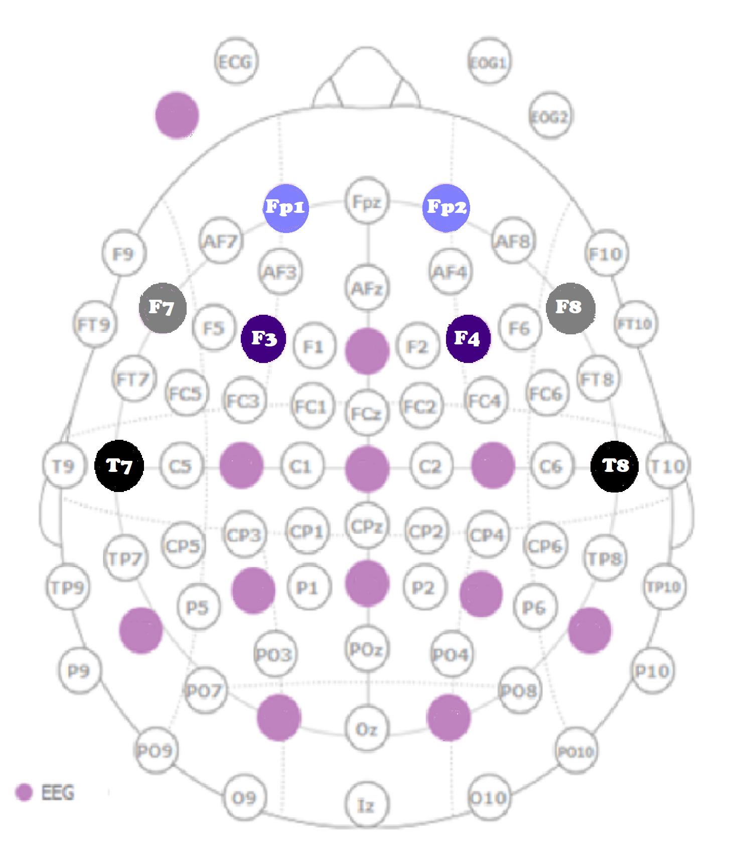
An EEG Study of Aphasia Recovery in Bilinguals
Alexis Medeiros, Meredith Adams, Michaela Ta, & Jenn Segawa
Stonehill College, Department of Neuroscience
Background
Monolingual Case Study
PWA:
56 years old
Broca's Aphasia
Ischemia Stroke –2 years post stroke
Monolingual
Highest Level of Education: Master's
Healthy Control:
51 years old
Monolingual
Highest Level of Education: Master's
Results
Methods Cont.
Stroke is the fourth leading cause of death and the leading cause of long-term disability in the United States.
Aphasia is a communication disability that often can occur as the result of a stroke. Aphasia is characterized as the loss of ability to express or understand speech. 25% of stroke survivors experience aphasia (PWA).
Past Research: has shown that healthy bilinguals have increased cerebral connectivity, particularly between the left and right hemispheres, which is thought to be due to the increased executive function of language required to speak multiple languages. In addition, these regions and their connectivity appear to play an important role in recovery of language of language processes lost due to stroke-induced aphasia.
Behavioral Testing
Edinburgh Handiness Inventory, Self Assessment of Language Proficiency, Digit Span Short Term Memory and Bilingual Aphasia Test
Tasks
Resting Task: (5 runs)
2 minutes of silence with the presence of a white cross
Passive Task: (4 runs)
3 minutes of 15 words that are in either English or a second language (Spanish, Tamil, or Russian)
Words presented for 0.5 seconds with a 1.0 second break successive word
English and second language versions of the words had the same number of syllables but were not cognates.
PWA
Power: Gamma (30-45Hz)
Control
Hypothesis
We expect that PWA will have similar power across hemispheres compared to healthy controls. This effect will be more pronounced for bilingual PWA.
nj
Discussion
In the PWA participant, there gamma power was more similar across hemispheres than for the matched healthy control. Past literature suggests that this may be due to R hemisphere was compensating for the L hemisphere during the resting state. Interestingly, electrodes F7 and F8 – approximately over Broca’s area – showed the largest discrepancy for the healthy control compared to the PWA.
We will continue to analyze our data, particularly for the bilingual participants.
Methods
6 PWA and 6 healthy controls matched for age, gender, language experience and education level. Half of the participants were monolinguals, half has experience with a second language.
Subject | Age | Education | Gender | Language | Aphasia
SCAS014 | 50 | JD | Male | English/Russian | Yes
Control | 43 | PhD | Male | English/Chinese | No
SCAS017 | 67 | Masters | Male | English | Yes
Control | 72 | Bachelors | Male | English | No
SCAS015 | 33 | Bachelors | Male | English/Dutch | Yes
Control | 35 | Bachelors | Male | English/Dutch | No
SCAS019 | 60 | High School | Female | English | Yes
Control | 55 | High School | Female | English | No
SCAS020 | 52 | Bachelors | Female | English/Tamil | Yes
Control | 45 | PhD | Female | English/French | No
SCAS007 | 65 | Masters | Female | English | Yes
Control | 53 | Masters | Female | English | No
nj
Acknowledgements
Thank you to NSF (Award #’s: 1643763) and Stonehill College for funding this work.
Notes:
Add the length of the words, timing between words and trials of words

