Slide 1
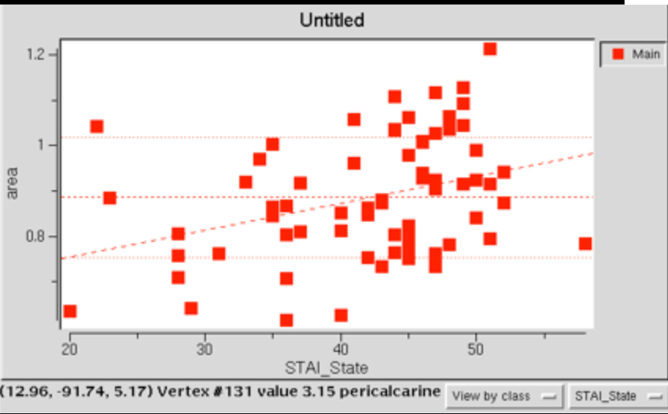
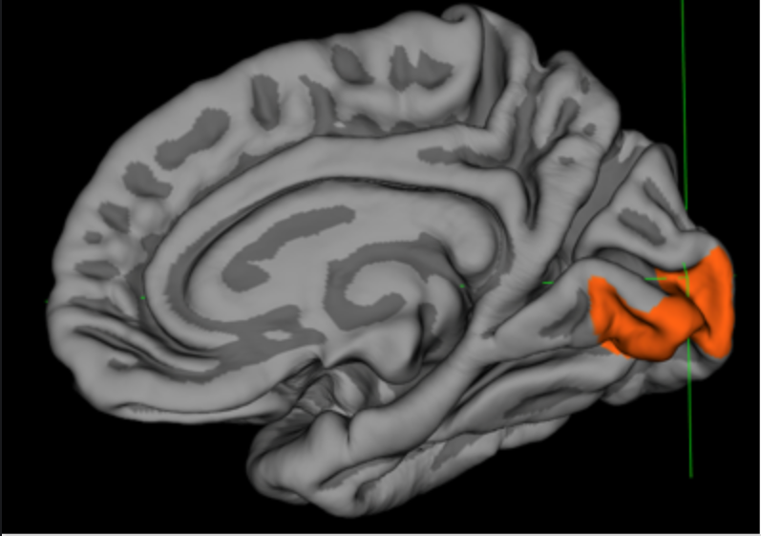
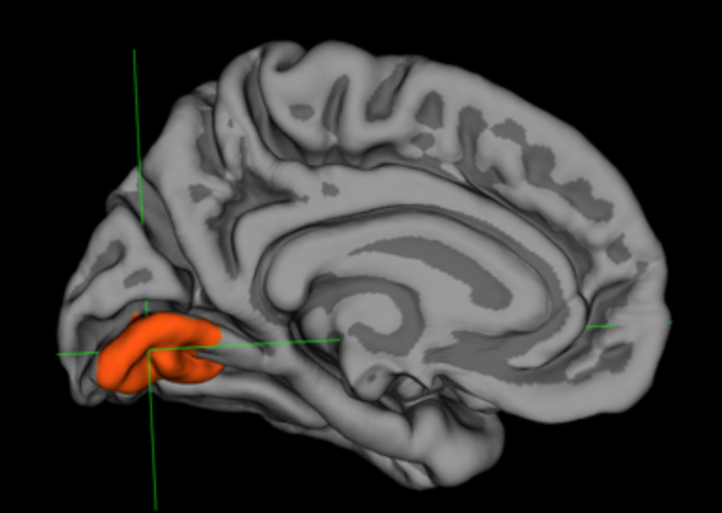
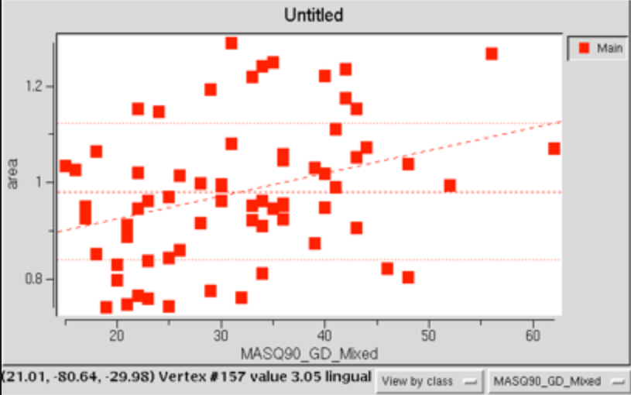
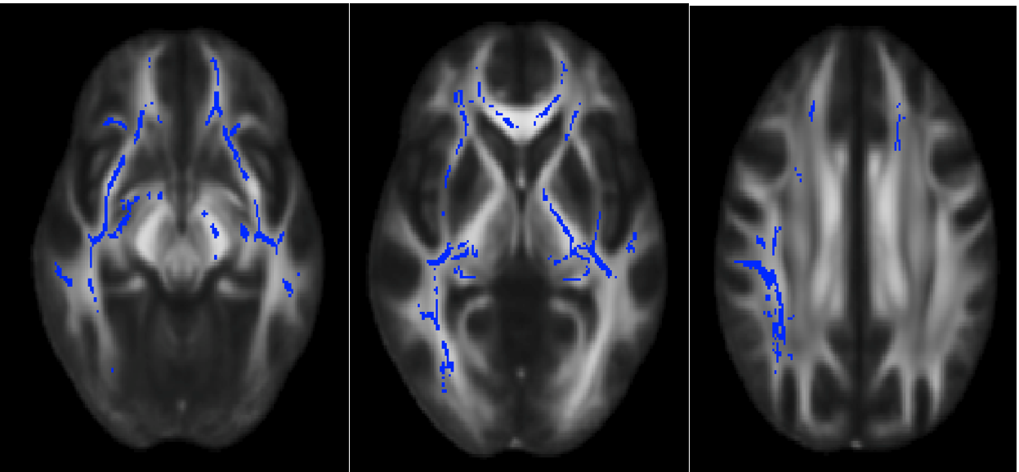
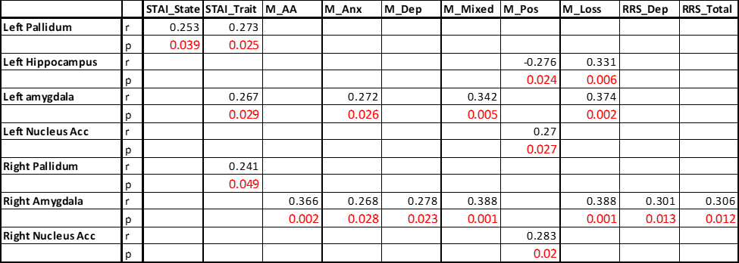
Individual Differences in Anxious Temperament relate to Differences in Brain Morphometrics
Kane, J.M., Schagene, J.D. & Depue, B.E..^{1,2} ¹University of Louisville Department of Psychological and Brain Sciences ²University of Louisville Department of Anatomical Sciences and Neurobiology
Background
Cortical Morphometric Results
White Matter Results
Anxiety disorders constitute the most prevalent subgroup of mental disorders in most western societies, with an estimated lifetime incidence of 33.7% in the US. Anxiety can be defined as a prolonged state of apprehension elicited by unpredictable threats, or threats that are spatially or temporally distant. It is characterized by tension, worry, and physical changes such as increased blood pressure.
Due to the high prevalence of these conditions in society, it becomes important to elucidate the brain basis of anxiety and its neural circuitries.
Figures 1 & 2: STAI_State scores and MASQ90_GD_Mixed scores exhibited positive correlation with surface area in the right pericalcarine cortex and the left lingual cortex, respectively.
Objective
Increased scores for the STAI_State scale correlated with increased surface area of the pericalcarine cortex in the right hemisphere (p < 0.0002) (Figure 1). In other words, increase state-level anxiety led to increased surface area in the right pericalcarine cortex. Furthermore, increased scores for the MASQ90_GD_Mixed (general distress) scale correlated with increased surface area at the lingual cortex in the left hemisphere (Figure 2). This suggests that increased scores of anxiety and depression related to increased surface area in the left lingual cortex.
Figure 4 a-c: Decreased integrity in the (left to right) ventral inferior longitudinal fasciculus, internal capsule, and superior longitudinal fasciculus with increased STAI_State scores.
We used a large sample size N=75 undergraduates (30 women) to examine the changes in the volume, thickness, and surface area of brain structures that related to people’s self-reported anxiety symptoms, collected through a series of questionnaires. More specifically, it was hypothesized that reductions of grey matter in the PFC along with changes in the volume of subcortical regions (specifically the amygdala and hippocampus) related to higher levels of anxiety symptoms. Individuals were recruited though the University of Louisville’s online research participation system (SONA Systems).
A negative correlation was determined with STAI_State scores and FA in three tracts: ventral inferior longitudinal fasciculus, internal capsule, and superior longitudinal fasciculus (Figure 4 a-c). In other words, higher levels of state anxiety related to decreased FA or indices of integrity of the three tracts.
Subcortical Morphometric Results
Conclusions
Cortical morphometry analysis suggests that individuals who are anxious and perhaps, hypervigilant may increase their attention to the environment and therefore utilize their visual cortex to a higher degree.
Generally, the subcortical morphometry analyses elucidated the relationship between the limbic system and higher anxiety levels, supporting hypotheses that the:
Amygdala works alongside visual cortex for emotional processes in anxiety/depression
Globus pallidus may relate to worry-related thoughts as it contains GABAnergic gates that link the PFC to subcortical regions for working memory
Nucleus Accumbens appeared related to reward related positive affect
In terms of white matter analyses, the internal capsule and its innervation between the striatum and basal ganglia, has previously been found to be significant in the neural circuitry of anxiety. Both inferior and superior longitudinal fasciculi also appear to be affected and are significant long range tracts that connect the PFC with visual and parietal areas.
Overall, the study suggests that several levels of neuroanatomical analyses related the cortical, subcortical, and white matter regions to outline morphometric features of anxiety and depression.
Methods
FreeSurfer Analysis: High-resolution, T1-weighted anatomical scans were acquired using a Siemens 3-Tesla MRI scanner. All of the images were assessed for excessive motion artifact, and structural MRI data was processed and analyzed using the FreeSurfer 5.3.0 image analysis software suite (http://surfer.nmr.mgh.Harvard.edu). Cortical measures were examined for significant regression with assessment scores in a within group analysis, using intracranial volume as a control variable. Vertex-wise threshold was set at p<.0001 level. Cluster-wise threshold was corrected for at the p<.01 level using permutation testing with Monte Carlo simulation.
FSL Analysis: Anatomical imaging data was segmented into subcortical regions, using FSL’s FMRIB Integrated Registration and Segmentation Tool (FIRST; FSL v4.0.1, http://www.fmrib.ox.ac.uk/fsl/first/index.html), which is a model-based segmentation tool that allows for parcellation of several subcortical brain structures from high resolution T1-weighted images of the brain (Patenaude, 2007; Patenaude et al., 2007, 2008). Importantly, this tool enables an unbiased approach to segmentation of the regions, which are hard to manually trace due to their small structure size. White matter analyses were performed by FSL’s TBSS.
A
B
C
D
Figure 3a-3d from left to right: nucleus accumbens, globus pallidus, amgydala, and hippocampus. Composite
example images from each region showing vertex changes when assessed with STAI, MASQ, and RRS scores
Subcortical morphometry results demonstrated that increased STAI scores of both state and trait anxiety correlated with increased volumes of the globus pallidus bilaterally (Figure 3b) and left amygdala (Figure 3c). Furthermore, increased volumes of the amygdala and nucleus accumbens (Figure 3a), positively correlated with increased MASQ90 scores in the anxiety, depression, mixed, positive affect, and loss of interest scales. A negative correlation was determined with hippocampal (Figure 3d) volumes and MASQ90 scores on the positive affect scale. Finally, a positive correlation was observed between right amygdala volume and the depression and total scales of the RRS. In sum, increased volume of the bilateral amygdala showed the most robust correlations across the different self reported mood and anxiety questionnaires.

