Slide 1
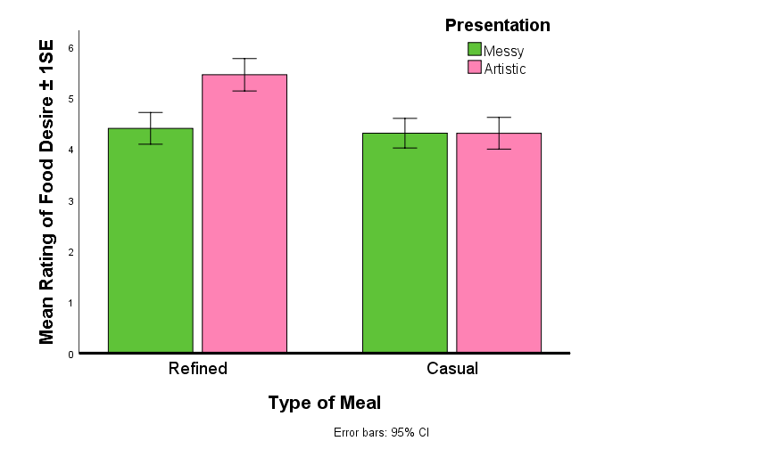
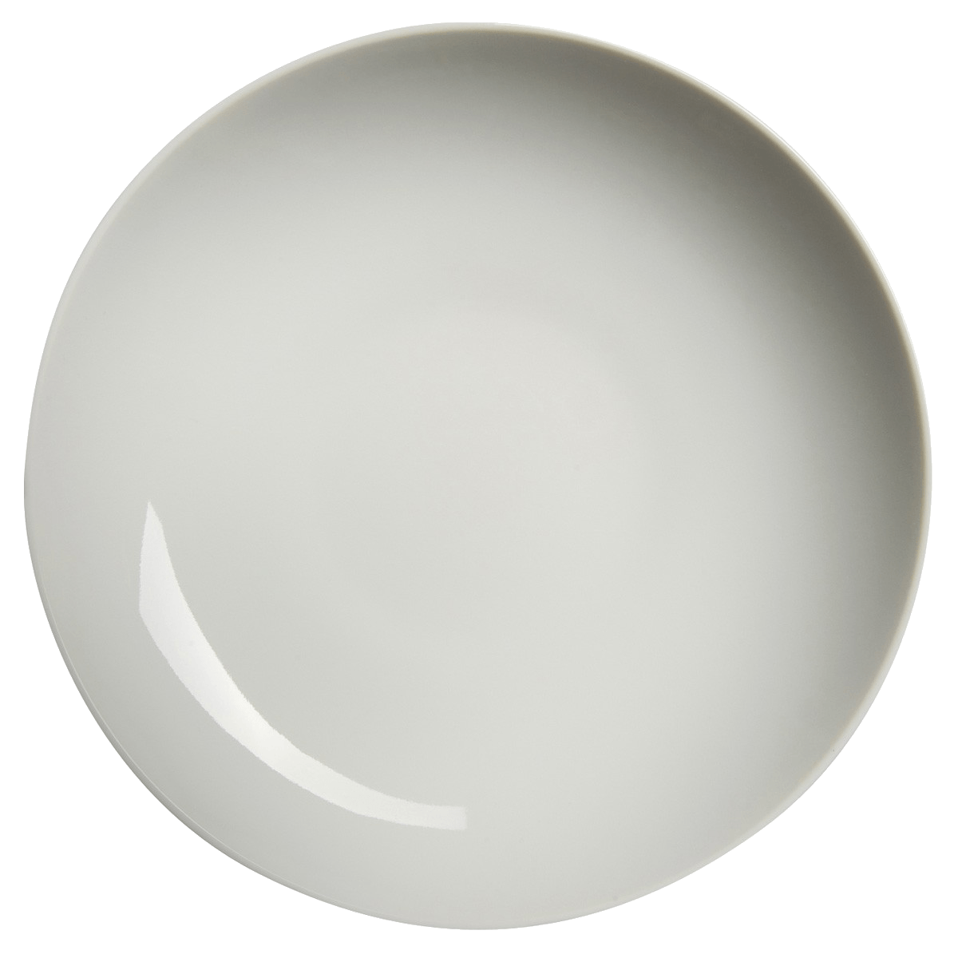
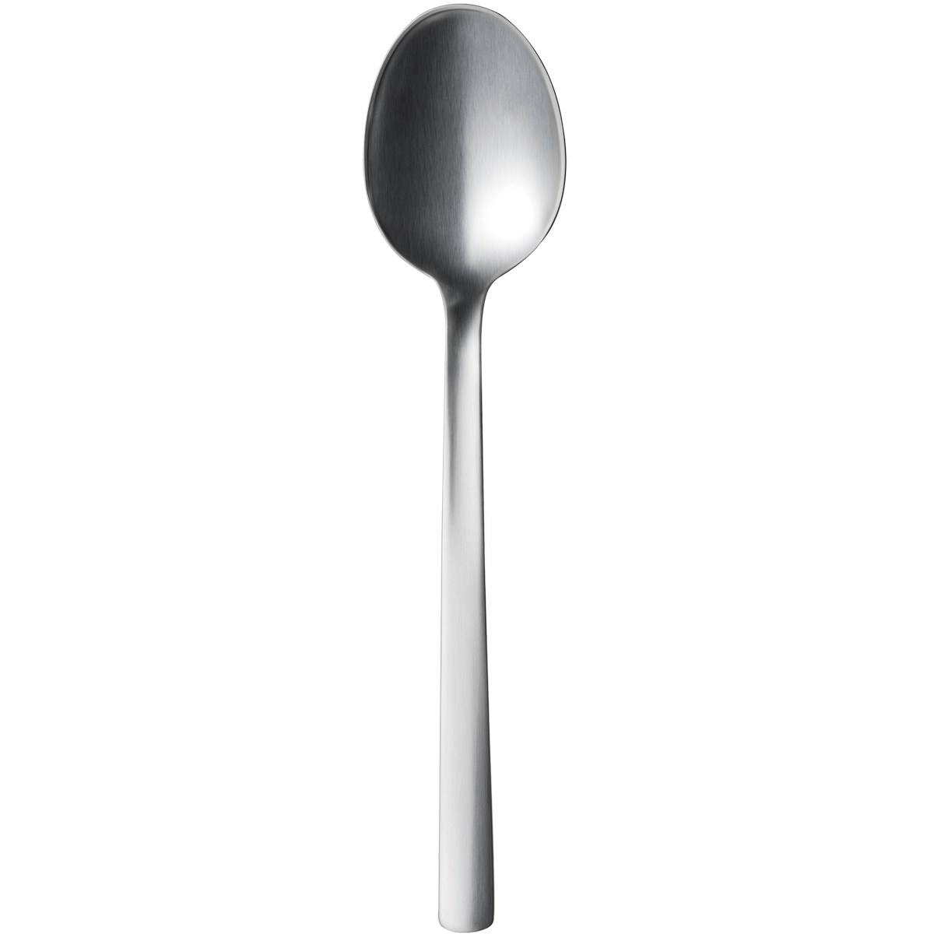
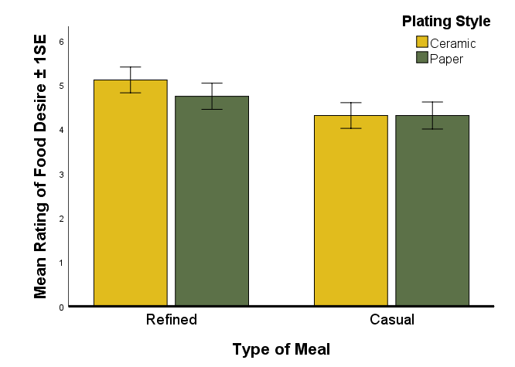
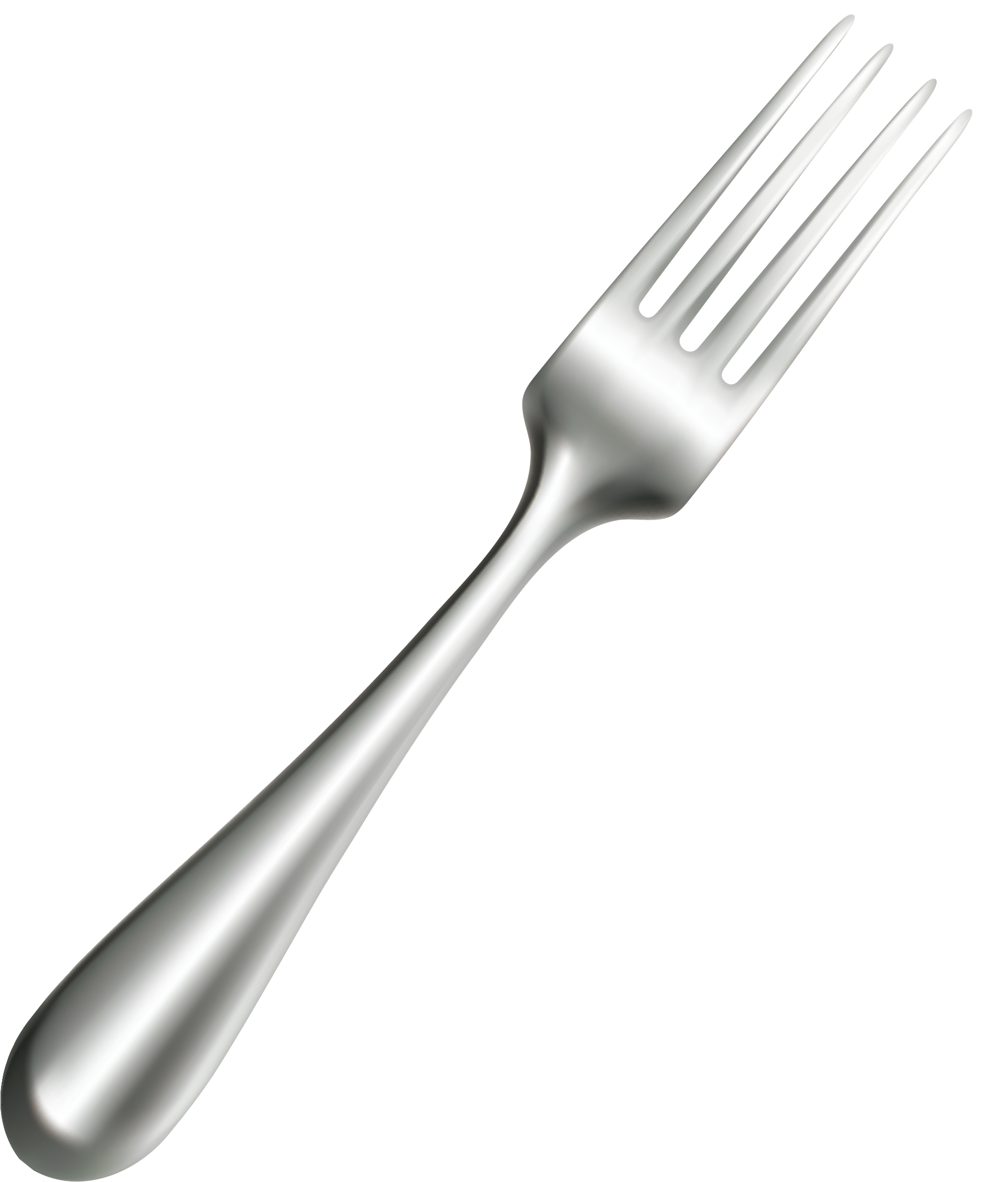
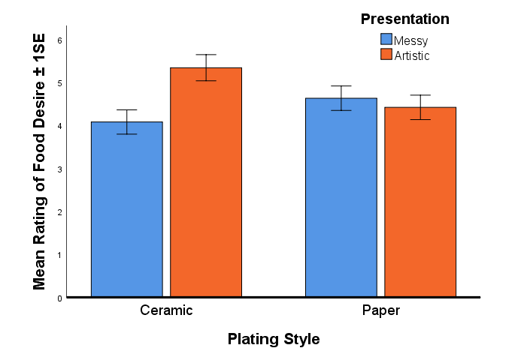
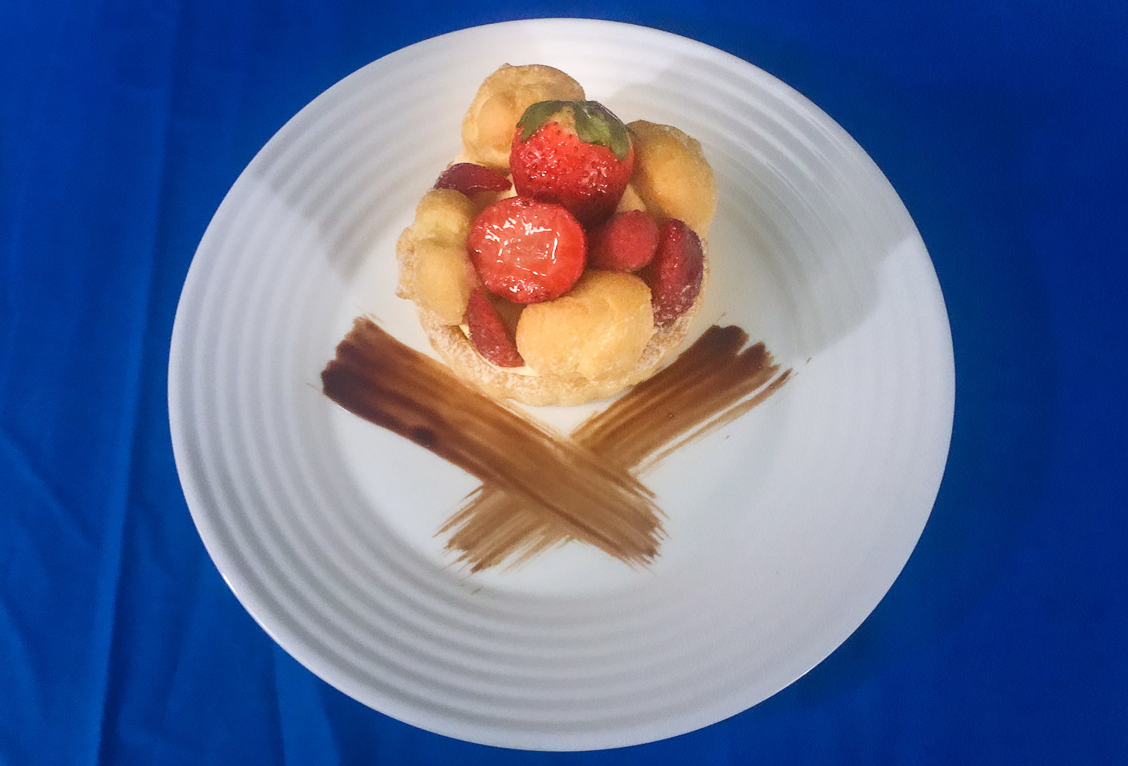
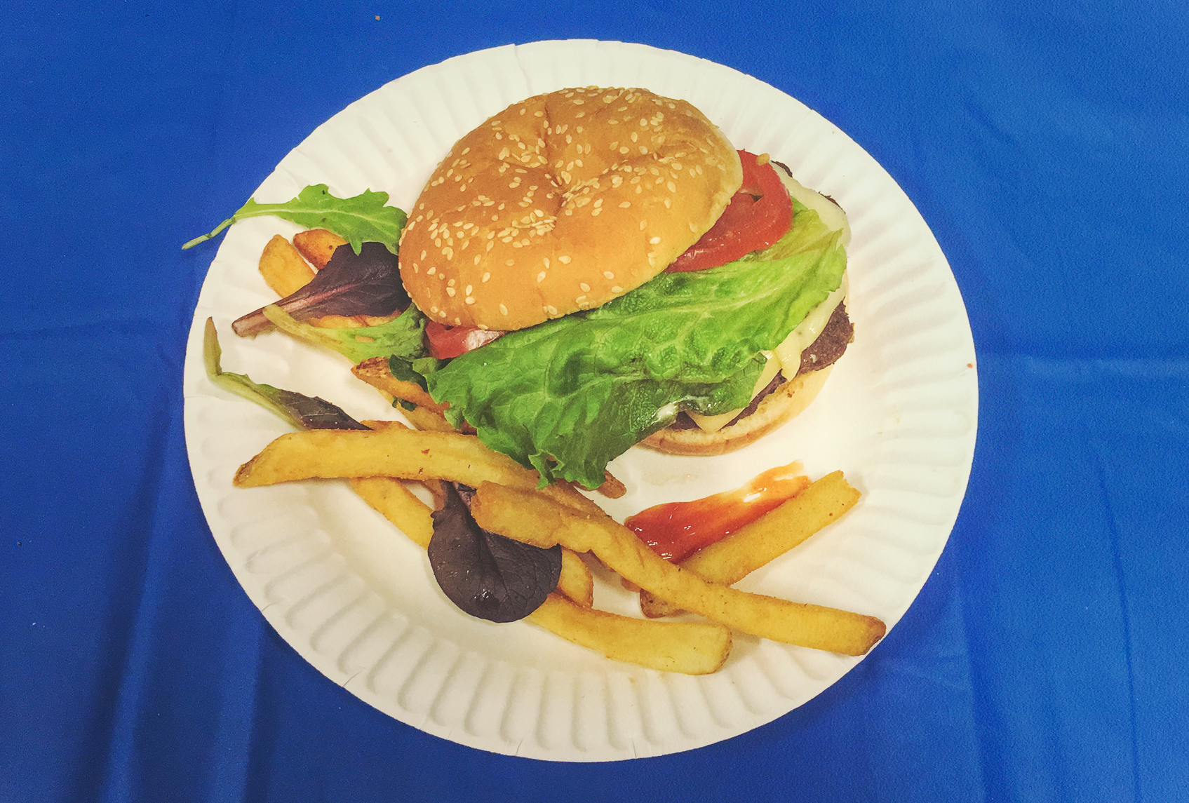
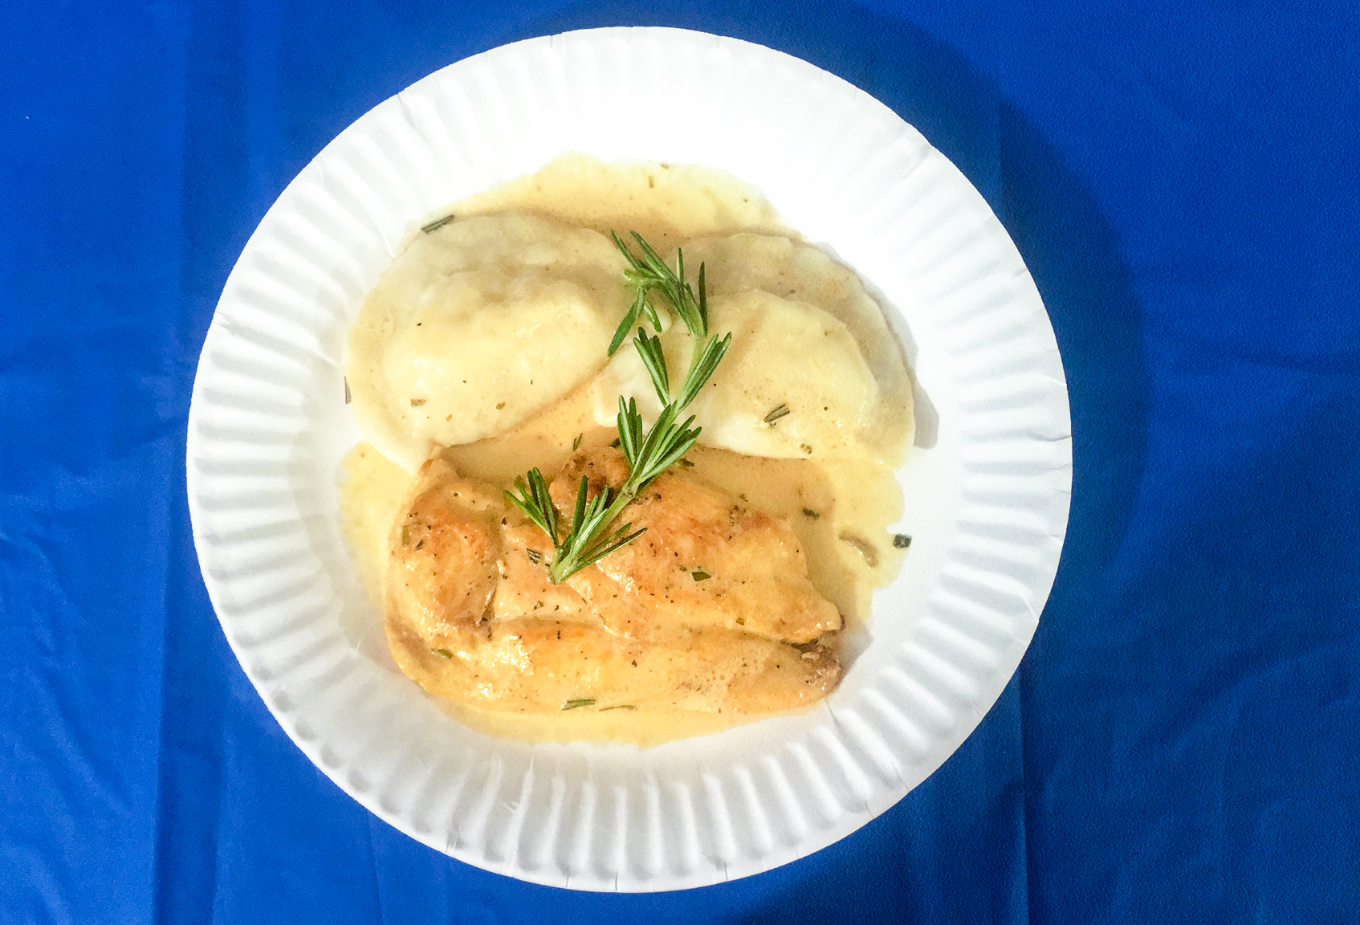
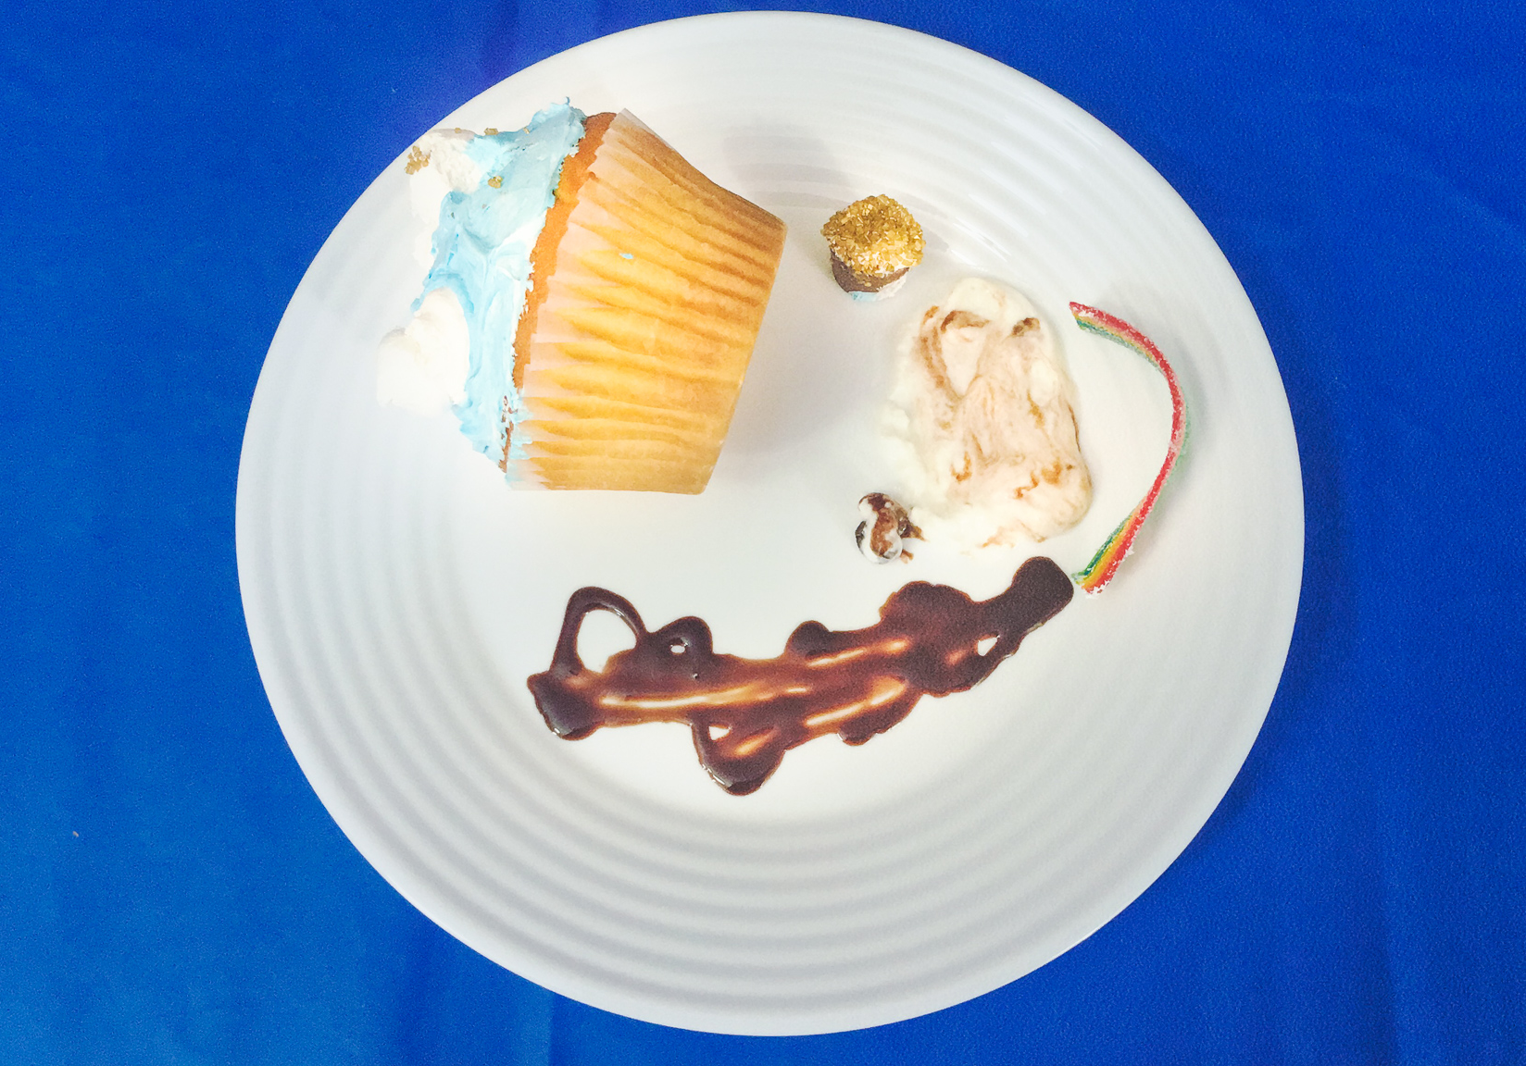
Introduction
Results (Cont.)
The smells and sight of real food can direct eating behavior or even further, enhance the desire to eat, to the point of overriding feelings of satiation (Blechert, Meule, Busch & Ohla, 2014; Cornell, Rodin & Weingarten, 1989).
In some studies (e.g., Zellner et al., 2011), participants reported higher liking when food is presented in a neat arrangement and in a more attractive manner on a plate.
Additionally, eating initiation can be predicted by visual presentation (Marcelino, Adam, Couronne, Köster & Sieffermann, 2001).
Advancing research on the relationship between food presentation and appetite presents several financial and non-financial advantages such as marketing ideas and potential treatments for eating disorders.
What’s Your Preference?
The Effect of Food, Plating,
and Presentation
on Desire for Food
There is an interaction between type of meal and presentation, F(1,91) = 35.43, p < .001, η²_{p} = .28
Participants significantly prefer the "nice" presentation (over messy) in refined foods, but are indifferent to presentation for a casual dish.
Objective
This study examined the different aspects of visually presented foods such as type of meal, taste profile, plate style, and quality of presentation on individual’s desire for this food.
Anh Duong
and
Catherine Mello
Methods
There is an interaction between type of meal and plate style, F(1,91) = 7.57, p = .007, η²_{p} = .077
Participants significantly prefer the ceramic plate (over paper) in refined foods, but are indifferent to plating style/material for a casual dish.
117 participants were recruited from introductory psychology classes and social media.
Participants completed an online survey viewing different images of food and reported their willingness to consume and purchase, as well as their anticipated enjoyment of, specific foods.
Desire for food is measured by averaging participants’ response to a series of 9-point Likert-style items about each food picture presented.
Procedure: Within-subjects ANOVA, 2 (Food flavor) x 2 (Type of Food) x 2 (Presentation style) x 2 (Plate).
Results
There is an interaction between plate style and presentation, F(1,91) = 61.10, p < .001, η²_{p} = .40
Participants expect consistency between quality of presentation style and plating style: messy foods are preferred on paper (vs. ceramic) and nice plating are preferred on ceramic (vs. paper).
Strawberry Choux
Sweet, Refined Dish, Ceramic Plate, Nice Presentation
Hamburger and Fries
Savory, Casual Dish, Paper Plate, Messy Presentation
Factor | M | SD | M | SD | F (1,91) | p | η²_{p}
Taste: Sweet - Savory | 4.9 | 1.4 | 4.3 | 1.2 | 35.45 | <.001 | .28
Type: Refined - Casual | 4.9 | 1.3 | 4.3 | 1.4 | 21.83 | <.001 | .193
Plate: Ceramic - Paper | 4.3 | 1.4 | 4.5 | 1.2 | 6.56 | =.012 | .067
Presentation: Artistic - Messy | 5.2 | 1.3 | 4.0 | 1.3 | 29.24 | <.001 | .243
Discussion
In conclusion, artistic presentation, more elegant plates, elicited greater desire for food but only in refined dishes.
A previously documented preference for sweet foods (Blechert et al., 2014) was replicated.
Future research should investigate how preferences for visual presentation are modulated by eating habits and experiences with different types of dining establishments.
Mean Ratings for Each Type of Food
Sautéed Chicken
Savory, Refined Dish, Paper Plate, Nice Presentation
Cupcake
Sweet, Casual Dish, Ceramic Plate, Messy Presentation

