Slide 1

National Center on the Use of Emerging Technologies to Improve Literacy Achievement for Students with Disabilities in Middle School
Using Data to Support Iterative Project Development:
The Case of an Online Literacy Platform to Support Middle-School Students with Disabilities
by: David Rose, Ed.D., Ted Hasselbring, Ed.D., Gabrielle Rappolt-Schlichtmann, Ed.D., Samantha Daley, Ed.D., and Alyssa Boucher, Ph.D
http://cet.cast.org

Slide 2
Abstract
Design-based research methods rely on researchers and developers using data collected with authentic stakeholders throughout the design process. Identifying critical patterns and trends can be difficult however, particularly when faced with large amounts of data during rapid iterative cycles. A national center focused on literacy outcomes for middle-school students with disabilities will share examples and insights from the use of a data analytics platform to address this challenge and support informed iterative refinement. Leveraging the power of analytics has revealed patterns of use that otherwise would have been difficult to appreciate but have substantial impacts for continued development.

Slide 3
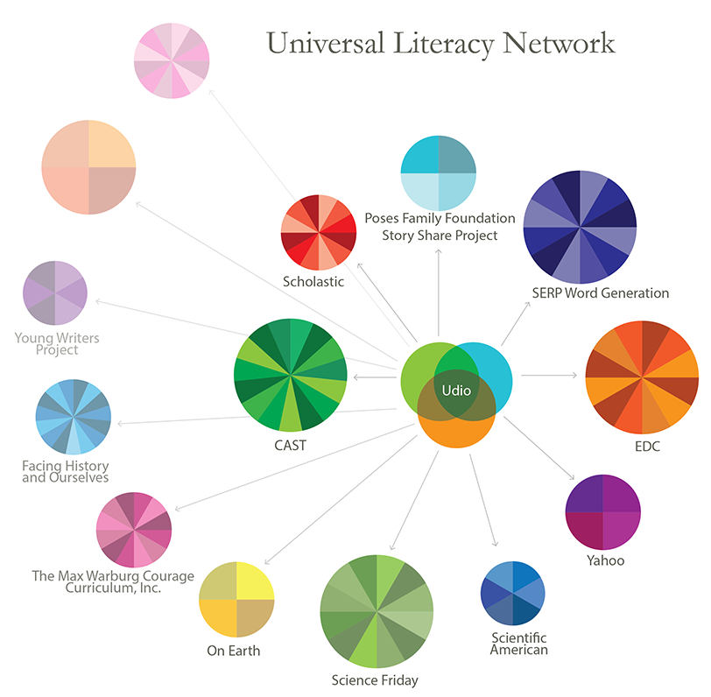
National Center on the Use of Emerging Technologies to Improve Literacy Achievement for Students with Disabilities in Middle School (CET)
CET Goals:
To foster a passionate interest and investment in reading for students who have traditionally been uninterested in, or disenfranchised by, traditional classroom literacy practices
To substantially improve the reading comprehension skills
of middle school students who have experienced recurrent failure in the domain of reading.
For more information visit the CET website http://cet.cast.org

Slide 4
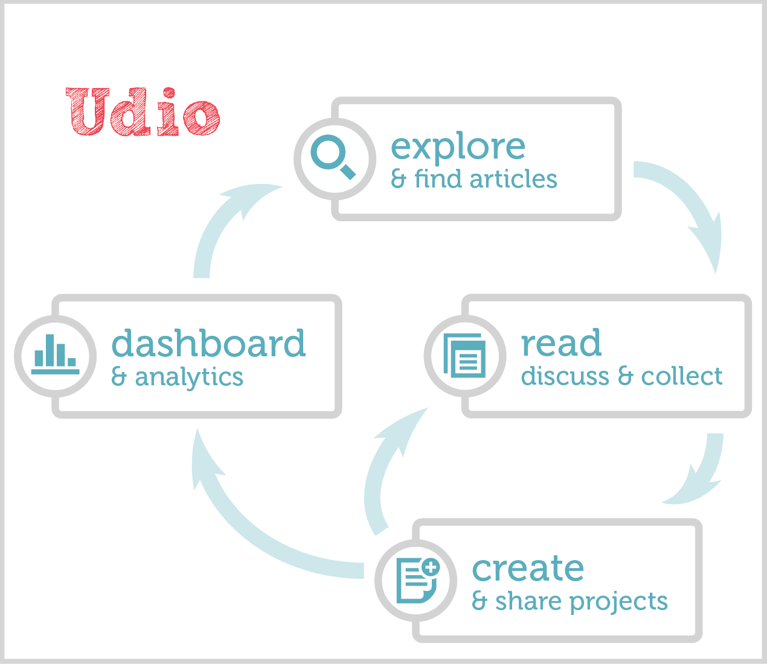
Udio: A platform to improve literacy for middle school students
A space to explore Udio’s content that provides students with access to hundreds of high-quality, high-interest articles;
A platform to read, discuss, and collect media of interest, provides substantive opportunities for active and social experiences of text, and provides access to UDL supports for just-right reading challenges;
A supported space to create and share projects that leverages writing in the service of reading comprehension skills development; and
A dashboard and analytic system that supports students in developing an understanding of their interests and allows students to track the volume and pace of their reading experiences in Udio.

Slide 5
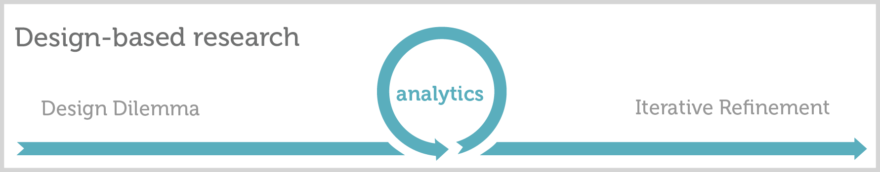
Design-based research
Analytic tools support our efforts at design-based research (Cobb, 2001; Collins, 1992). With a current pilot test of 337 students with 11 teachers, in 7 schools, we have been collecting data since the implementation started in November 2014.
Measures: Digital event usage log, teacher surveys, student surveys, teacher interviews, student interviews, classroom observations, pre/post measures.
Today’s presentation focuses on use of the event usage log, which collects data as students and teachers use Udio, to support understanding of implementation variation and address questions in development.
Two examples of questions considered to guide iterative refinement of Udio:
In such an autonomy-based environment, how are students choosing to spend their time? Are there different profiles we should consider?
We know teachers are using Udio in different ways. What patterns are evident in usage between classes?

Slide 6
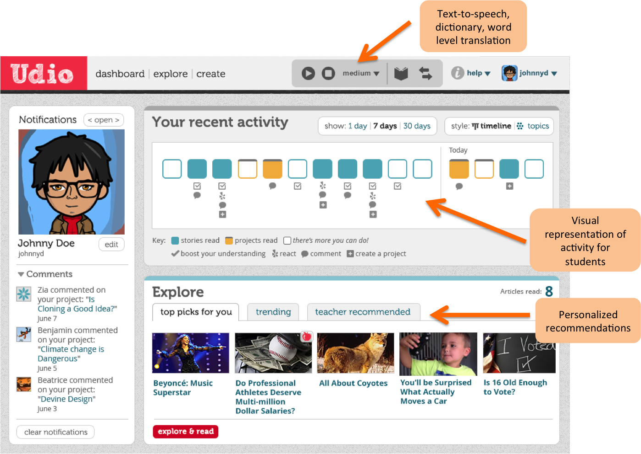
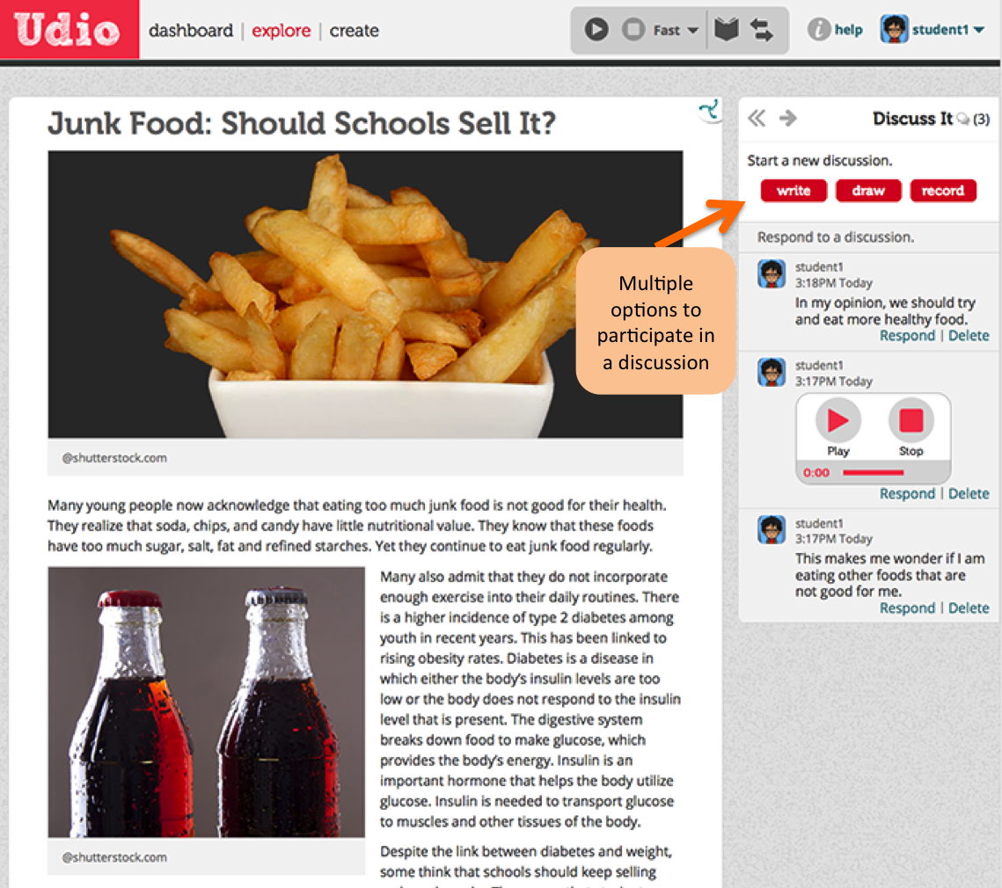
Key Udio components: dashboard and article pages

Slide 7
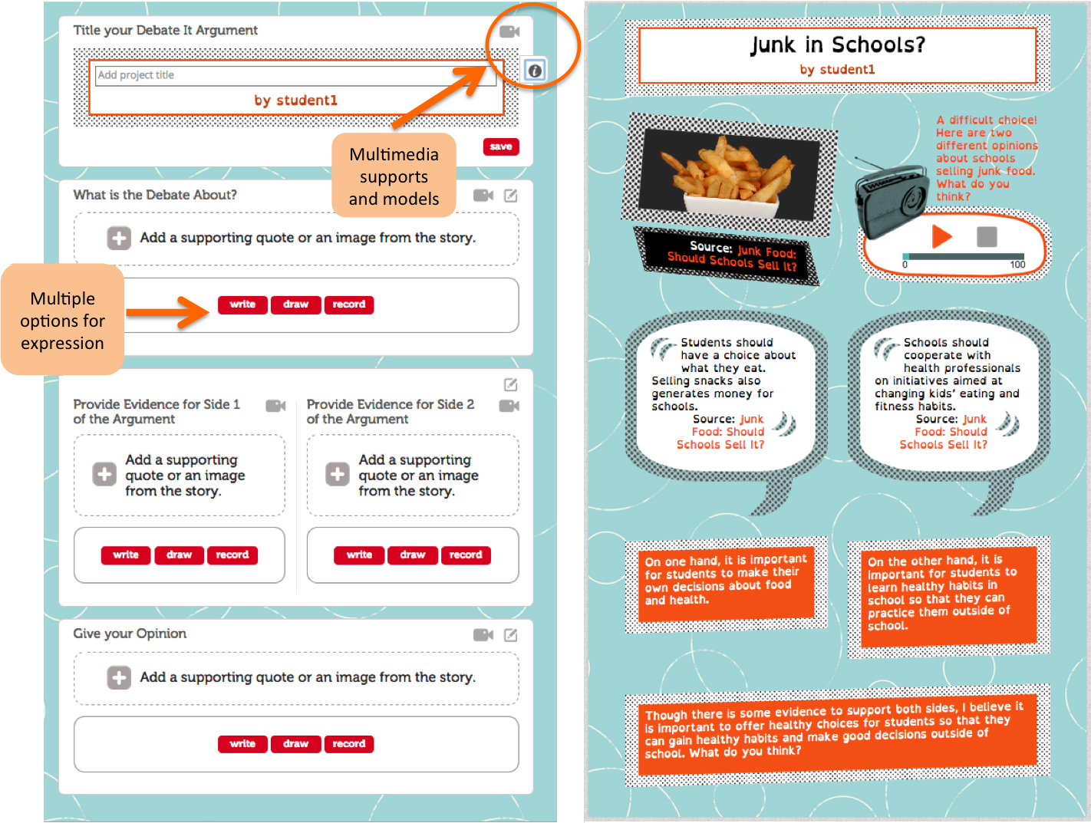
Key Udio components: creating and publishing projects

Slide 8
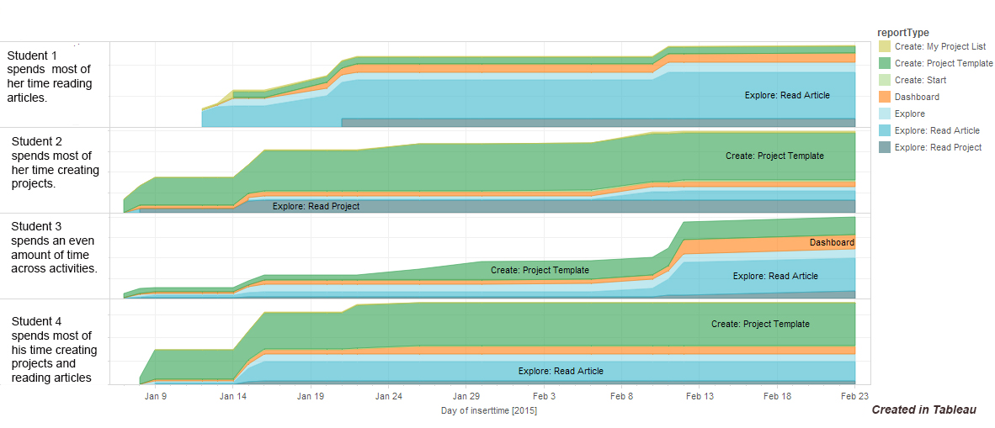
How do students spend their time in Udio?

Slide 9
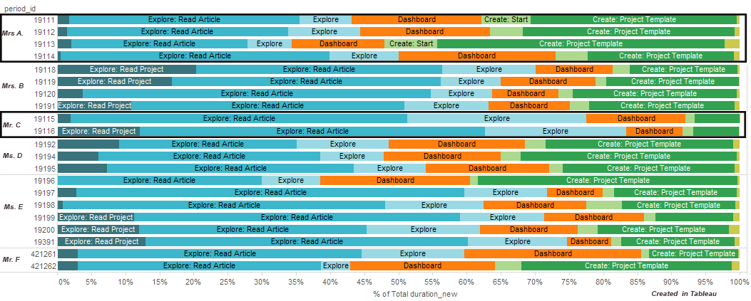
How do teachers differ in their implementation of Udio?
Differences in classroom use are highlighted. Students in Mrs. A’s and Mr. C’s classes spend different proportions of their time reading articles and creating projects.

Slide 10

Conclusion
These reports, of which these are two among many, are valuable because they
suggest patterns that are useful for deeper research dives
reveal feature usage patterns that inform improvements to navigation and design of supports
provide a better understanding of teacher variability that can inform development of teacher support materials
Ongoing efforts will
identify report types that most effectively inform customized supports for teachers
use standard analytic approaches to address questions about how patterns revealed here relate to outcomes
The contents of this presentation were developed under a grant from the U.S. Department of Education (#H327M11000). However, those contents do not necessarily represent the policy of the Department of Education, and you should not assume endorsement by the Federal government.

