Slide 1
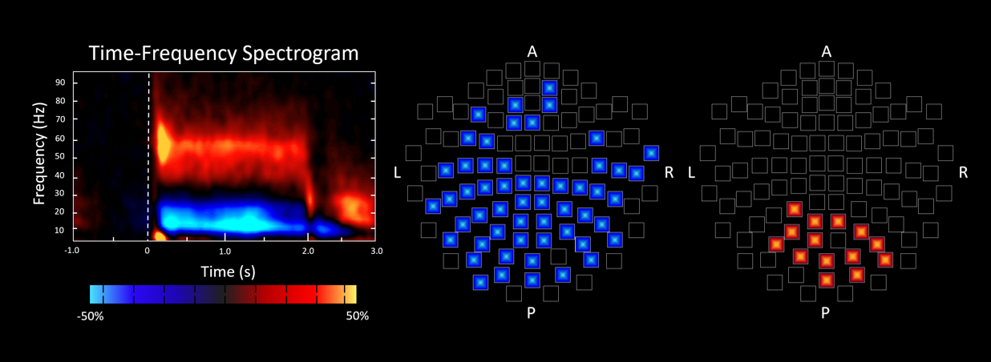
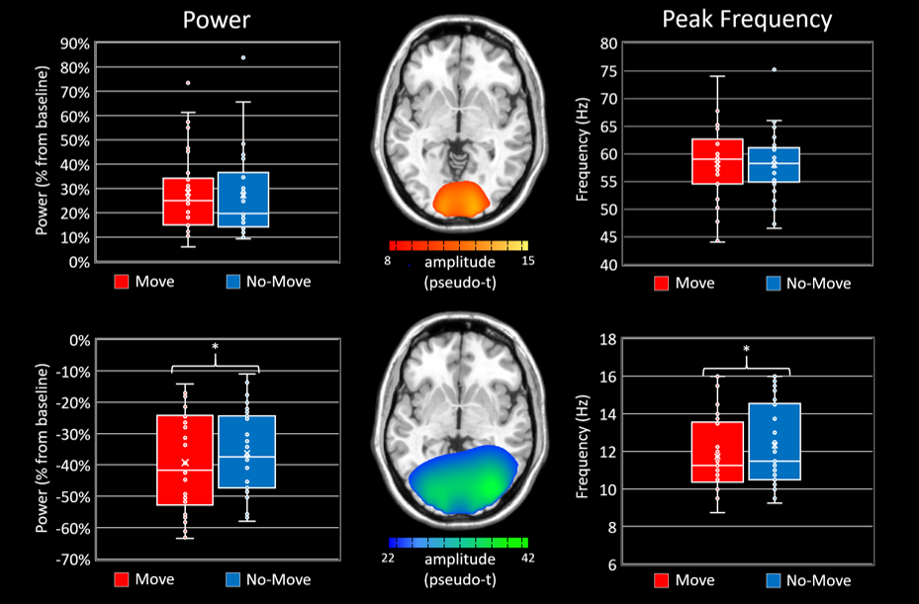
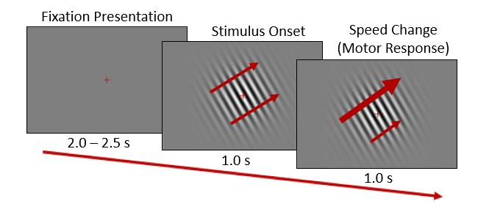
Alpha, but not Gamma, Visual Oscillations are Impacted by Movement.
Timothy R. Joe,^{a,b,c} Alex I. Wiesman,^{a,c} Christine M. Embury,^{a,b,c} Mikki Schantell,^{a,c} Jacob A. Eastman,^{a,c} Tony W. Wilson,^{a,c} & Elizabeth Heinrichs-Graham^{a,c}
ªDepartment of Neurological Sciences, University of Nebraska Medical Center, Omaha, NE, USA
^{b}Department of Psychology, University of Nebraska – Omaha, Omaha, NE, USA
^{c}Center for Magnetoencephalography (MEG), University of Nebraska Medical Center, Omaha, NE, USA
Introduction
Sensor-level Results
Visual processing is widely understood to be served by a decrease in alpha activity in occipital cortices, largely concurrent with an increase in gamma activity. While the characteristics of these oscillations are well documented in response to a range of complex visual stimuli, little is known about how these dynamics are impacted by concurrent motor responses, which is problematic as many common visual tasks involve such responses. Thus, the goal of this study was to investigate how movement modulates the occipital alpha and gamma oscillatory dynamics serving visual processing.
Methods
Left: Grand-averaged time-frequency spectrogram from a representative sensor near the occipital cortices, where 0.0 s is the onset of the initial stimulus and 1.0 s is the onset of the speed change.
Middle: Distribution of significant alpha (10-16 Hz) activity during the speed change across the sensor array (p < .001).
Right: Distribution of significant gamma (44-76 Hz) activity during the speed change across the entire array (p < .001)
Participants
34 healthy participants (15 females; 2 left-handed); mean age 26.34; range 19-37 years.
Task Paradigm
Participants were instructed to respond to one of two speed changes, which were counterbalanced across participants.
MEG Acquisition, Preprocessing, and Data Analysis
Neuromagnetic responses were sampled continuously at 1 kHz using an Electa Neuromag system with 306 magnetic sensors.
Data were corrected for head motion, subjected to noise reduction, and coregistered to a T1-weighted MRI.
Artifact-free epochs were transformed into the time-frequency domain using complex demodulation.
Time-frequency windows used for imaging were determined using statistical analysis of the sensor-level spectrograms across gradiometers.
Cortical networks were imaged through an extension of the linearly-constrained minimum variance vector beamformer.
Virtual sensors were extracted from peak voxels determined using whole-brain map averages of each time-frequency bin of interest across all participants and conditions.
For each peak voxel, virtual sensors were averaged across hemispheres, peak frequency and power were characterized by condition, and relationships between metrics and conditions were assessed.
Source-level Results
The group-averaged whole-brain map (pseudo-t) depicting gamma ERS activity across both conditions is displayed centrally. Box-and-whisker plots of power (left, in % change from baseline) and frequency (right; in Hz) for each condition are shown. There were no differences in either power or frequency between Move and No-Move conditions (both p’s > .05) in the gamma response. However, there was a significant decrease in alpha ERD peak frequency in the Move condition relative to the No-Move condition (p = .023). There was also a significantly stronger alpha ERD (i.e., more negative from baseline) in the Move relative to the No-Move condition (p = .022).
Conclusions
This study is the first to systematically investigate the impact of movement on visual oscillatory dynamics. In sum, the presence of a motor response to a visual stimulus significantly enhances alpha ERD power and decreases peak frequency in the primary visual cortices, but does not appear to impact visual gamma power or frequency. We suggest that this information can be used in the design of new visual experiments meant to elicit these responses. Specifically, investigators should implement a behavioral response during or after a visual stimulus as it increases alpha ERD response and ensures the participant is paying attention.
Acknowledgements: This work was supported by the National Institute of Mental Health grants R01MH103220 (TWW), R01MH116782 (TWW), R01MH118013 (TWW), and R01MH121101 (TWW), National Institute of General Medical Sciences U54GM115458 (EHG), and National Institute on Aging F31AG055332 (AIW). The content is solely the responsibility of the authors and does not reflect the official views of the NIH.

