Slide 1
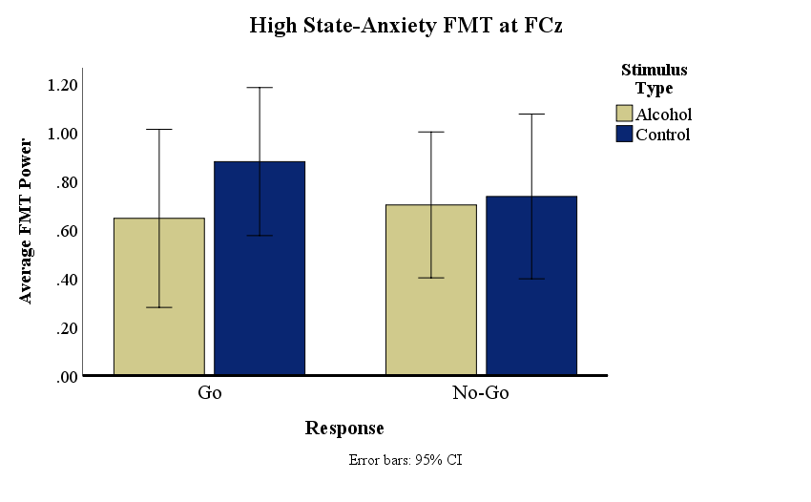
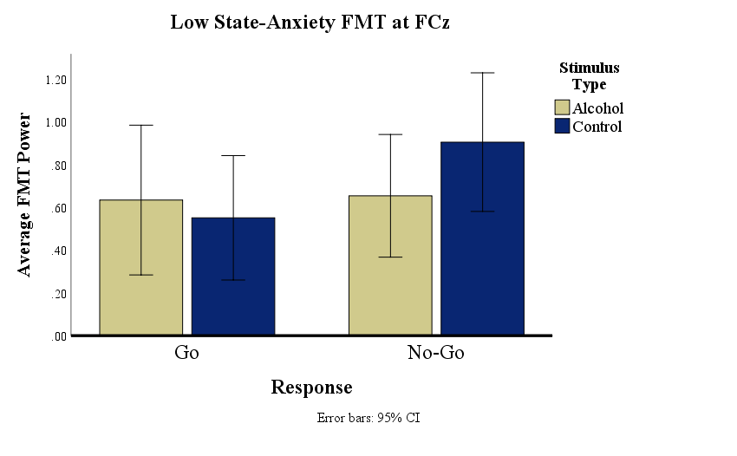
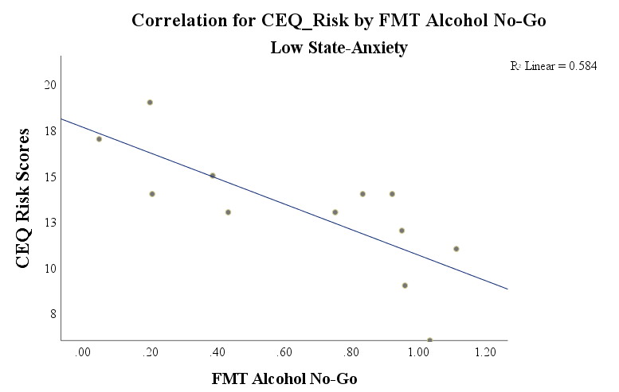
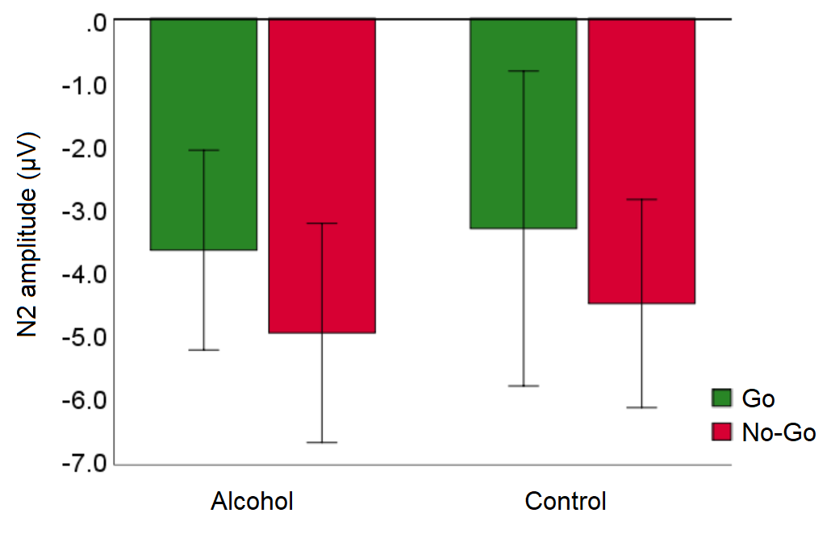
TRAIT ANXIETY MODULATES EVENT-RELATED POTENTIALS TO ALCOHOL IMAGES IN SOCIAL DRINKERS
Alyse Finch, Allison Zborowski, Scott Oettli, Natalie Ceballos, and Reiko Graham
Department of Psychology, Texas State University
Results
Introduction
Repeated associations between alcohol and its rewarding effects are thought to strengthen automatic cue reactivity and decrease cognitive control, resulting in cravings and alcohol-seeking.
Reactivity may be influenced by anxiety, especially in people who drink for negative reinforcement.
Alcohol cue reactivity has been studied primarily using ERPs, especially the frontal N2 component. However, reward-related activity (Christie & Tata, 2009) and cognitive control (Nigbur et al., 2011) are also associated with frontal midline theta (FMT), ~3-8 Hz oscillations over fronto-medial sites.
We examined FMT during the time window of the N2 to images of preferred alcoholic vs. non-alcoholic beverages using a Go/No-Go paradigm. Trait anxiety was also included as a factor.
We predicted that FMT power would be higher for No-Go trials (response inhibition), but lower for alcohol No-Go trials reflecting decreased cognitive control, and that anxiety would mediate this effect.
Participants were broken into two groups based on a median split of trait anxiety scores:
Low Anxiety, n = 12; High Anxiety, n = 11
Repeated-measures ANOVAs for N2 peak latencies and amplitudes, and FMT at site FCz were conducted.
Within Subjects: stimulus type (Alcohol, Control) & response type (Go, No-Go)
Between Subjects: state anxiety group (Low, High)
Intergroup comparisons: High Anxiety vs. Low Anxiety
High anxiety group had higher DAQ Strong craving scores (current strong cravings to consume alcohol), t(12.572) = -2.703, p = .019, and BAS Drive scores (the motivation to go to any lengths to achieve a reward), t(21) = -3.338, p = .003 than the low anxiety group.
ERP analyses: N2 latency and amplitude
No effects observed for N2 peak latency
N2 amplitude, main effect of response, F(1, 21) = 5.65, p = .027) – larger N2 for No-Go trials
FMT analyses:
Post-Hoc Analyses
High anxiety group: Marginal difference in FMT for Go responses, with higher FMT for control vs. alcohol Go trials, t(10) = -2.043, p = .068.
Low anxiety group: higher FMT power during Control No-Go trials
vs. Alcohol No-Go, t(11) = -2.939, p = .013,
vs. Control Go, t(11) = -4.035, p = .002
vs. Alcohol Go s, t(11) = -3.496, p = .005
FMT during Alcohol No-Go trials in the low state anxiety group was negatively associated CEQ drive (the self-reported tendency to become aggressive or impulsive while drinking) , r(9) = .607, p < .048, R² = 0.584.
Low anxiety participants who had lower CEQ Risk scores experienced higher FMT during Alcohol No-Go trials.
Method
Subjects:
Twenty-three social drinkers (21-26 years old; M_{age} = 22.0; 5 males) with normal/corrected-to-normal vision and no history of seizure/concussion within 6 months or psychiatric medication use
Stimuli:
Color photos of alcoholic and non-alcoholic (control) beverages equated for contrast and luminance. Alcoholic beverages were categorized into 3 types: beer, wine, and liquor (120 images in each category, including non-alcoholic beverages).
Procedure:
Completion of self-report measures –alcoholic beverage preferences, family history of alcohol use disorder (Mann et al., 1985), alcohol use over the previous six-month period (Cahalan, 1969), drinking expectancies and motives (Cooper, 1994; Fromme et al., 1993), binge drinking practices (Cranford et al., 2006), alcohol craving (Clark, 1994; Love et al., 1998), and behavioral activation/inhibition (Carver & White, 1994).
Participants chose their preferred beverage type, and then completed 2 blocks of 240 trials (Alcohol Go, Alcohol No-Go; Control Go, Control No-Go – counterbalanced)
ERP Methods:
EEG was recorded from 64 channels at 1000 Hz (Synamps2, Neuroscan, Charlotte NC)
Epoched -100 ms (baseline-corrected) to 1000 ms. Artifact rejected trials +/- 100μV.
Referenced offline to linked mastoids and band-pass filtered offline (3 to 7 Hz) during the time window of the frontal N2 (150-300 ms).
Traditional N2 peak amplitudes and latencies also extracted (FCz, 150-300 ms).
Four averages for 1) ERP and 2) FMT analyses: Alcohol Go, Alcohol No-Go; Control Go, Control No-Go (correct trials only).
Statistical Analyses: 1) intergroup comparisons of high- and low-anxiety social drinkers, 2) ANOVAs of N2 latency and amplitude, and 2) ANOVA of FMT during the N2 time window.
Conclusions
Social drinkers high in anxiety had higher alcohol craving and BAS drive scores, which might be related to the participants' previous experiences with alcohol's anxiolytic effects.
N2 amplitudes were larger for NoGo relative to Go trials, consistent with studies showing overall N2 sensitivity to response inhibition.
FMT analyses revealed no differences in FMT power in the high anxiety group as a function of stimulus or response type.
The low anxiety group had higher FMT but only for non-alcoholic No-Go trials. FMT power during alcohol No-Go trials was negatively correlated with alcohol-related impulsivity. This suggests that in this group, FMT was a more sensitive marker of alcohol-related response inhibition. The lack of differences in the high anxiety group is suggestive of anxiety-related deficits cognitive control, possibly due to higher resting levels of norepinephrine.
Together, these results suggest a dissociation between FMT and N2 amplitudes and point to the use of coping interventions for social drinkers with high anxiety to help reduce negative mood states that might lead them to misuse alcohol as a means of self-medicating.
Cahalan, D., Cisin, I.H., & Crossley, H.M. (1969). American drinking practices: Monograph no. 6., New Brunswick, NJ: Rutgers Center of Alcohol Studies.
Carver, C. S., & White, T. L. (1994). Journal of Personality and Social Psychology, 67, 319-333
Clark, D., Love, A., James, D., & Willner, P. (1998). Desires for Alcohol Questionnaire. Addiction, 93(7), 1091–1102.
Cooper, L.M. (1994). Psychological Assessment, 6(2), 117-128.
Cranford, J. A., McCabe, S. E., & Boyd, C. J. (2006). Alcoholism: Clinical and Experimental Research, 30(11), 1896-1905.
Christie, G. J., & Tata, M. S. (2009). NeuroImage, 48, 415–422.
Fromme, K., Stroot, E.A., & Kaplan, D. (1993). Psychological Assessment, 5, 19-26.
Love, A., James, D., & Willner, P.A. (1998). Addiction, 93, 1091-1102.
Mann, R.E., Sobell, L.C., Sobell, M.B., & Pavan, D. (1985). Drug and Alcohol Dependence, 15, 61-67.
Nigbur, R., Ivanova, G., and Stürmer, B. (2011). Clinical Neurophysiology. 122, 2185–2194.
Alcohol
Control
FMT Analysis
Main effect of stimulus type, F(21) = 4.99, p = .037. FMT higher for the control trials compared to alcohol trials.
Significant interaction of anxiety group and response type, F(21) = 5.739, p = .026.
These effects were mitigated by a 3-way interaction of state anxiety group, response type and stimulus type, F(21) = 5.318, p = .031.

