Slide 1
CHC Leadership Network

Slide 2
Our Purpose & Values
November 6th, 2017
John Broderick, Head of International

Slide 3
Activation stories
Poland
Magdalena Kruszewska
The CHC team in Poland has been familiarize with our Purpose&Values in the most engaging way that they could fully understand why we come to work each day. The team proved that our Values are more than just slogans, showing their commitment, strong engagement and fantastic teamwork Spirit. We reached out to consumers directly through our socio-educational campaigns – to serve healthier and fuller lives.
I am really proud what we have achieved so far

Slide 4
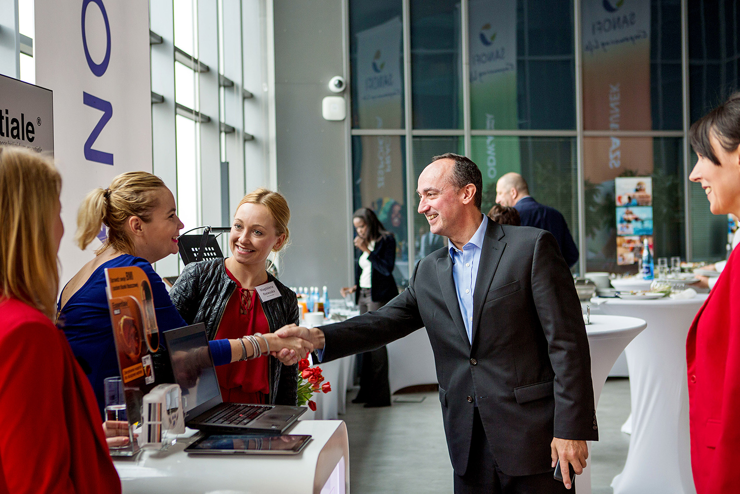
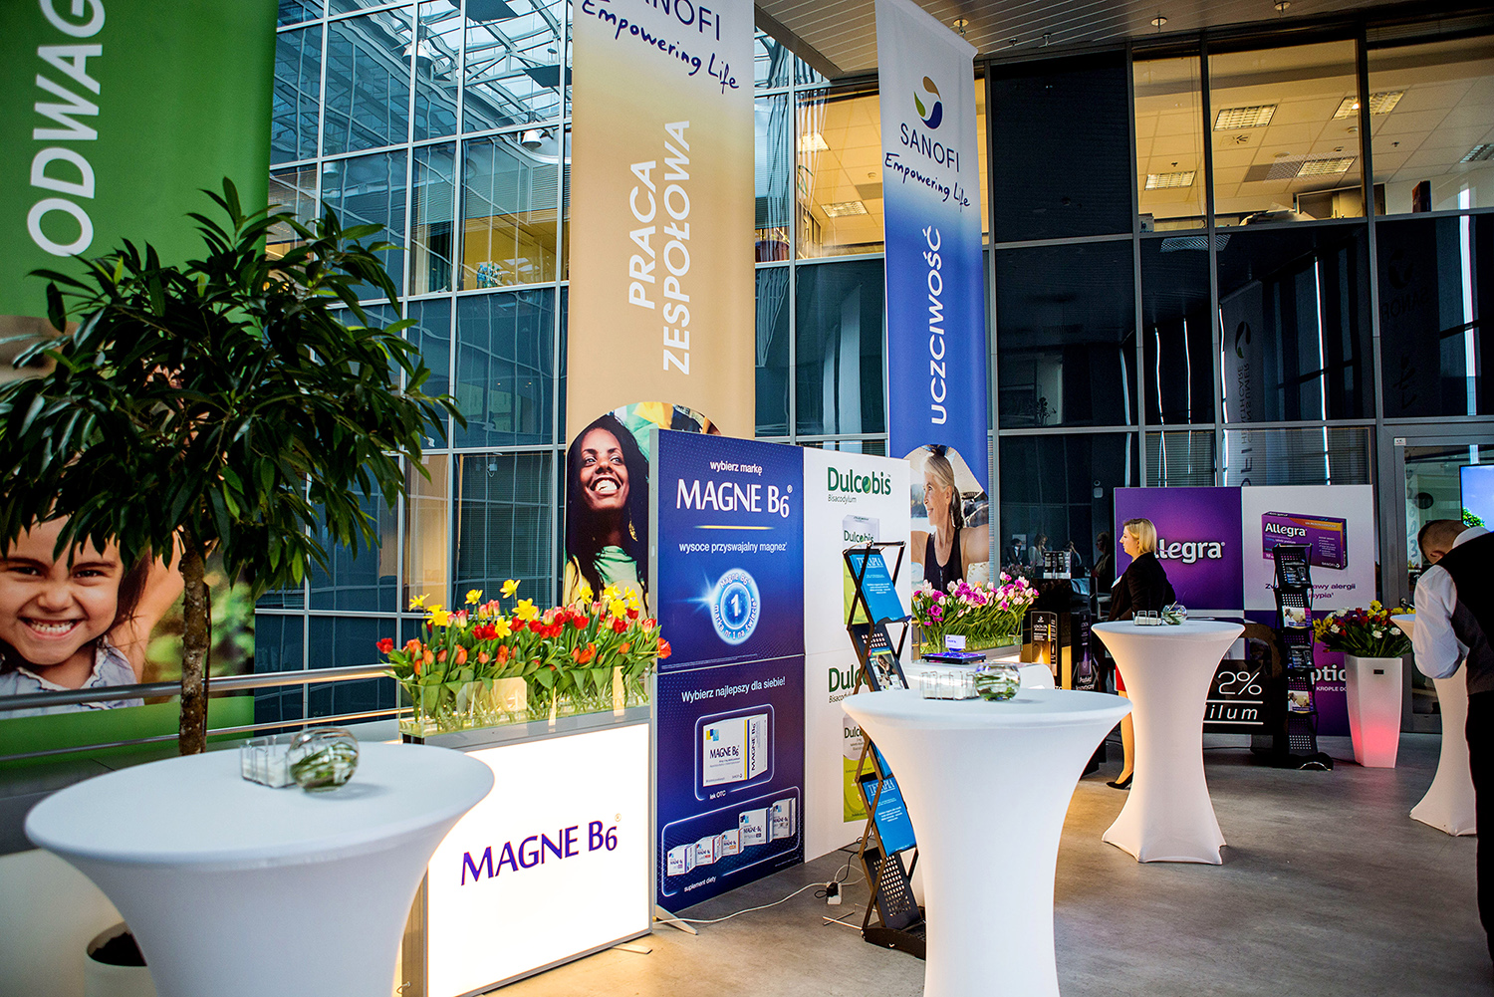
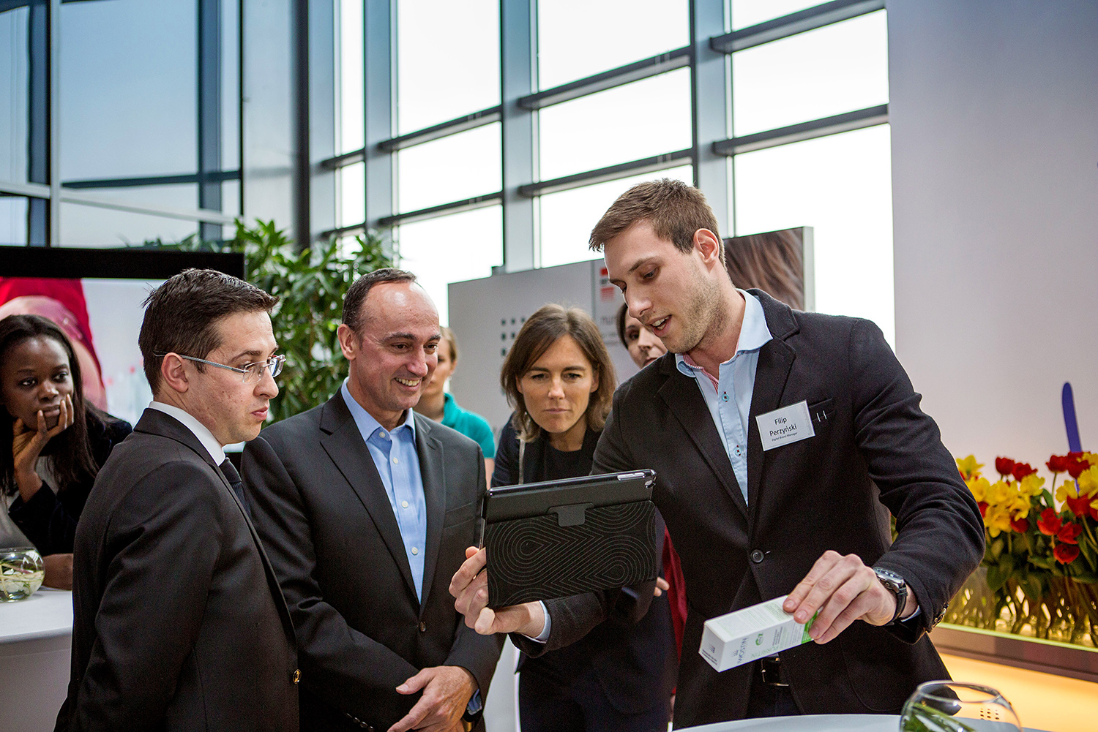
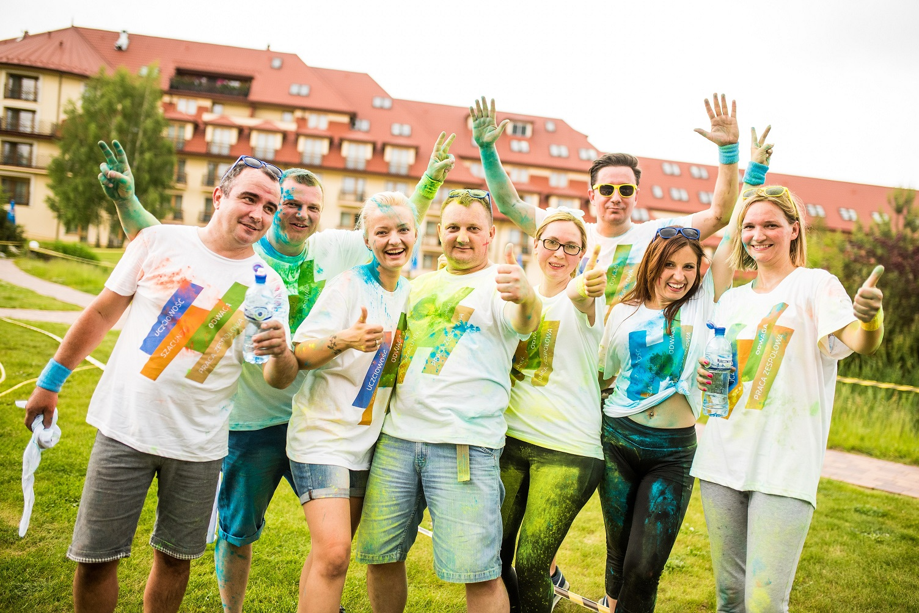
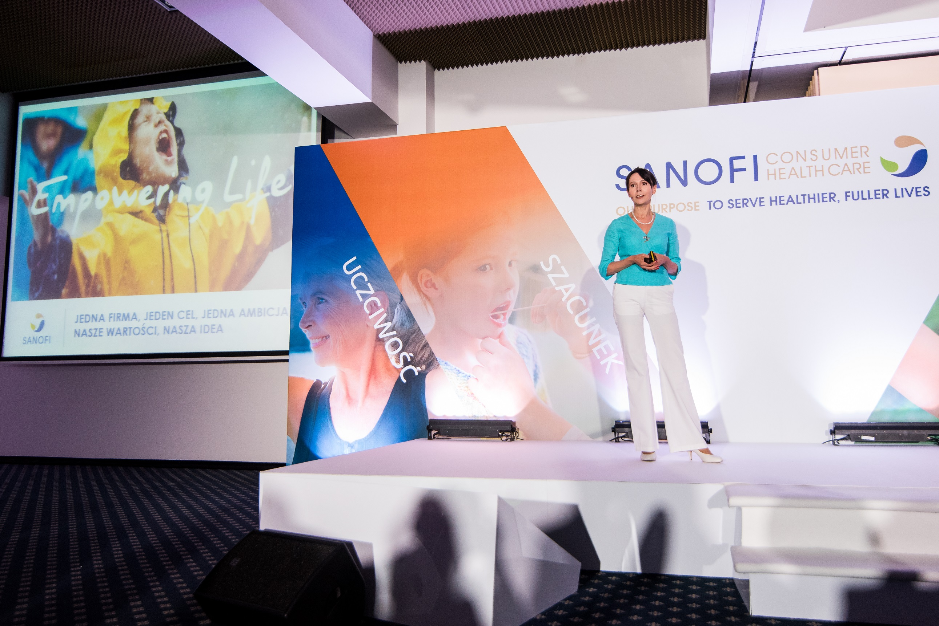
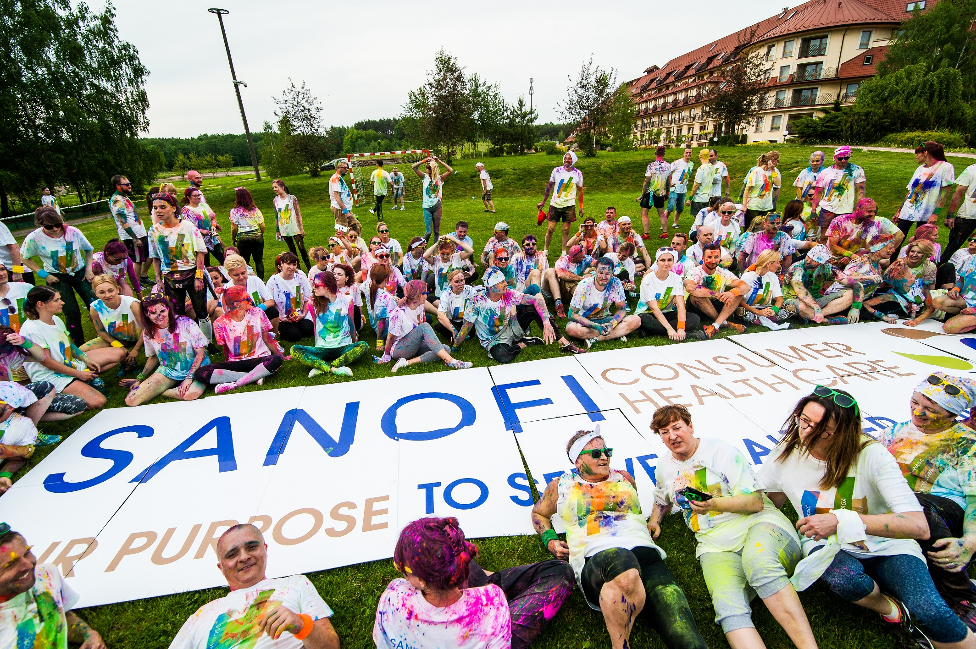
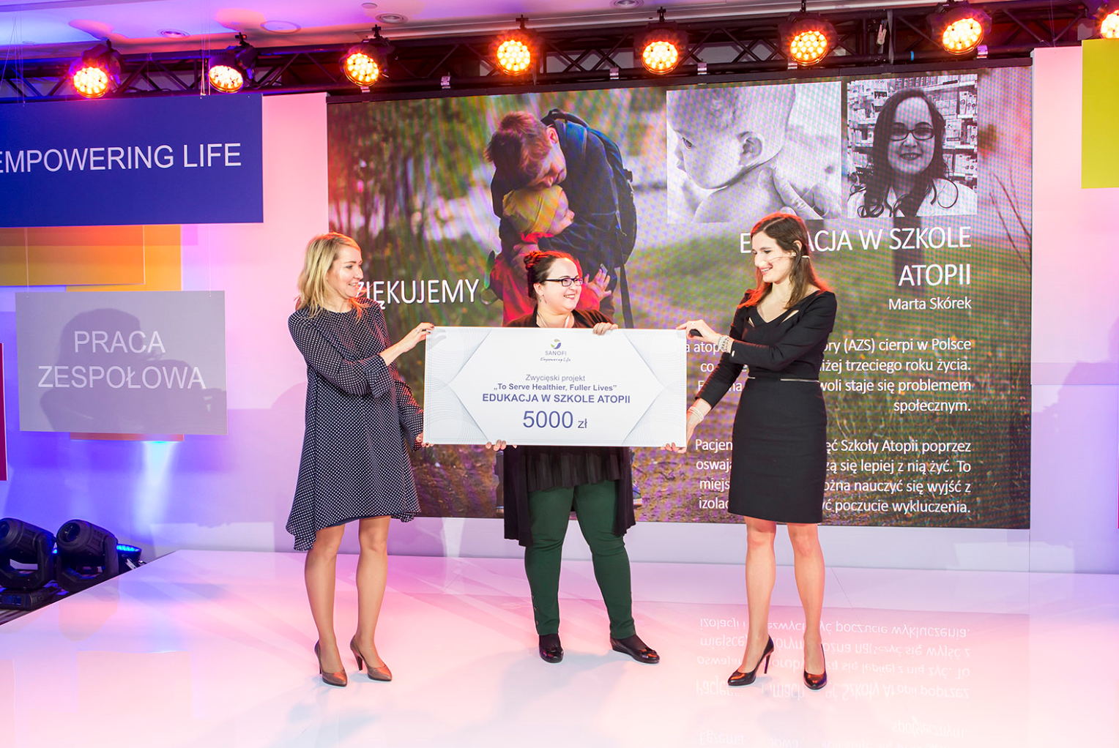
How we are reaching out our mission in CHC Poland?
Activating our Purpose
Living our Values
Values
To Serve Healthier, Fuller Lives
Purpose
Engaging launch: THM with Alan Main
Pre-cycle meeting in May fully dedicated
Follow up
Strong Internal communication & branding in the HQ in Warsaw and manufacturing site in Rzeszow
Socio-educational external campaigns
„How can I change the life of our patients project”
Dedicated project for employees - they can claim for a grant to implement special activity that can change life of our patients
CHC Poland Spirit Award for employees
Rewarding people for outstanding attitude in the area of our values
HAPPY LIVER, HAPPY YOU
CHILDHOOD DREAMS
Stresssmart
&

