Slide 1
Virtual Exhibitor Booth
–––––– May 2020

Slide 2
Who We Are
The CASH Campaign of Maryland promotes economic advancement for low-to-moderate income individuals and families in Baltimore and across Maryland. CASH accomplishes its mission through operating a portfolio of direct service programs, building organizational and field capacity, and leading policy and advocacy initiatives to strengthen family economic stability.
Notes:
Our coalition partners are engaged through committee
VITA
Asset Development
Marketing
Committee on Aging

Slide 3
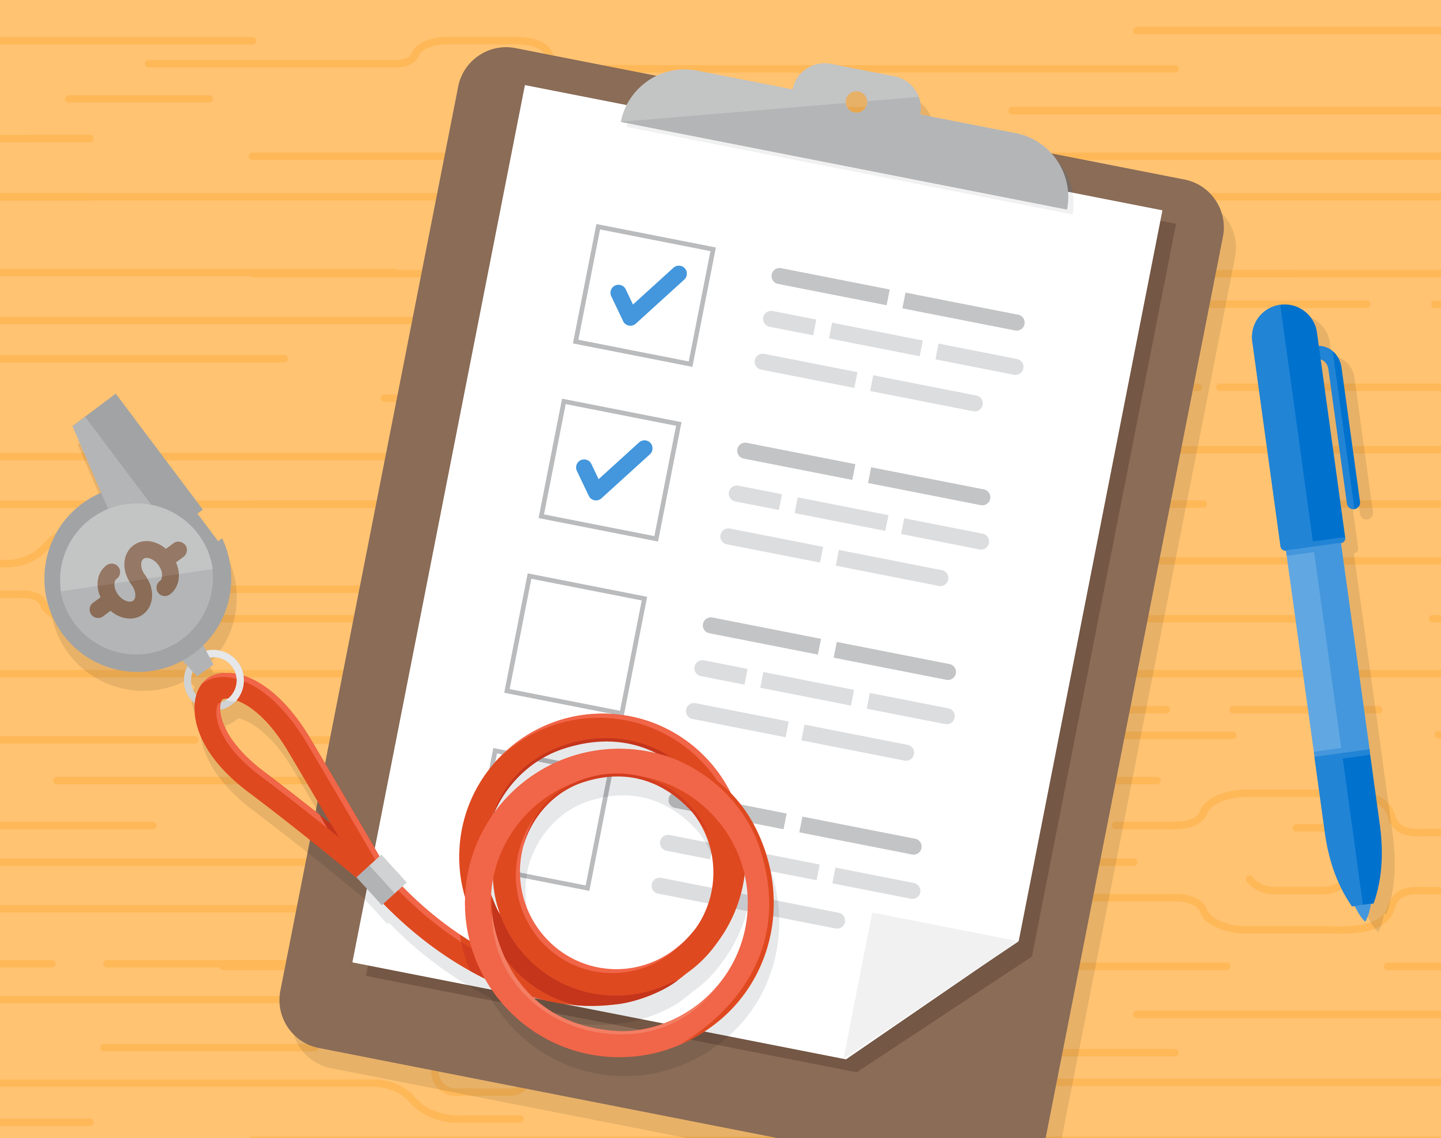
Financial Coaching
Ongoing, unlimited, one-on-one support to help you eliminate debt, rebuild credit, and stick to a spending plan.
Financial Planning
One-on-one consultation with a Certified Financial Planner®. Get expert advice on investing, homeownership, college funding, and wills and retirement planning. Our Certified Financial Planners® provide 1-2 consultations sessions to CASH Campaign clients.
Visit
www.cashmd.org/financial-coaching
to sign up!

Slide 4
Benefits Screening
CASH provides a free program that helps you apply for 22 public benefits – at the same time! Benefits include utilities, energy assistance, health, nutrition, tax credits, and more!
Visit
www.cashmd.org/benefits-screening/
to sign up!

Slide 5
Boost Your Financial Knowledge
Maryland CASH Academy connects you with free, unbiased, high-quality financial education resources.
Sign up to take a class from the comfort of our own home!
Visit
www.mdcashacademy.org
to sign up!

Slide 6
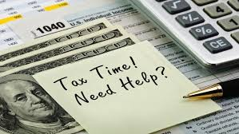
Free Tax Preparation Services
If you earned $56,000 or less in 2019, you may be eligible for free, remote tax prep available. The IRS has extended the filing deadline to July 15, 2020
Visit
www.cashmd.org/free-tax-preparationresources/
to sign up!

