Slide 1
OSEP TA&D Program Performance Measurement
OSEP Project Directors’ Conference
April 28th, 2015

Slide 2
Performance Measures
OSEP reports progress on program performance measures annually to OMB and Congress
This provides an aggregate picture of performance
Their review of our performance data affects the continued funding of IDEA Part D programs
OSEP uses the data to improve the TA&D Program’s performance

Slide 3
TA&D Program Performance Measures
Annual Measures
Quality of New Service or New Product
Relevance of New Service or New Product
Usefulness of New Service or New Product
Efficiency - milestones completed within budget
Long-term Measures
Implementation of evidence-based practices
Promotion of effective models

Slide 4
Review for Annual Measures
Scientific Review Panel
Panel receives the New Product and New Service Description Guides as well as electronic copies of the product and supporting materials for services
Rates the quality of evidence-based products and services
Stakeholder Review Panel
Panel receives the New Product and New Service Description Guides as well as electronic copies of the product and supporting materials for services
Rates the quality of policy-related products and services and the relevance and usefulness of all products and services

Slide 5
How is Quality Rated by the Panel?
Percentage of Special Education Technical Assistance and Dissemination (TA&D) Products and services deemed to be of high quality by an independent (Scientific) review panel.
Substance: Does the product content or the content delivered through the service reflect evidence of conceptual soundness and quality, grounded in recent scientific evidence, legislation, policy, or accepted professional practice?
Communication: Is the product content or the content delivered through the service presented in such a way so as to be clearly understood, as evidenced by being well-organized, free of editorial errors and appropriately formatted?
Notes:
Quality is defined as the degree to which the product/service is consistent with current evidence or policy

Slide 6
How is Relevance Rated by the Panel?
Percentage of Special Education Technical Assistance and Dissemination (TA&D) Products and services deemed to be of high relevance by an independent (Stakeholder) review panel.
Need: Does the product content or the content delivered through the service attempt to solve an important problem or deal with a critical issue?
Pertinence: Does the product content or the content delivered through the service address a problem or issue recognized as important by the target audience(s)?
Reach: To what extent is the product content or the content delivered through the service applicable to diverse segments of the target audience(s)?
Notes:
Relevance is defined as the degree to which the product/service addresses current educational problems or issues.

Slide 7
How is Usefulness Rated by the Panel?
Percentage of Special Education Technical Assistance and Dissemination (TA&D) Products and services deemed to be useful by an independent (Stakeholder) review panel.
Ease: Does the product content or the content delivered through the service address a problem or issue in an easily understood way, with directions or guidance regarding how the content can be used to address the problem or issue?
Likelihood of Use: Is it likely that the information derived from the product content or the content delivered through the service will eventually be used by the target audience(s) to achieve the intended benefit?
Replicability: Is it likely that the information derived from the product content or the content delivered through the service will be used repeatedly in multiple settings to achieve the intended benefit?
Notes:
Usefulness is defined as the degree to which the product/service can be readily and successfully used by consumers.

Slide 8
Selection for Annual Measures
2014 Sample Selection
Random selection of projects by The Study Group Inc. (TSG)
Additional TA&D Centers selected by TSG to ensure areas in the strategic plan are represented (i.e., assessment, literacy, behavior, instructional strategies, early intervention, secondary transition, and inclusive practices)
11 TA&D Centers and 10 State Deaf-Blind Projects

Slide 9
Sample Selection and Data Collection for Annual Measures
Data Collection
Projects generated a list of new products/services developed or delivered during the fiscal year
TSG randomly selected one product and one service from the list
Projects provided a description of the selected product and service
Descriptions and products were sent to a scientific review panel (for evidenced-based products or services) to rate quality and a stakeholder review panel to rate relevance and usefulness

Slide 10
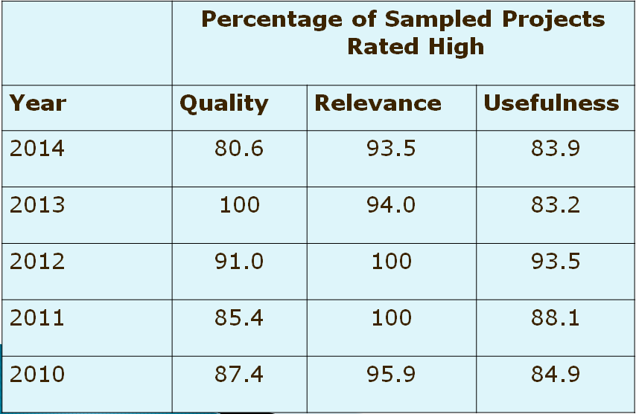
TA&D Program Performance Outcomes for Annual Measures

Slide 11
Long-term Measure for TA&D
The percentage of effective evidence-based program models developed by Model Demonstration Projects that are promoted to states and their partners through the TA&D Network.
Year | Target | Actual | Status
2012 | Set Baseline | 50 | Baseline
2013 | Not available. |  | Not Collected
2014 | Set Baseline | 29 | Baseline
Notes:
Collected every other year; not collected in 2011, 2013

Slide 12
Revised Efficiency Measure
Program Performance Measure #4: The cost efficiency of the technical assistance and dissemination program includes the percentage of milestones achieved in the current APR period and the percentage of funds spent during the current fiscal year.
Use the following format for your Project Measure that aligns with Program Measure #4:
“(X) milestones completed out of (X) milestones proposed for the reporting period.”

Slide 13
Milestone Data
Milestones proposed should be discussed with your Project Officer.
“Milestone” is defined as a scheduled event signifying the completion of a major deliverable or set of deliverable or a phase of work. “Deliverable” is defined as a technical assistance and dissemination product or service.
Proposed milestones for the NEXT reporting period (March 1st – February 28th) should be included in Section C of your APR.
Include a bulleted list of proposed milestones in your APR submission.

Slide 14
Section C – Additional Information
Projects must include:
A list of all new products that were developed in FY 2014 (Between October 1, 2013 and September 30, 2014)
A list of all new services that were rendered in FY 2014 (Between October 1, 2013 and September 30, 2014)
In conjunction with your PO, provide a bulleted list of proposed milestones (e.g. products and services you will develop or provide in the next reporting period (March 1st through February 28th).

Slide 15
Our Partnership is the Key to Successful Performance

